Slide 1

Attributes of a Successful Scientist

Slide 2
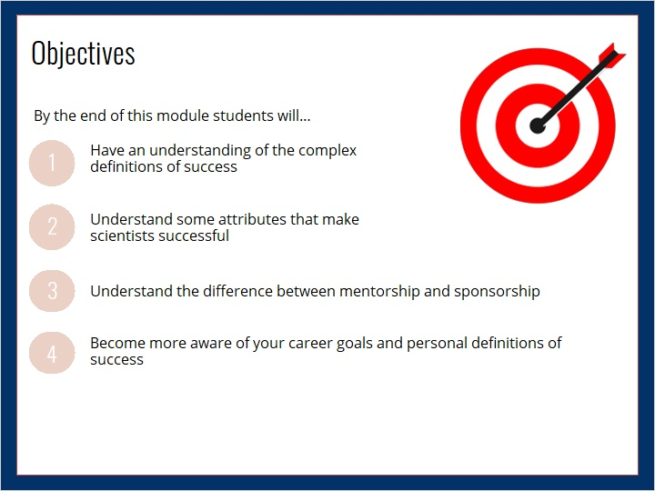

Slide 3


https://www.youtube.com/watch?v=ilBiP7d7y5o&feature=emb_logo
Notes:
https://www.youtube.com/watch?v=ilBiP7d7y5o&feature=emb_logo

Slide 4


Slide 5


Slide 6

https://www.youtube.com/watch?v=BM-FJbosFvE&feature=emb_logo
Notes:
https://www.youtube.com/watch?v=BM-FJbosFvE&feature=emb_logo

Slide 7
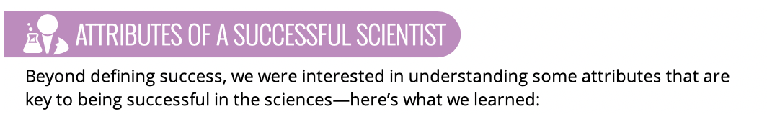

https://www.youtube.com/watch?v=91A2d6Bcs_8&feature=emb_logo
Notes:
https://www.youtube.com/watch?v=91A2d6Bcs_8&feature=emb_logo

Slide 8


Slide 9

https://www.youtube.com/watch?v=KLYtkUwXlYc&feature=emb_logo
Notes:
https://www.youtube.com/watch?v=KLYtkUwXlYc&feature=emb_logo

Slide 10


Slide 11
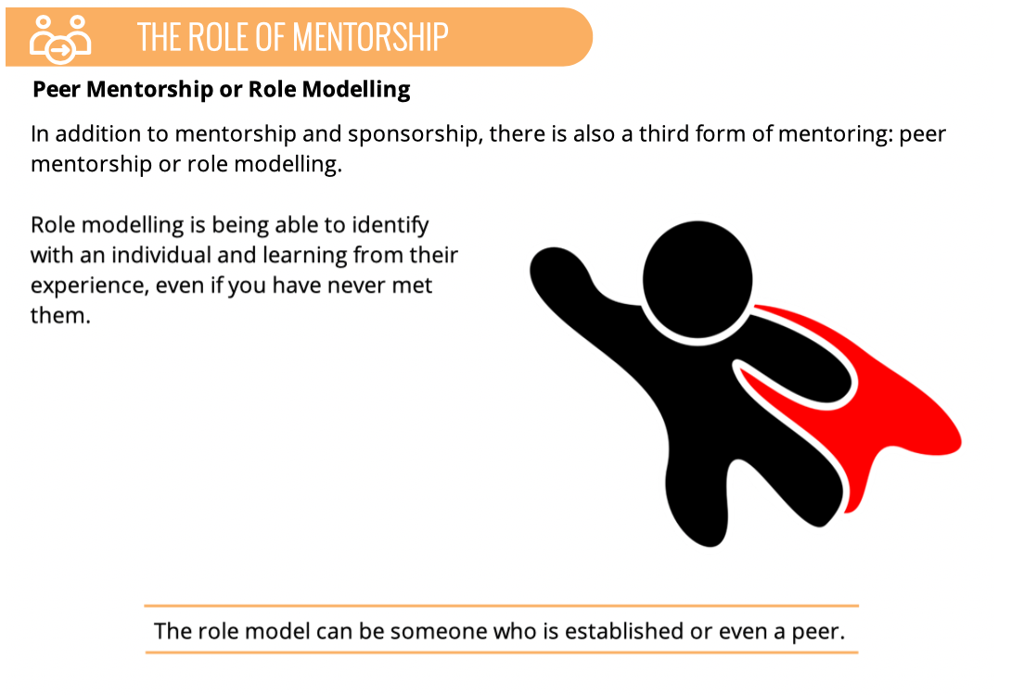

Slide 12

https://www.youtube.com/watch?v=BODHgdaNMPI&feature=emb_logo
Notes:
https://www.youtube.com/watch?v=BODHgdaNMPI&feature=emb_logo

Slide 13


Slide 14

https://www.youtube.com/watch?v=PdHNDNpq6cM&feature=emb_logo
Notes:
https://www.youtube.com/watch?v=PdHNDNpq6cM&feature=emb_logo

Slide 15
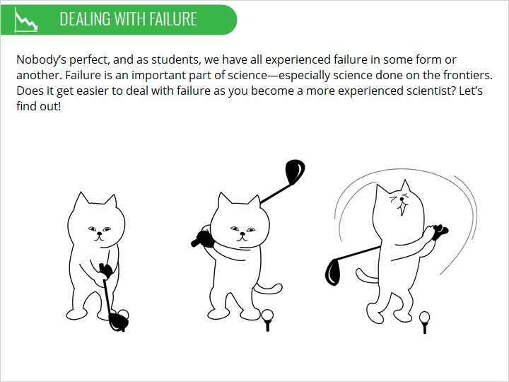

Slide 16

https://www.youtube.com/watch?v=3UWFZuQZe90&feature=emb_logo
Notes:
https://www.youtube.com/watch?v=3UWFZuQZe90&feature=emb_logo

Slide 17

Notes:
https://www.youtube.com/watch?v=G4qwtw6TNAo&feature=emb_logo

Slide 18

https://www.youtube.com/watch?v=G4qwtw6TNAo&feature=emb_logo
Notes:
https://www.youtube.com/watch?v=G4qwtw6TNAo&feature=emb_logo

Slide 19


Slide 20
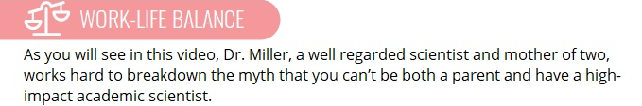
https://www.youtube.com/watch?v=2Ihr7WVmVus&feature=emb_logo
Notes:
https://www.youtube.com/watch?v=2Ihr7WVmVus&feature=emb_logo

Slide 21
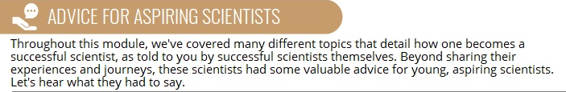
https://www.youtube.com/watch?v=3ayupU62cAw&feature=emb_logo
Notes:
https://www.youtube.com/watch?v=3ayupU62cAw&feature=emb_logo

Slide 22
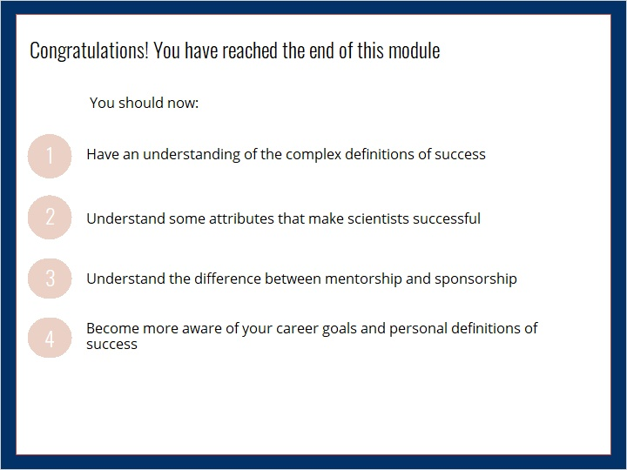

Slide 23
