Slide 1
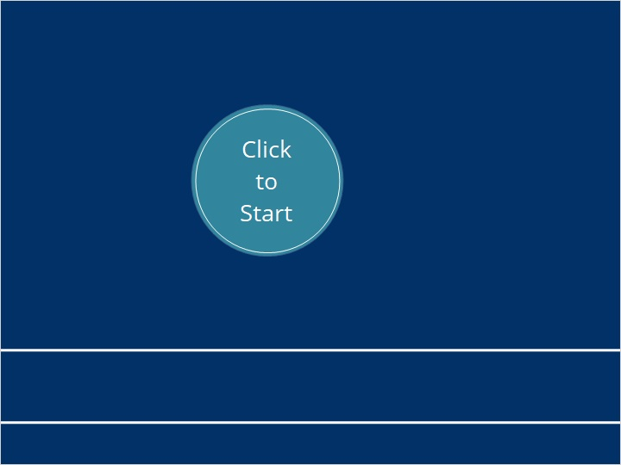
Good
Clinical
Practice

Slide 2

https://www.youtube.com/watch?v=3_cFFDpeAx0&feature=emb_title
Notes:
https://www.youtube.com/watch?v=3_cFFDpeAx0&feature=emb_title

Slide 3


Slide 4
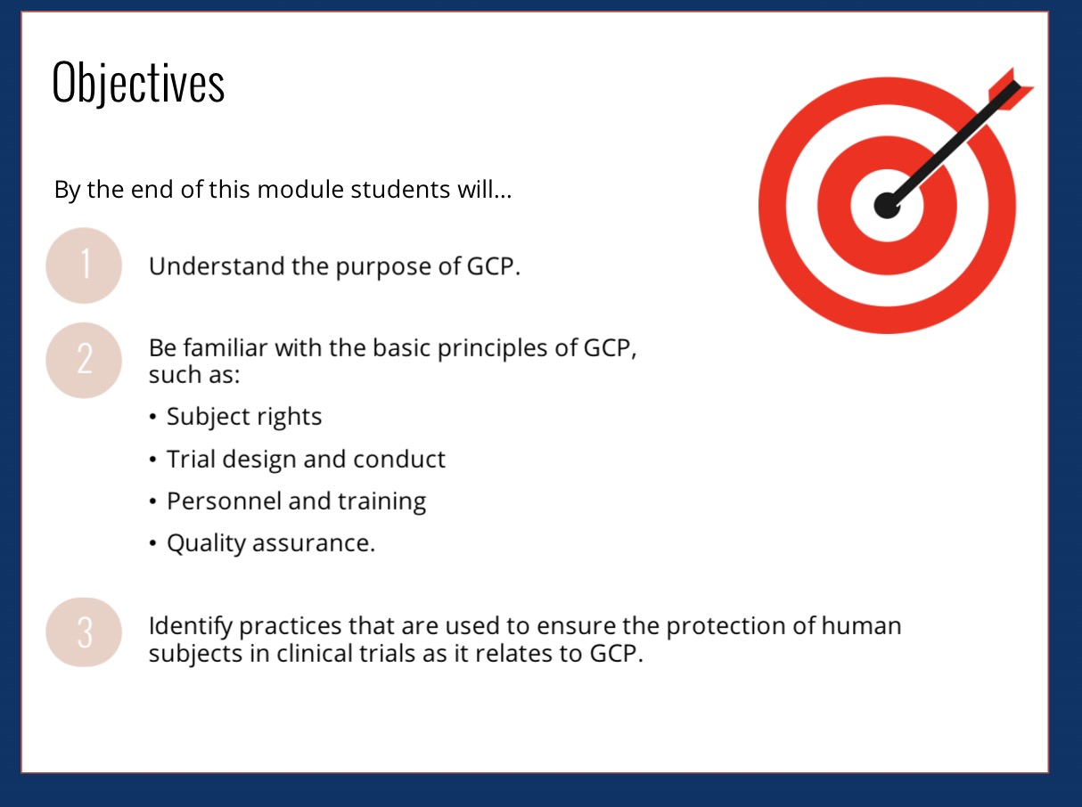

Slide 5
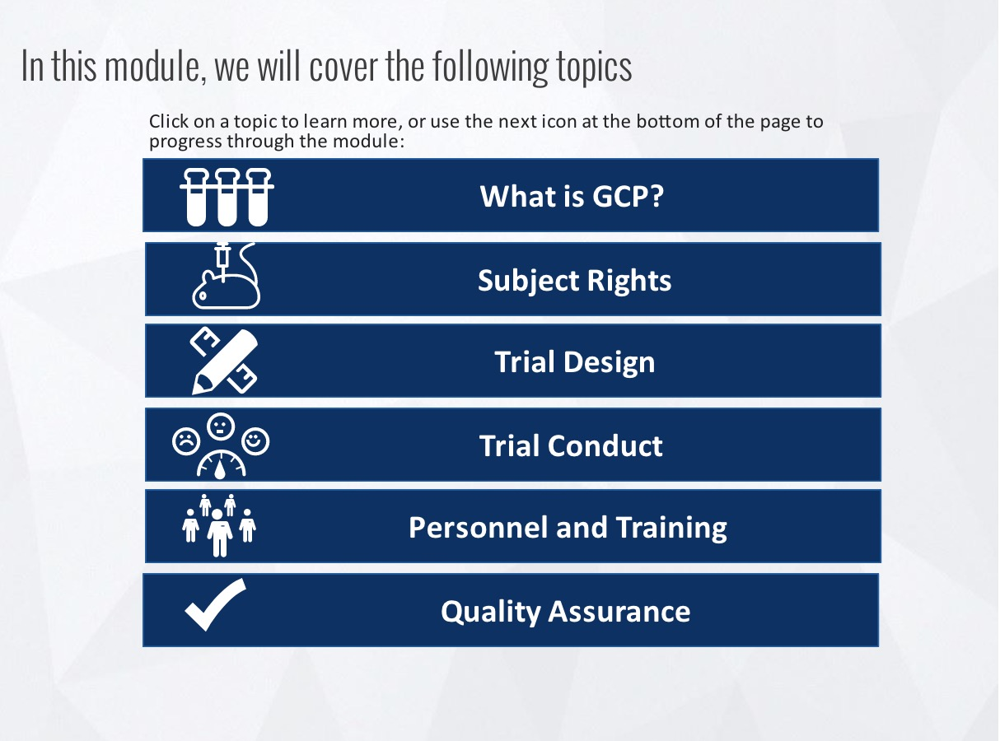

Slide 6


Slide 7
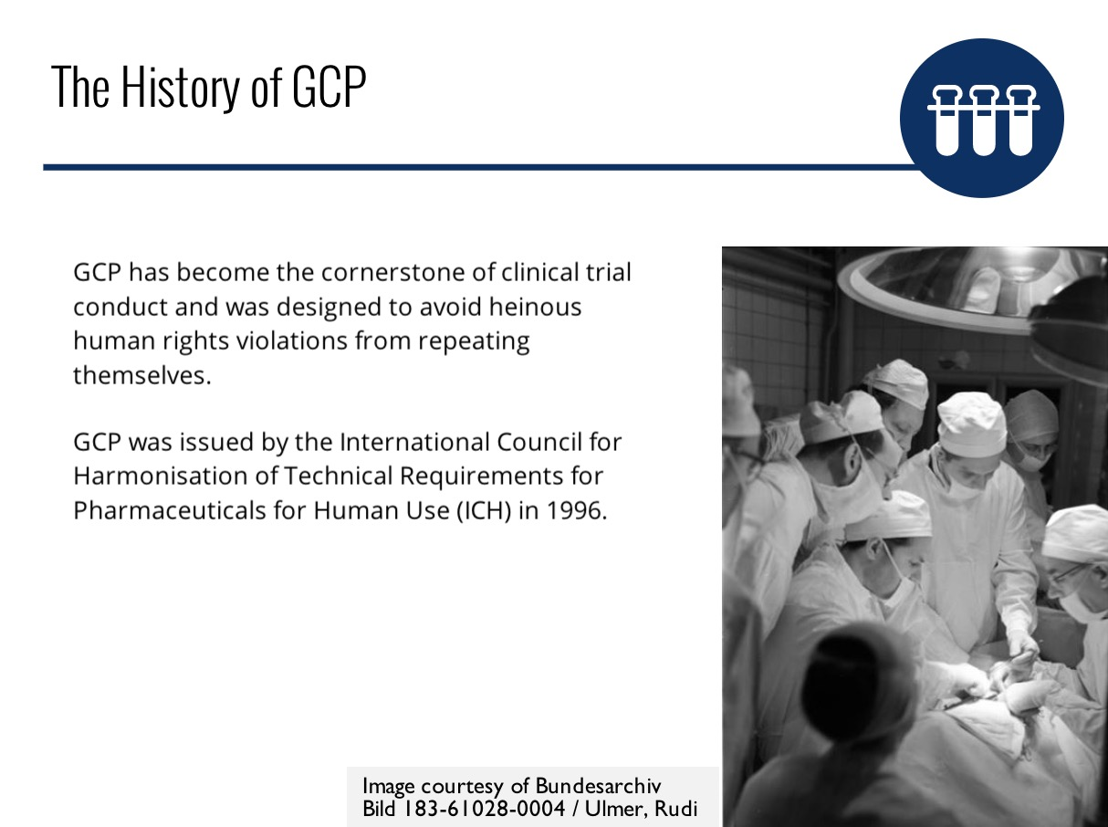

Slide 8
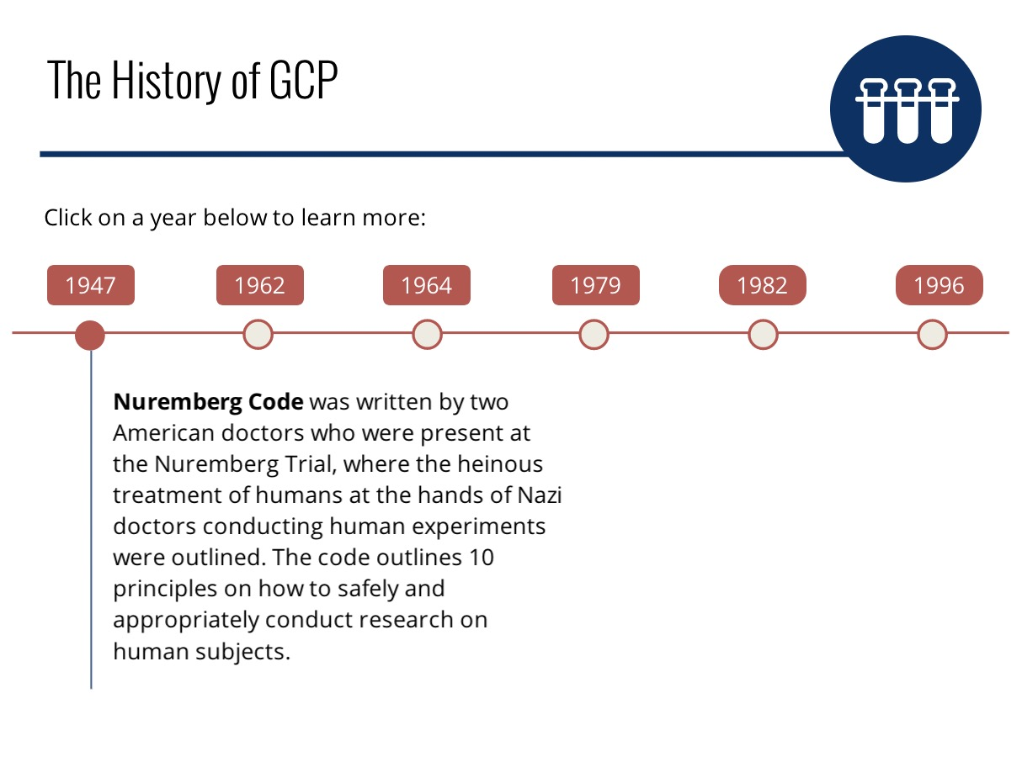

Slide 9
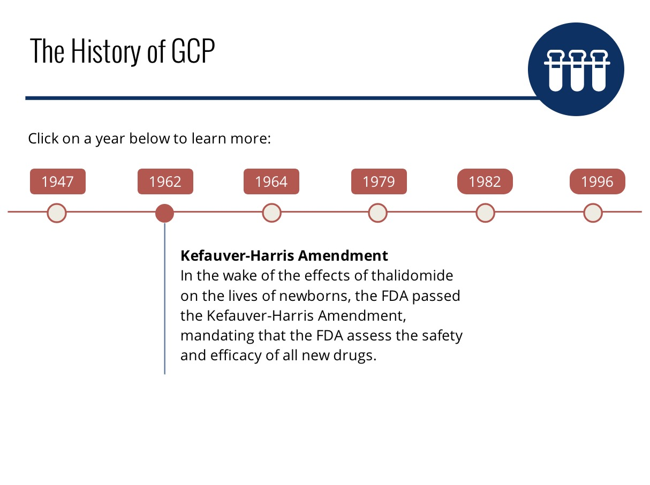

Slide 10
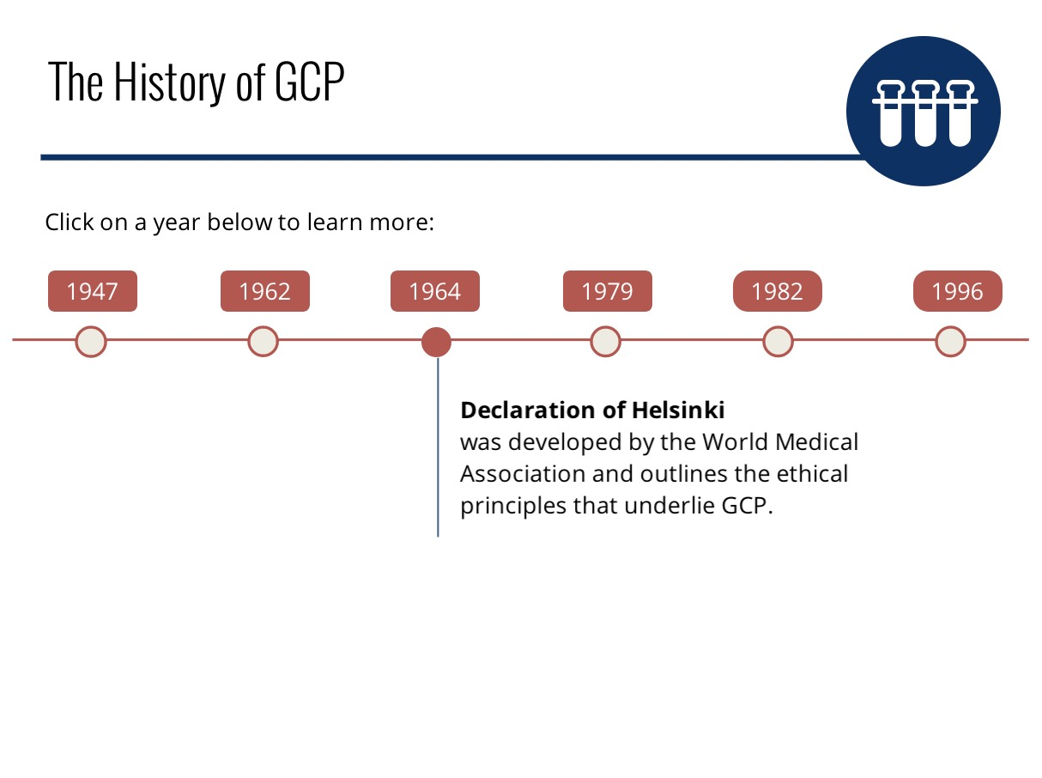

Slide 11
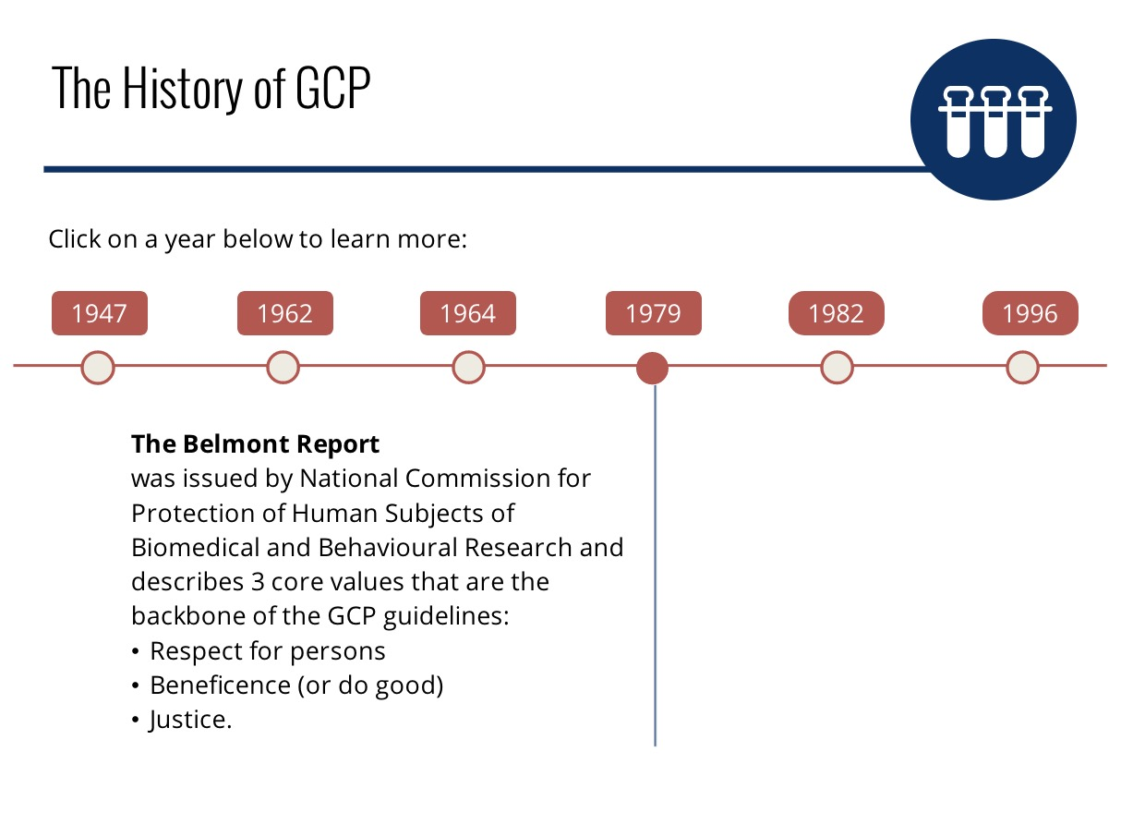

Slide 12
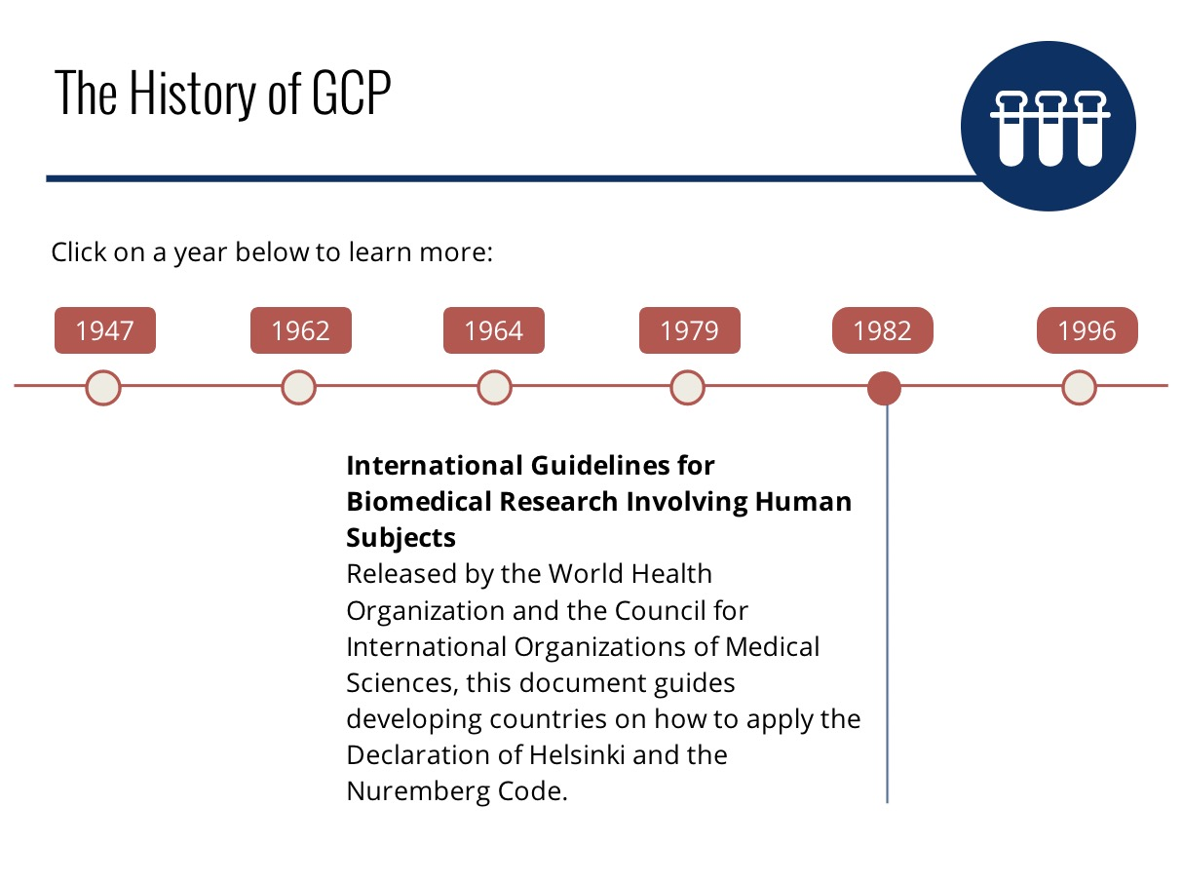

Slide 13
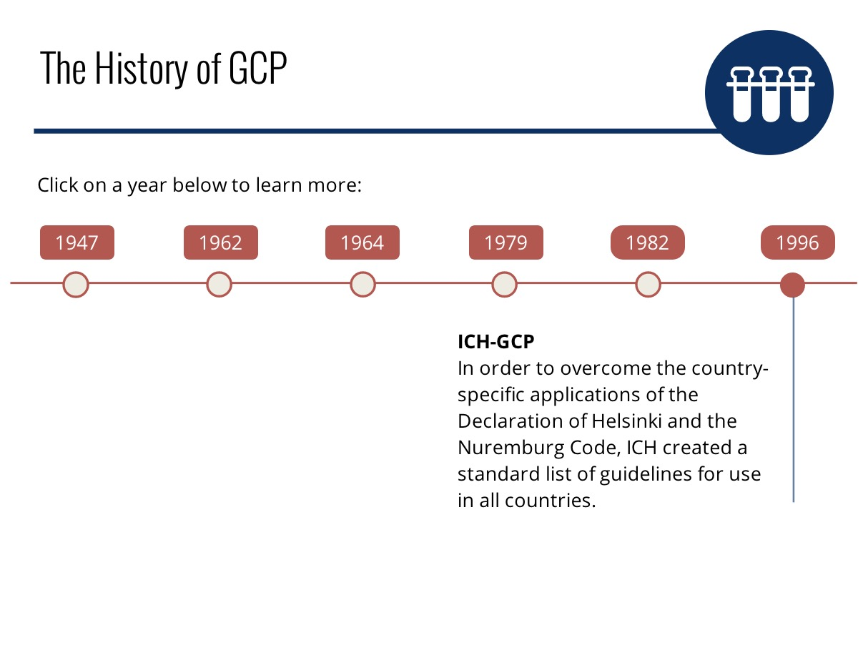

Slide 14
https://www.youtube.com/watch?v=7e056wtesW8&feature=emb_title
Notes:
https://www.youtube.com/watch?v=7e056wtesW8&feature=emb_title

Slide 15
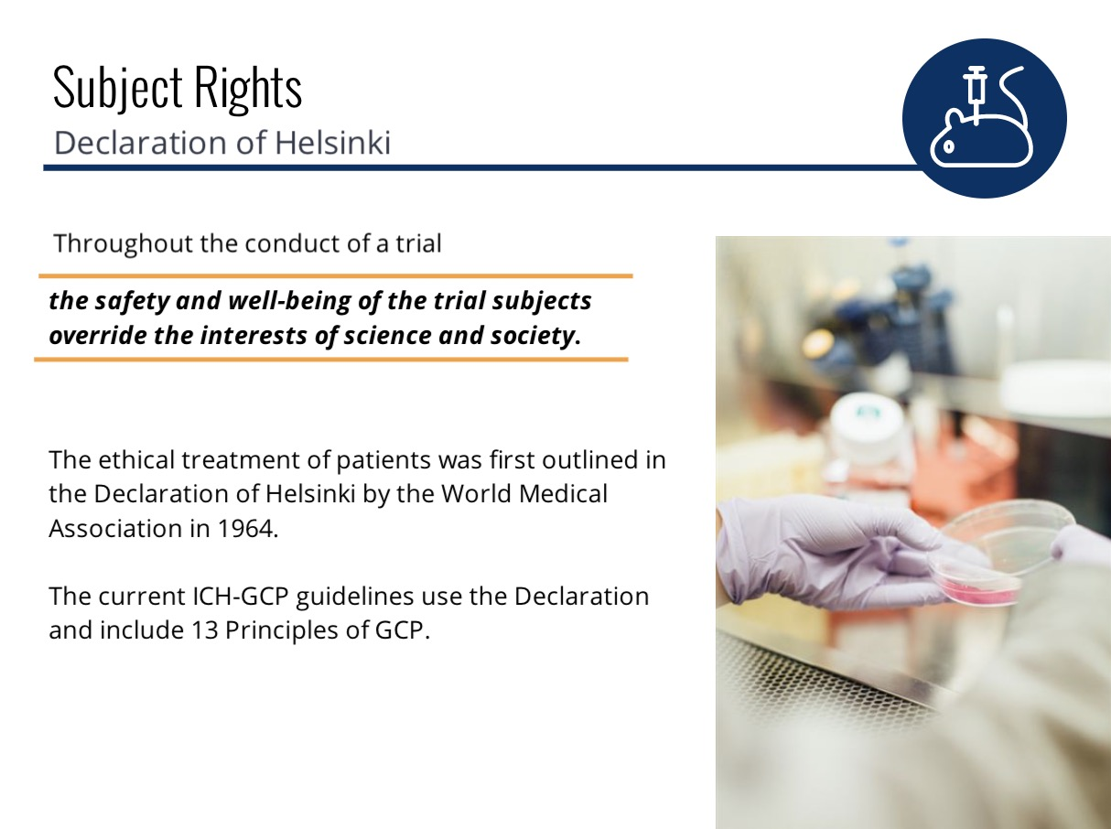

Slide 16
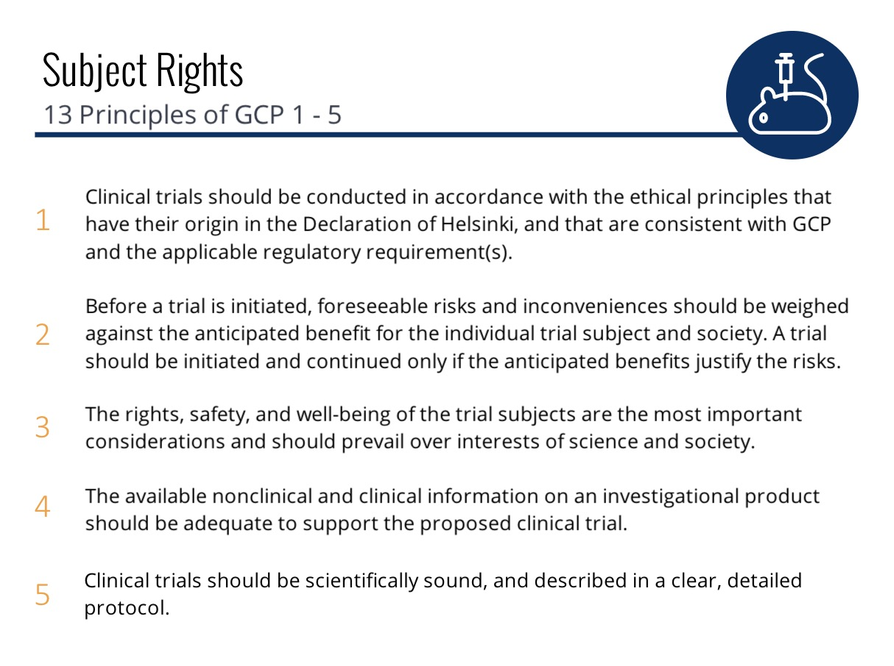

Slide 17
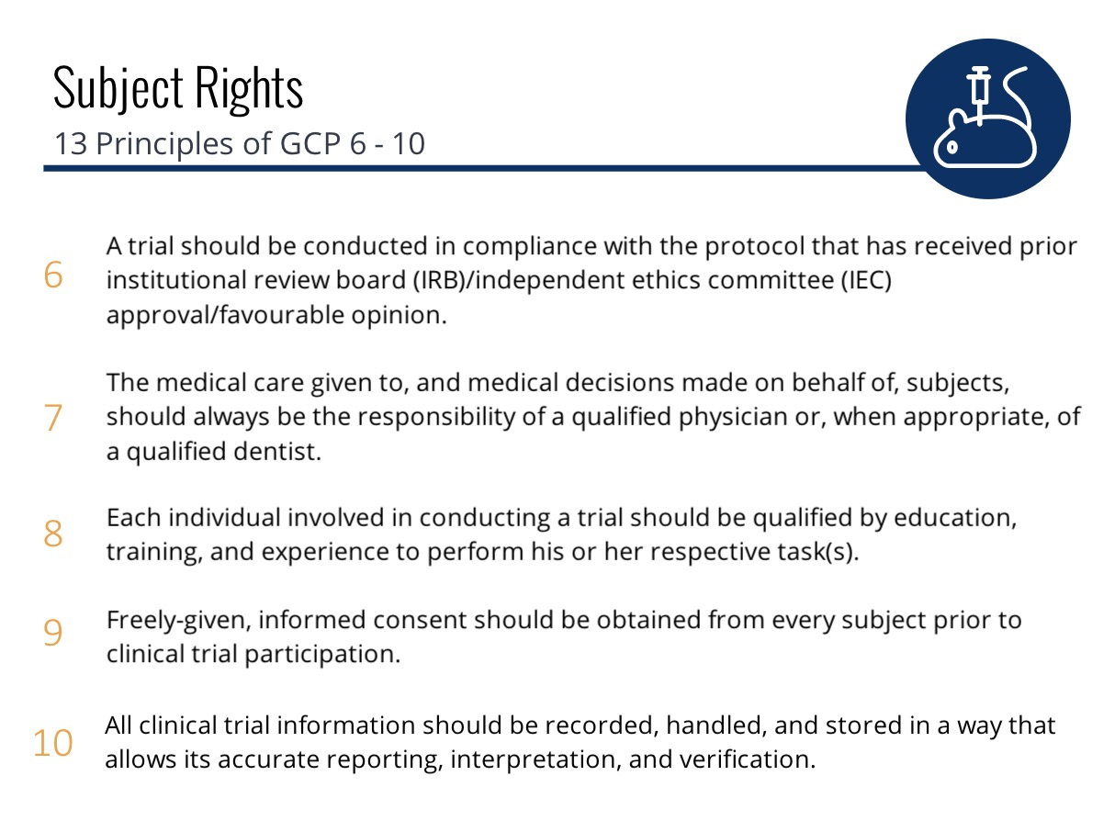

Slide 18
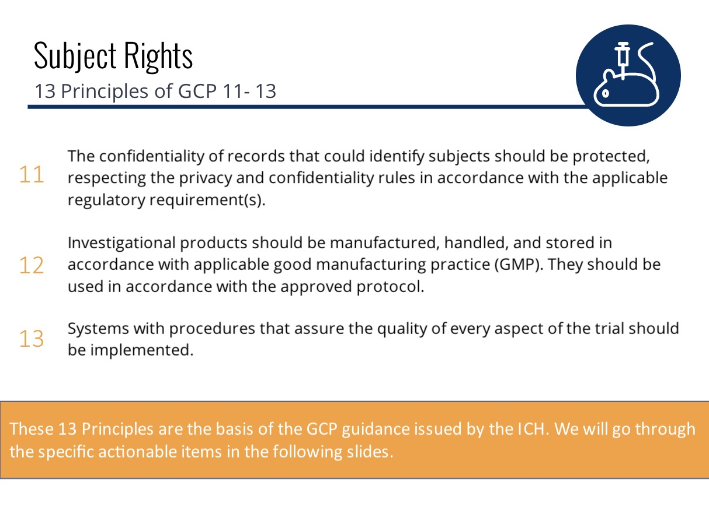

Slide 19
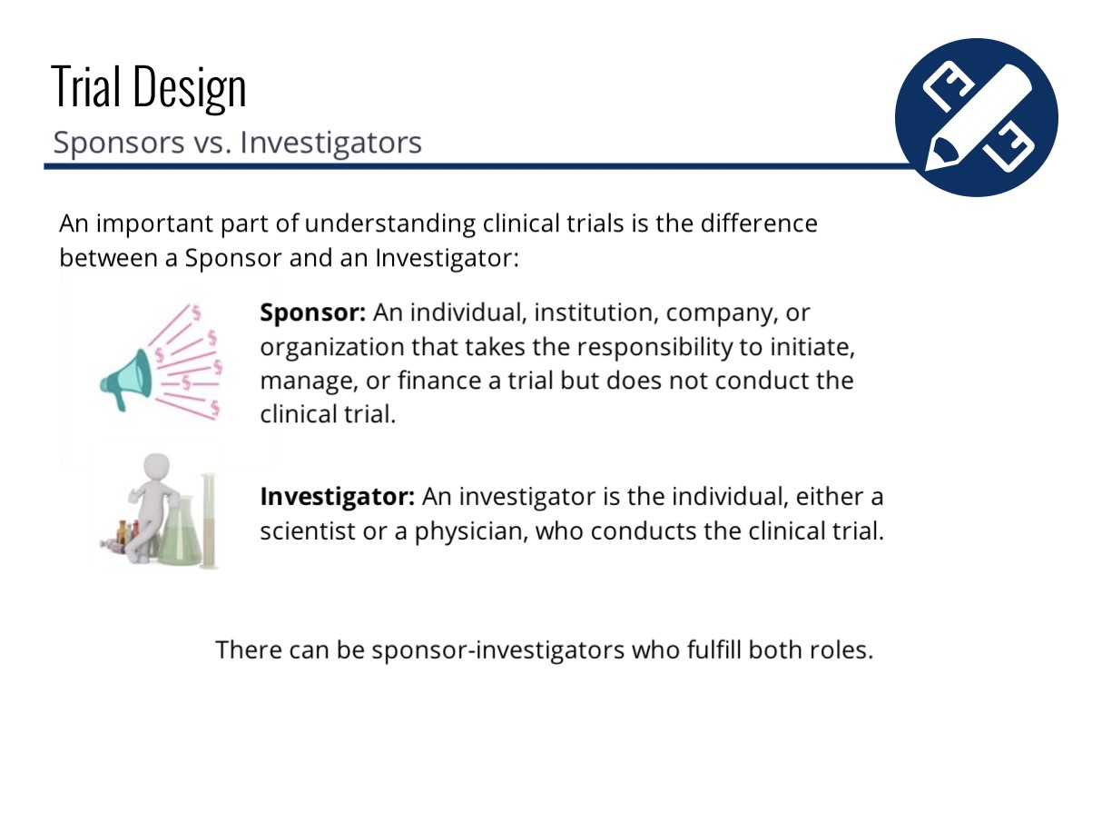
Notes:
Link for the video

Slide 20
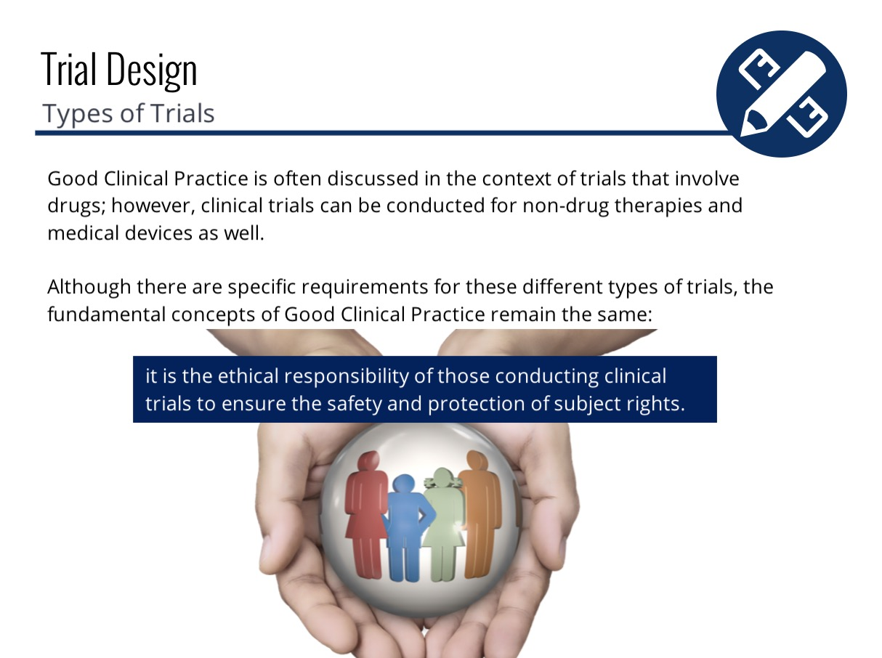

Slide 21
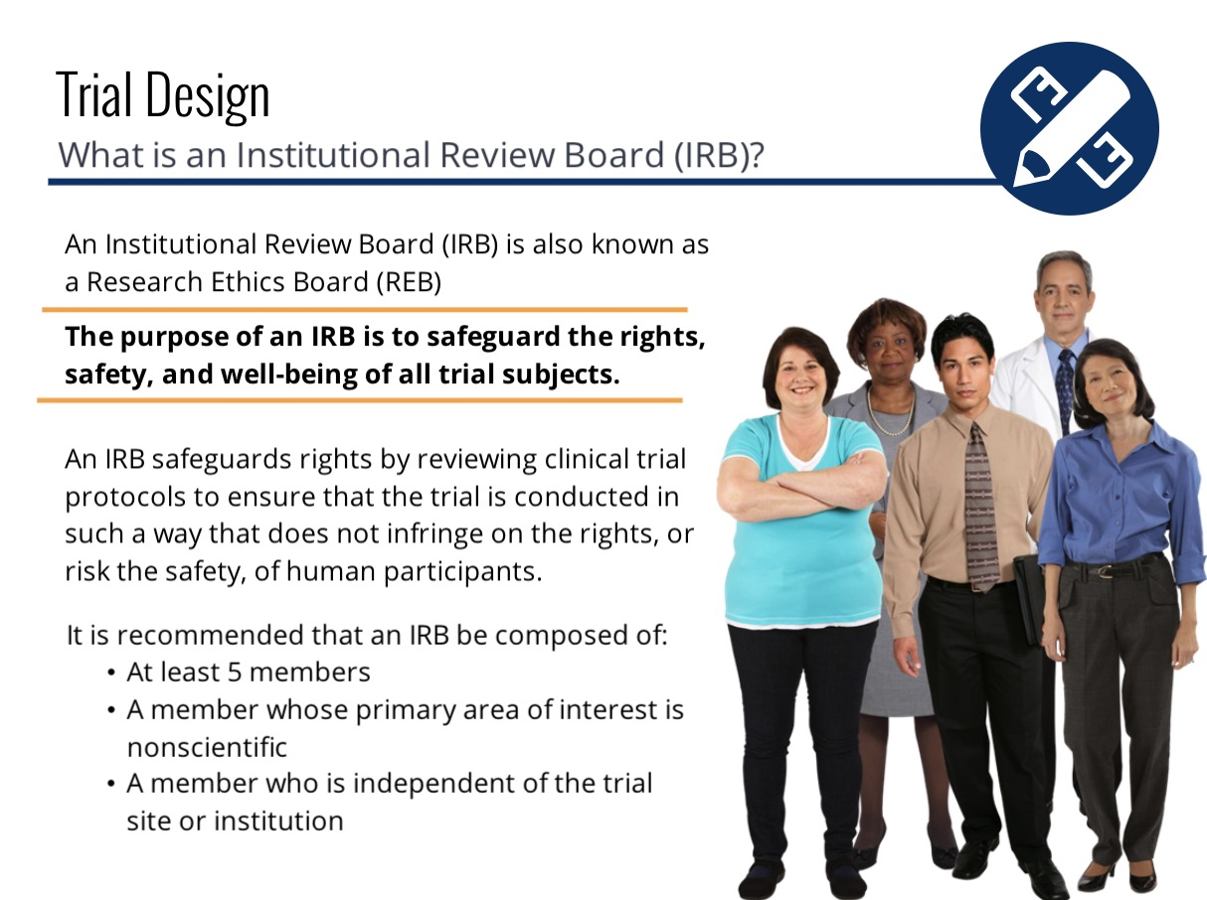

Slide 22
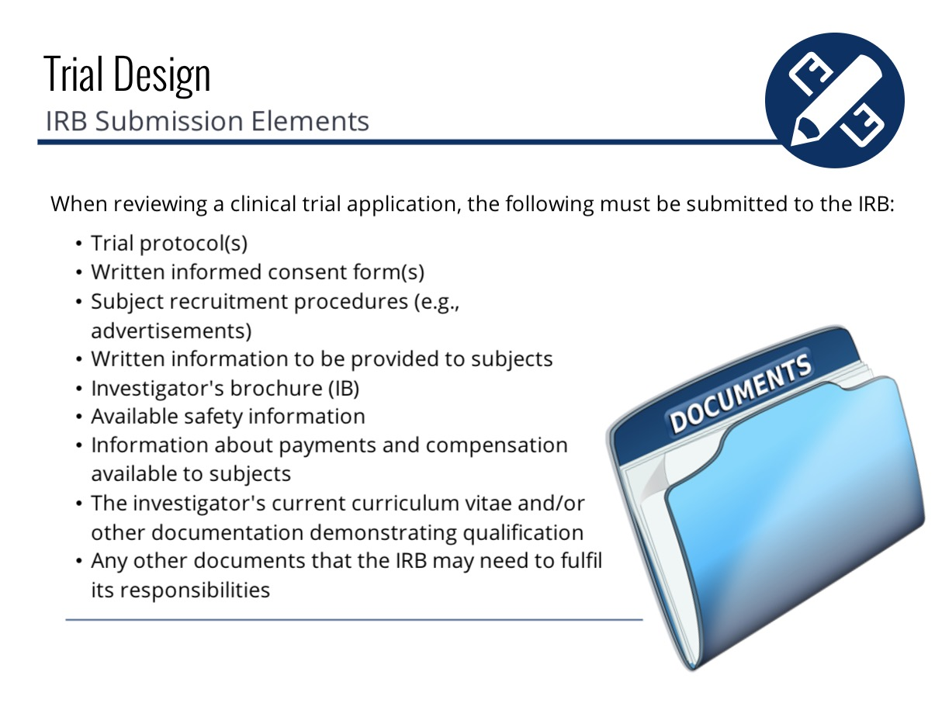

Slide 23
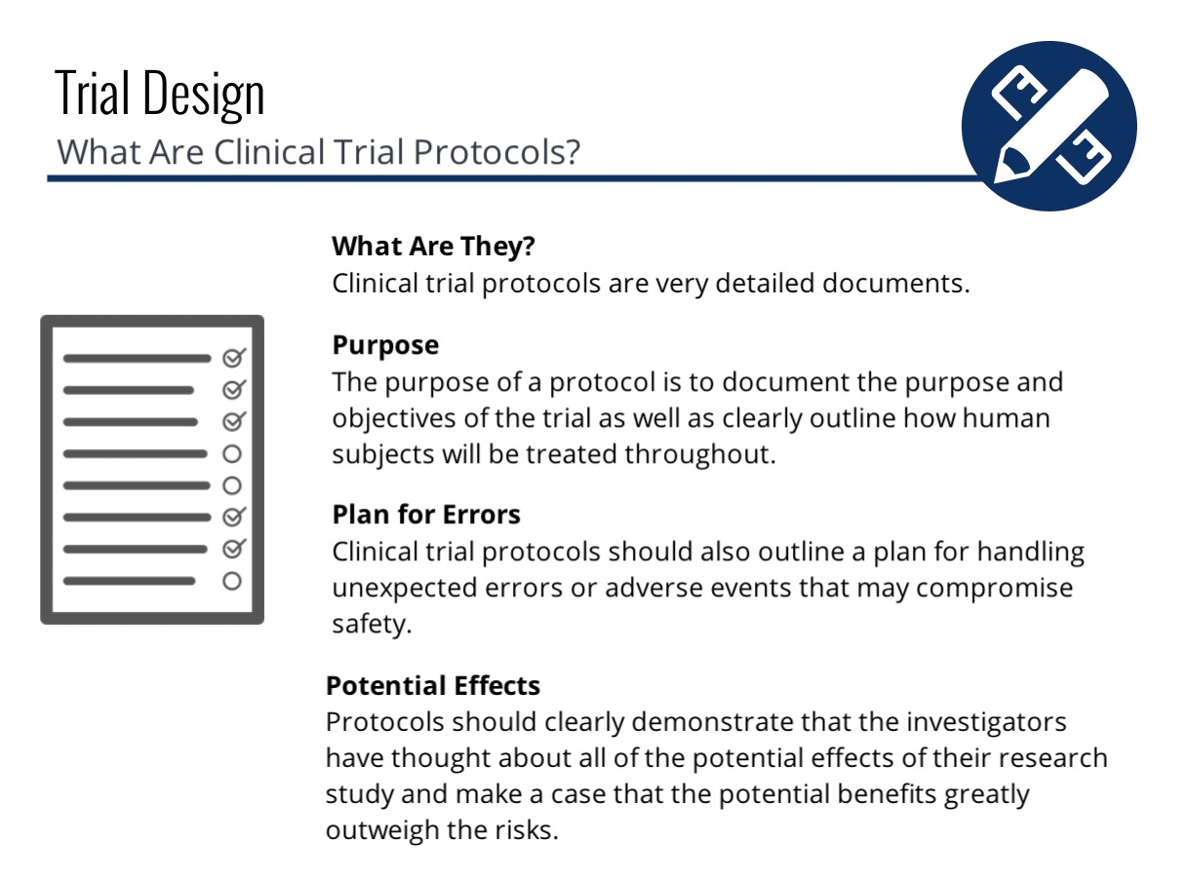

Slide 24
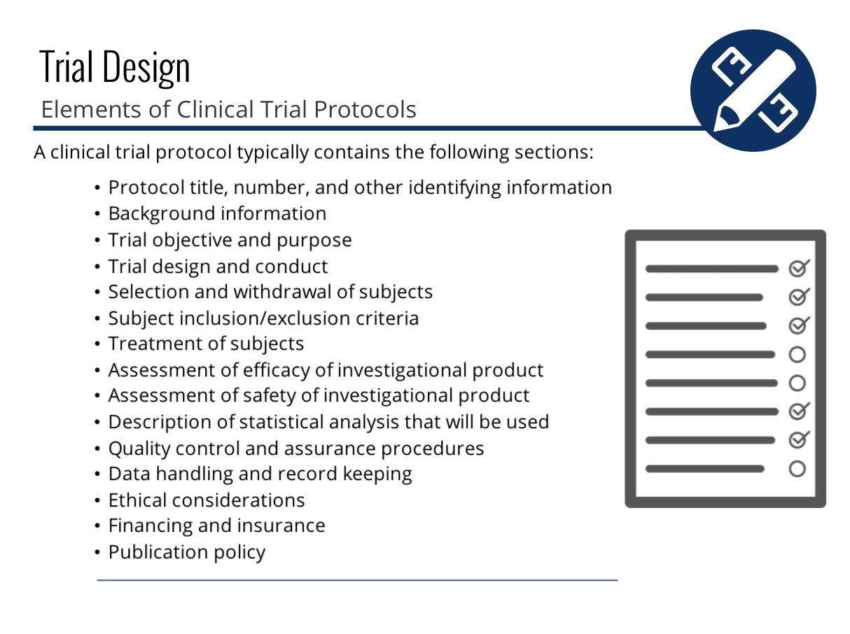
Notes:
Link for the video

Slide 25
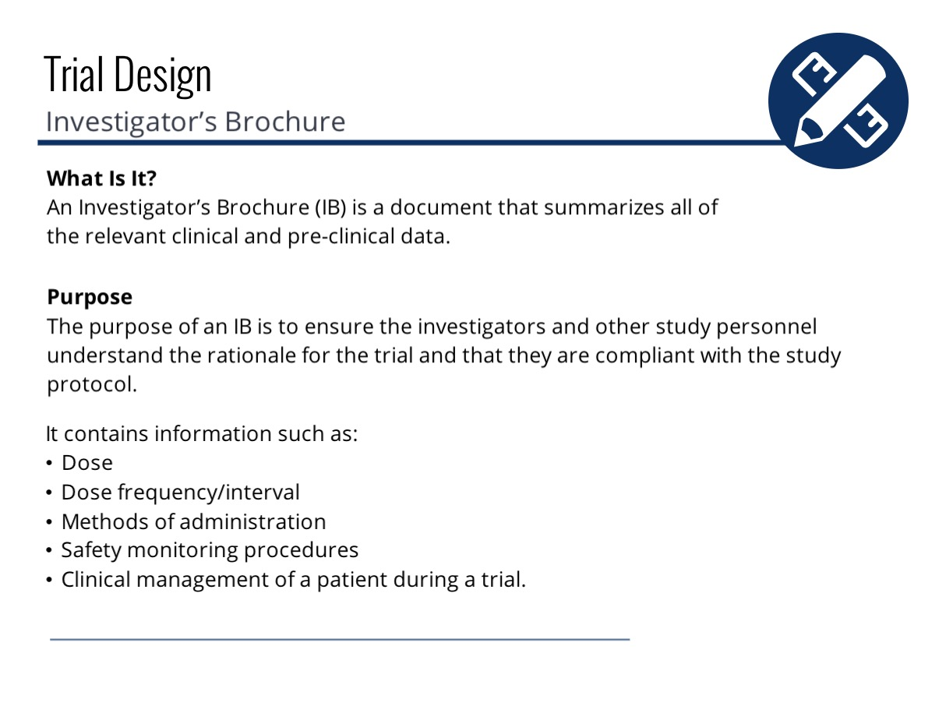

Slide 26
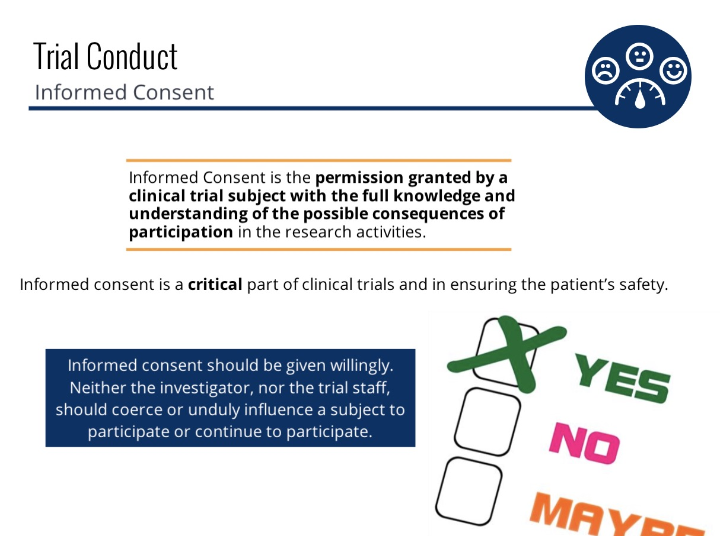

Slide 27
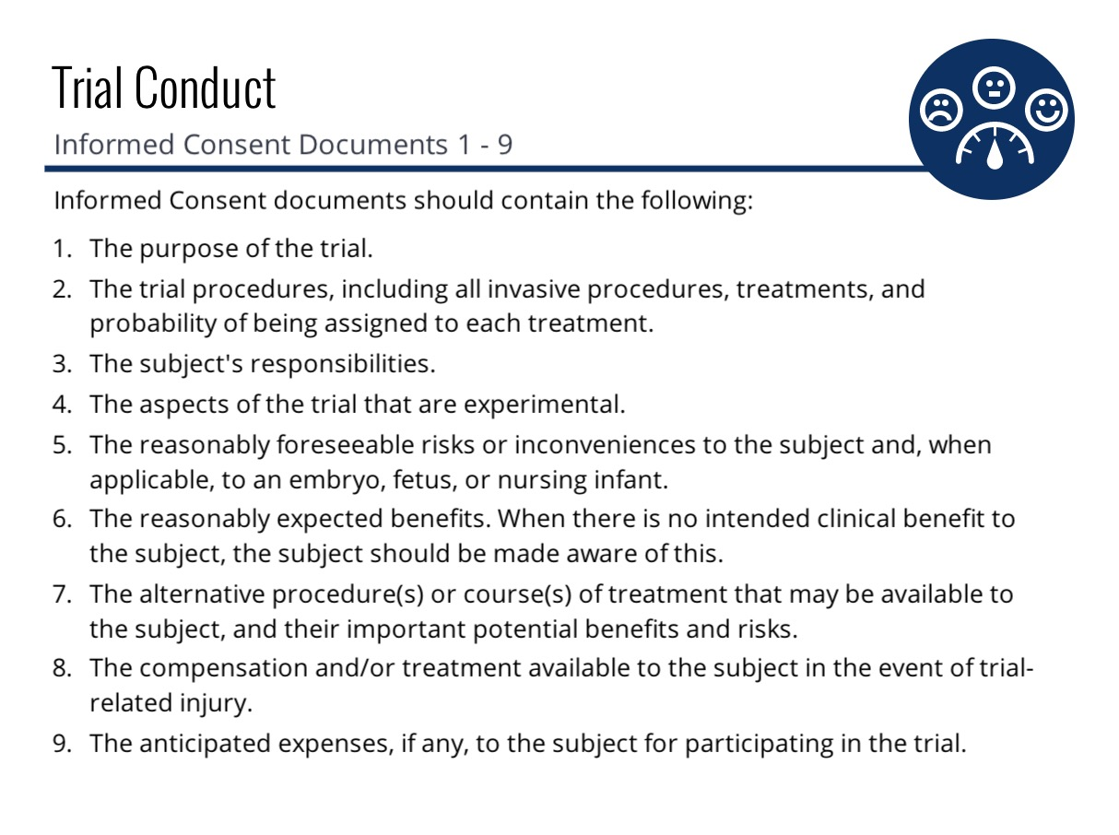

Slide 28
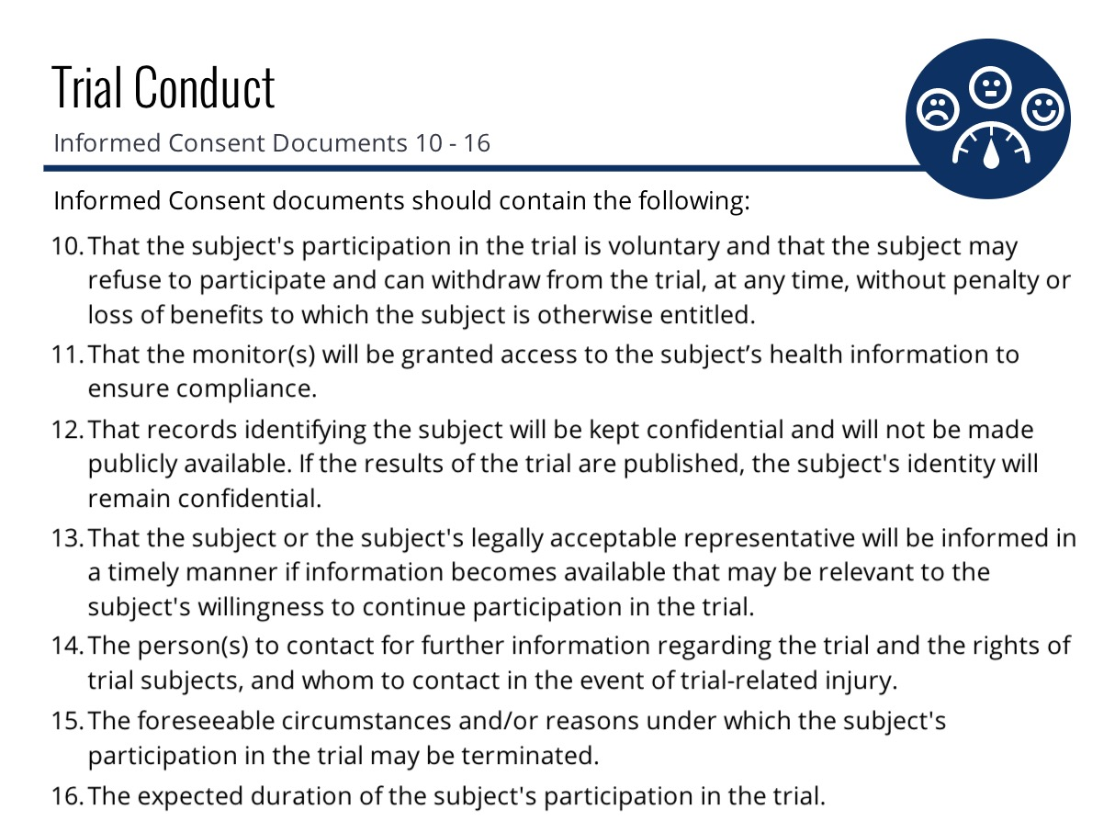

Slide 29
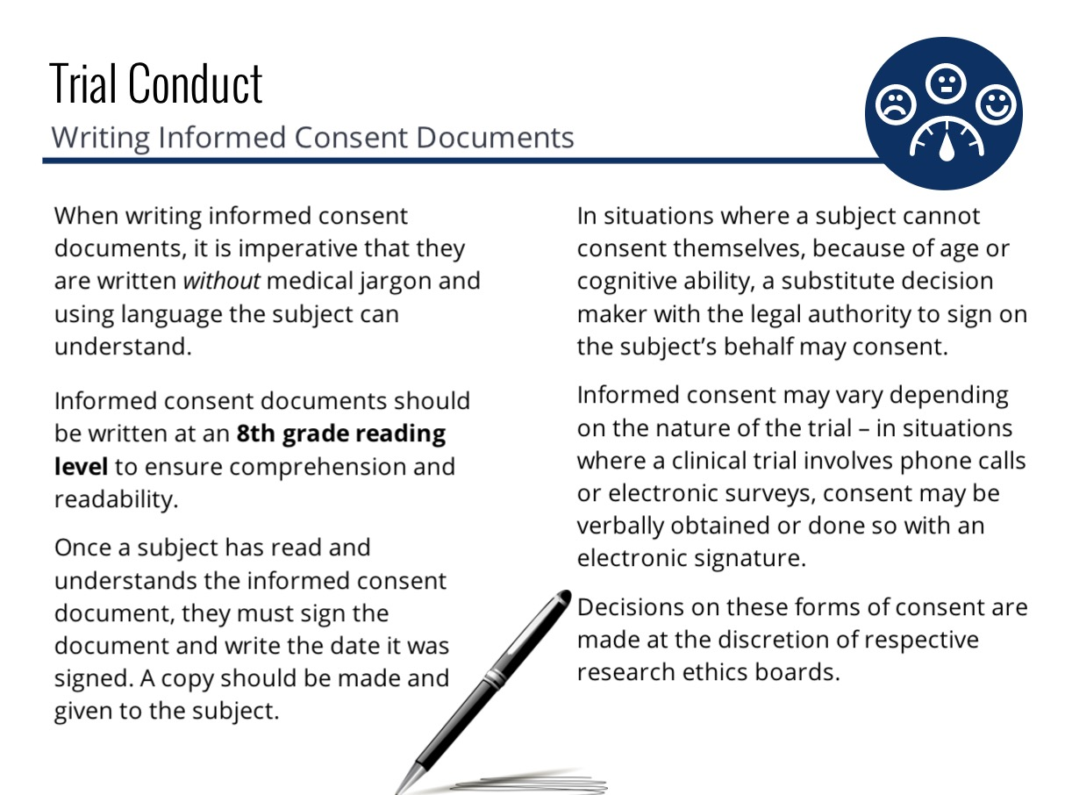

Slide 30
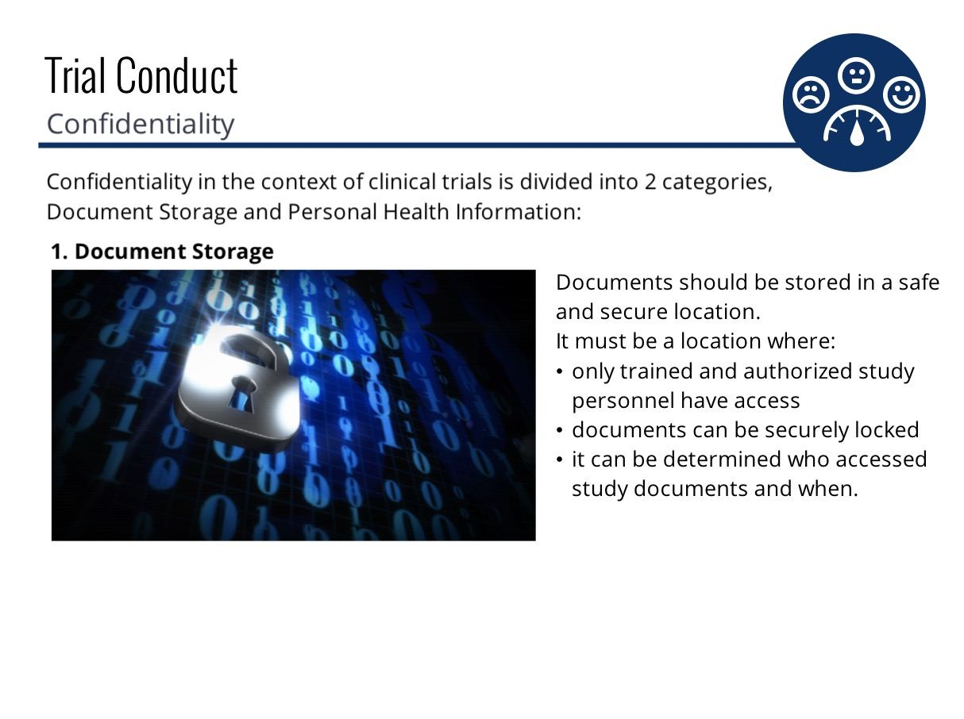

Slide 31
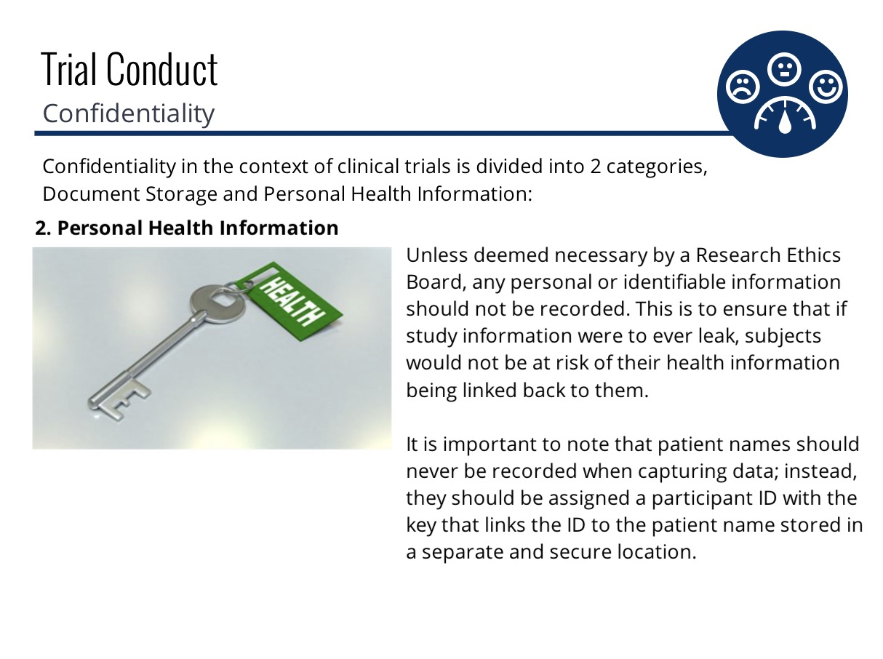
Notes:
Link for the video

Slide 32
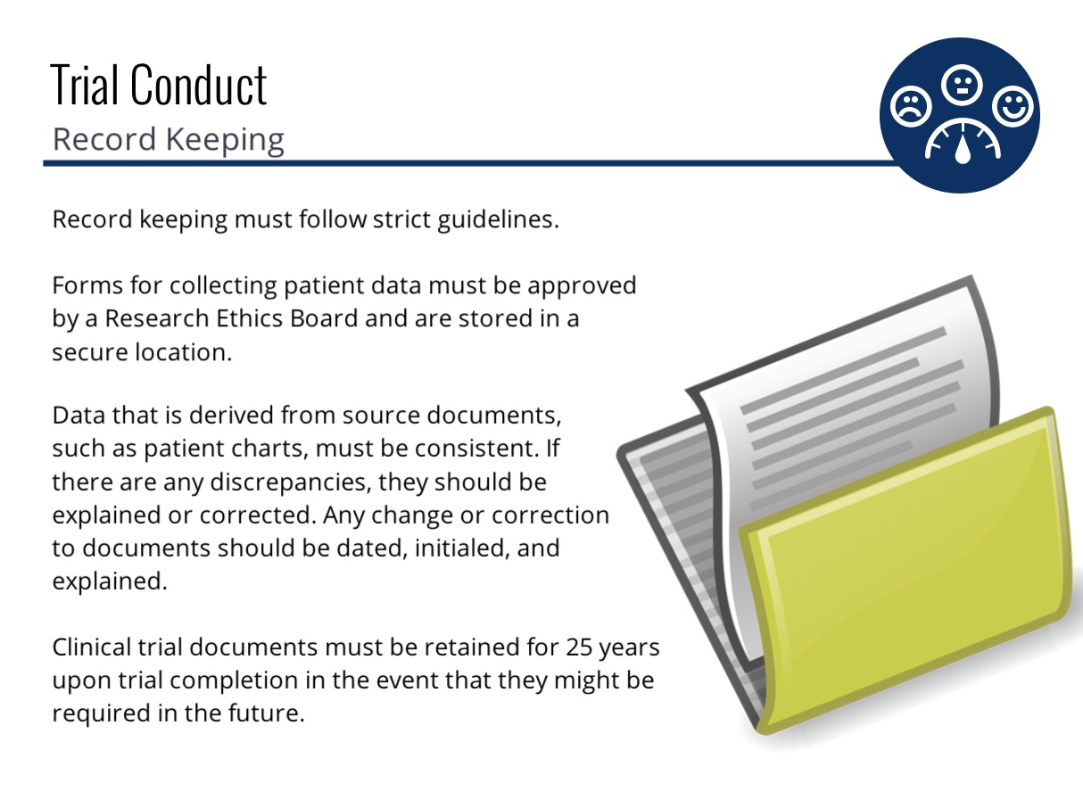

Slide 33
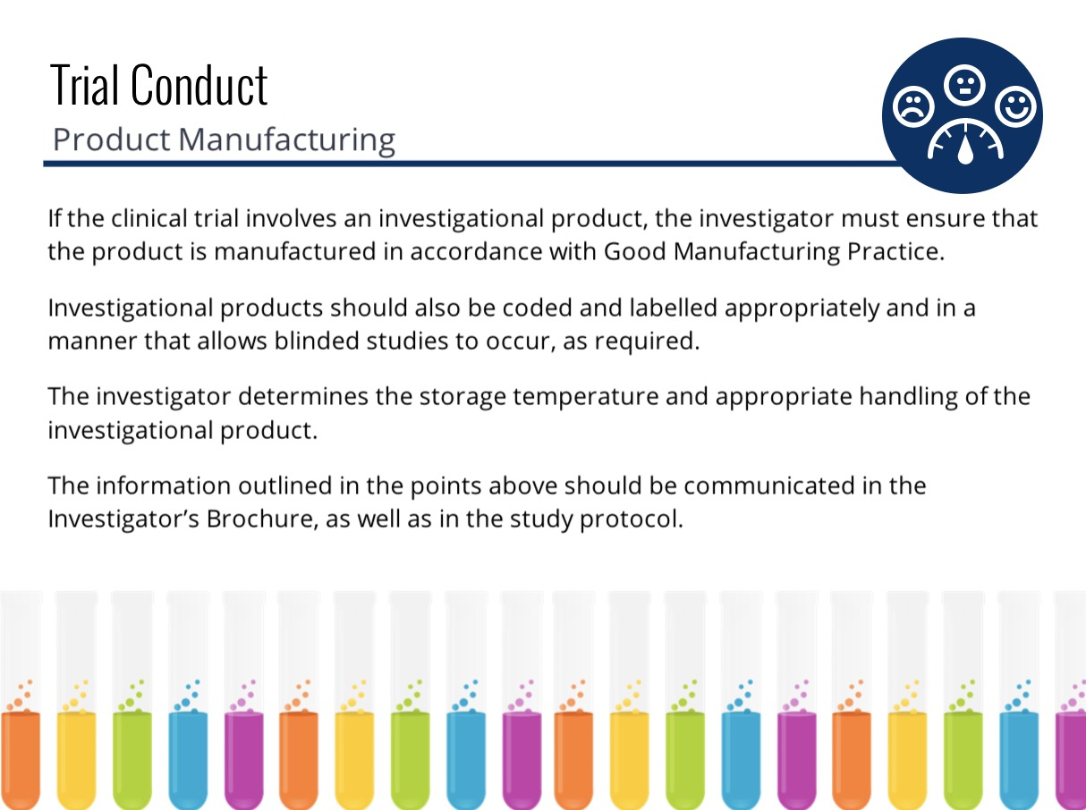

Slide 34
https://www.youtube.com/watch?v=53Oqn-nwv1I
Notes:
https://www.youtube.com/watch?v=53Oqn-nwv1I

Slide 35
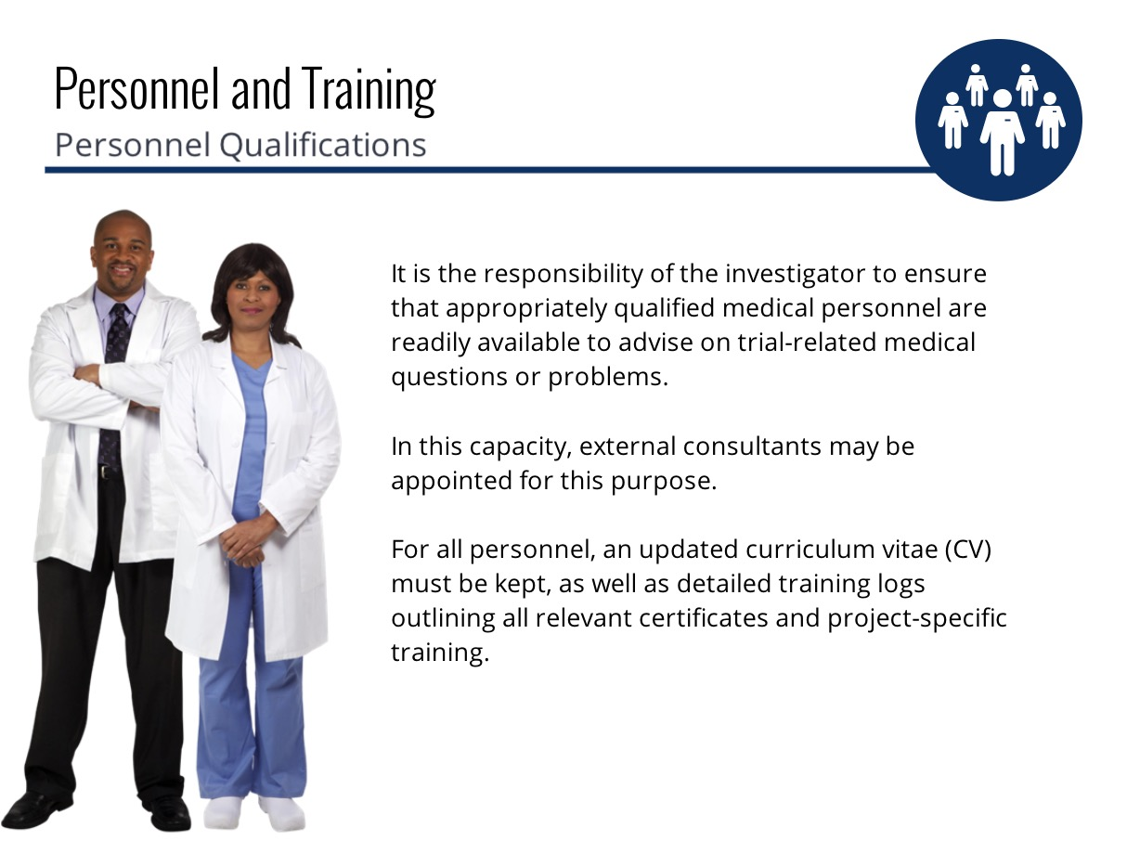

Slide 36


Slide 37
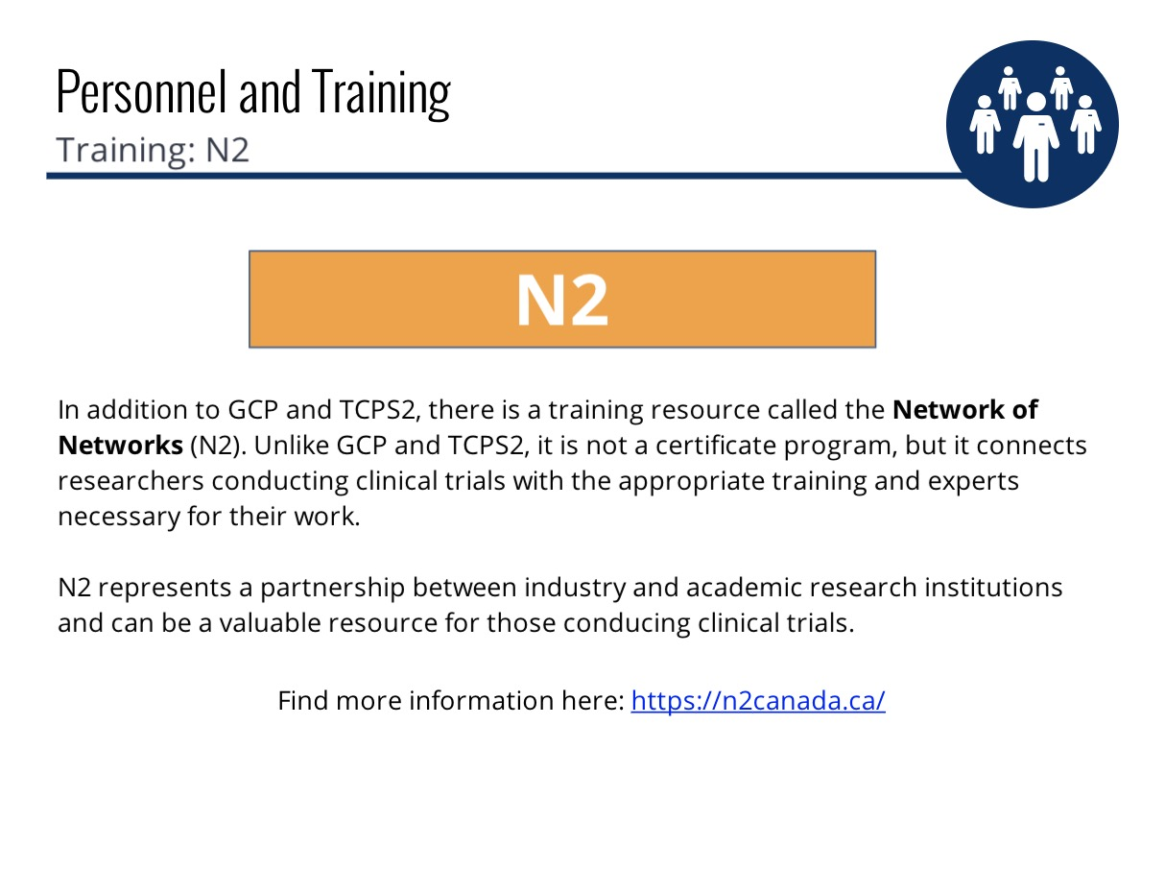
https://n2canada.ca/
Notes:
https://n2canada.ca/

Slide 38
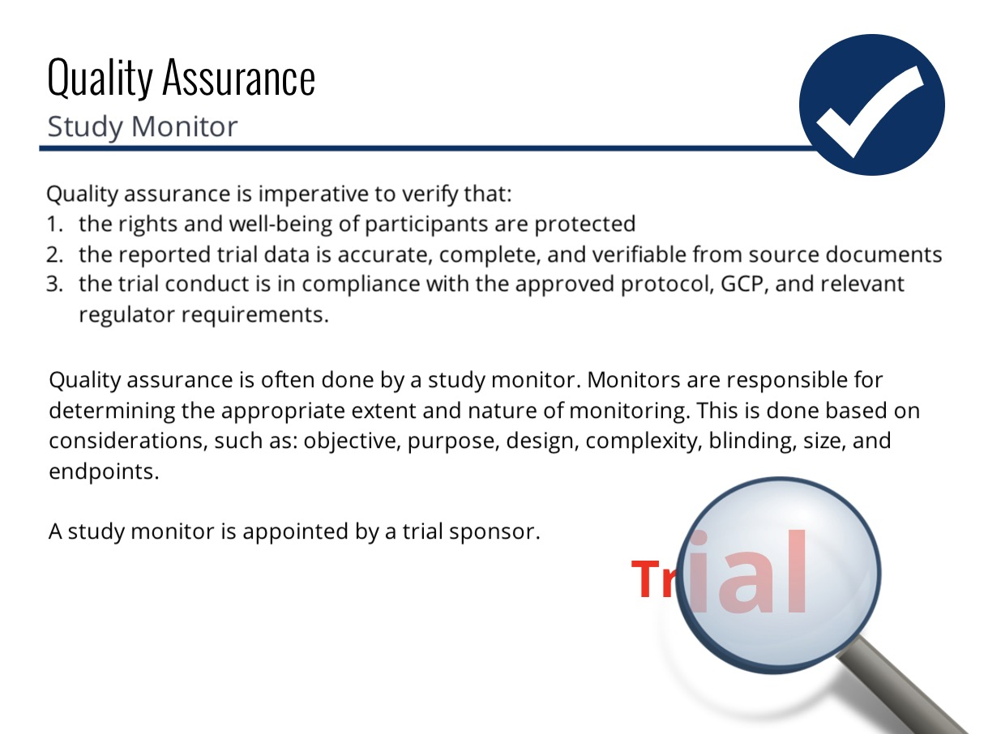

Slide 39
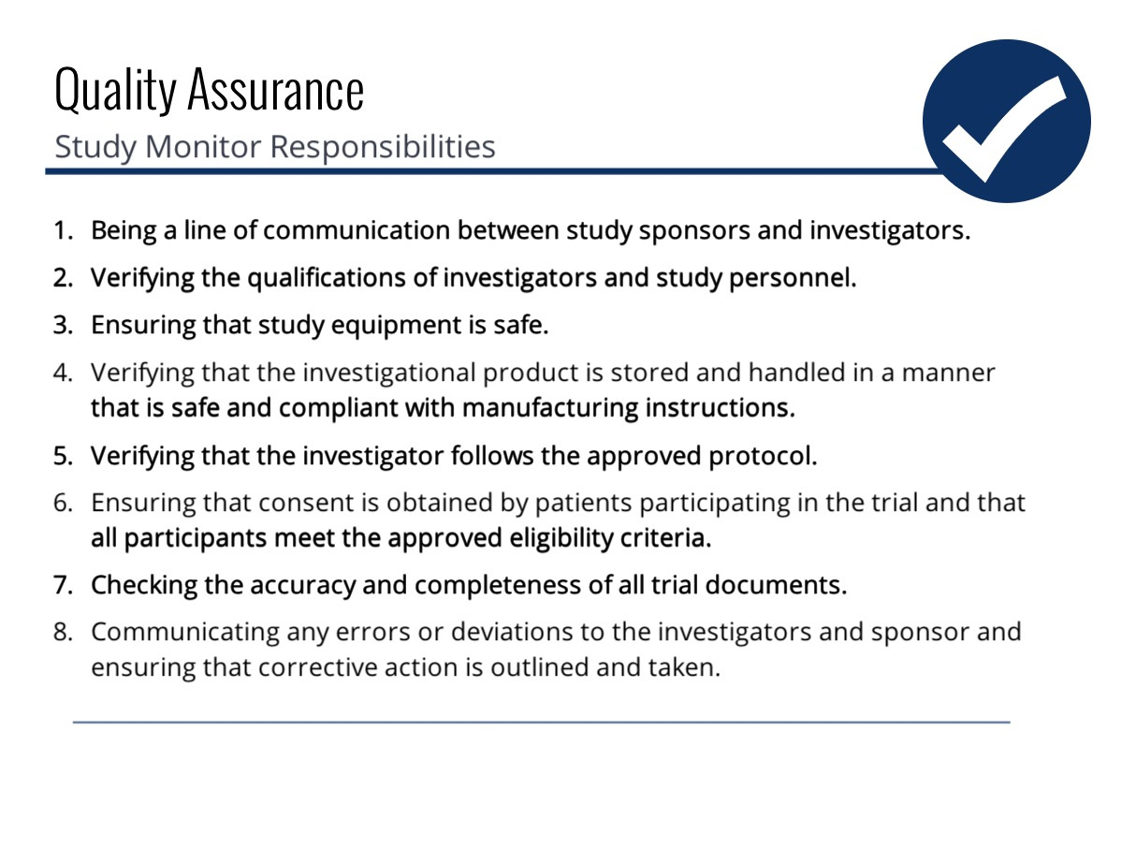

Slide 40
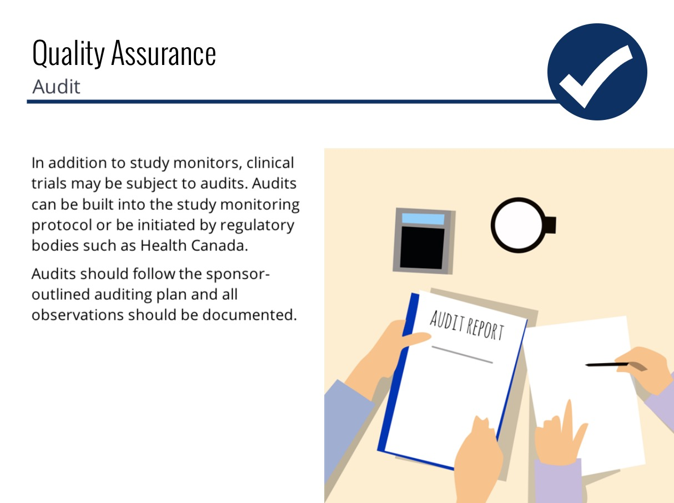

Slide 41
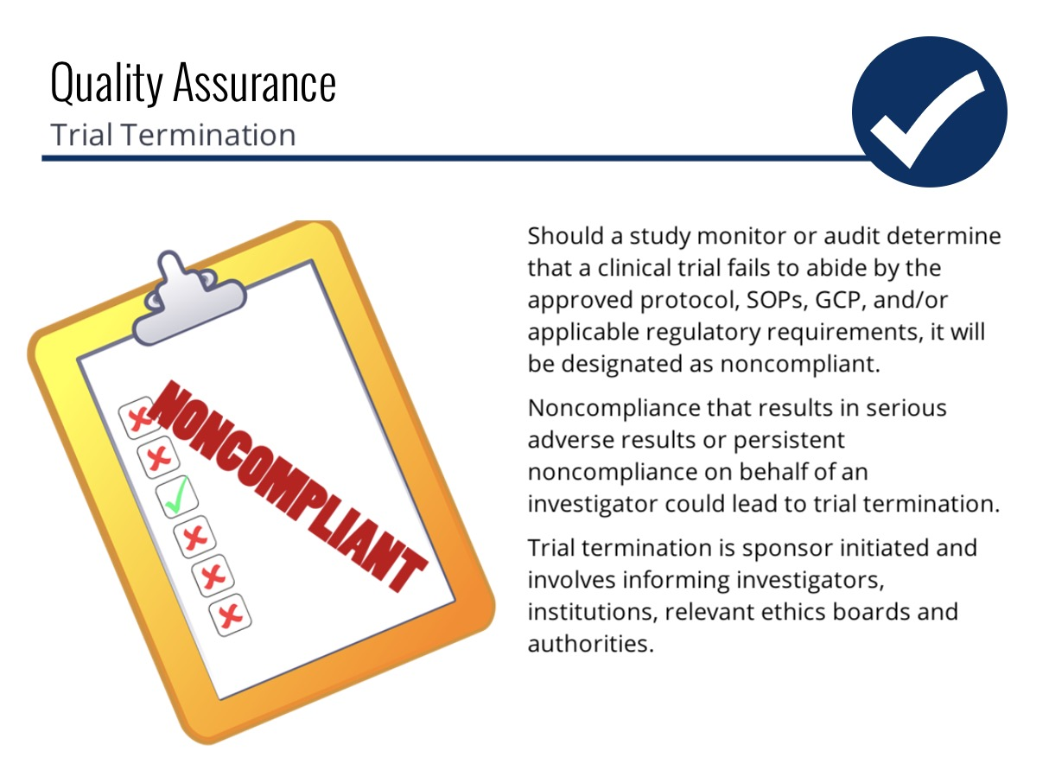

Slide 42
https://www.youtube.com/watch?v=H4Y3BSg3nXw
Notes:
https://www.youtube.com/watch?v=H4Y3BSg3nXw

Slide 43
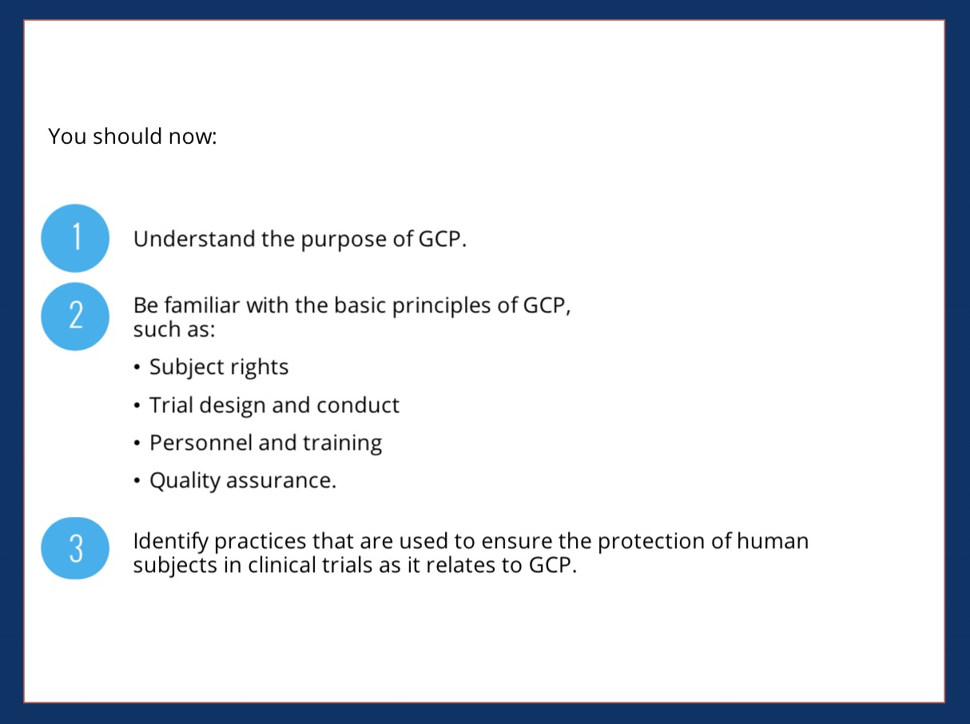

Slide 44


Slide 45
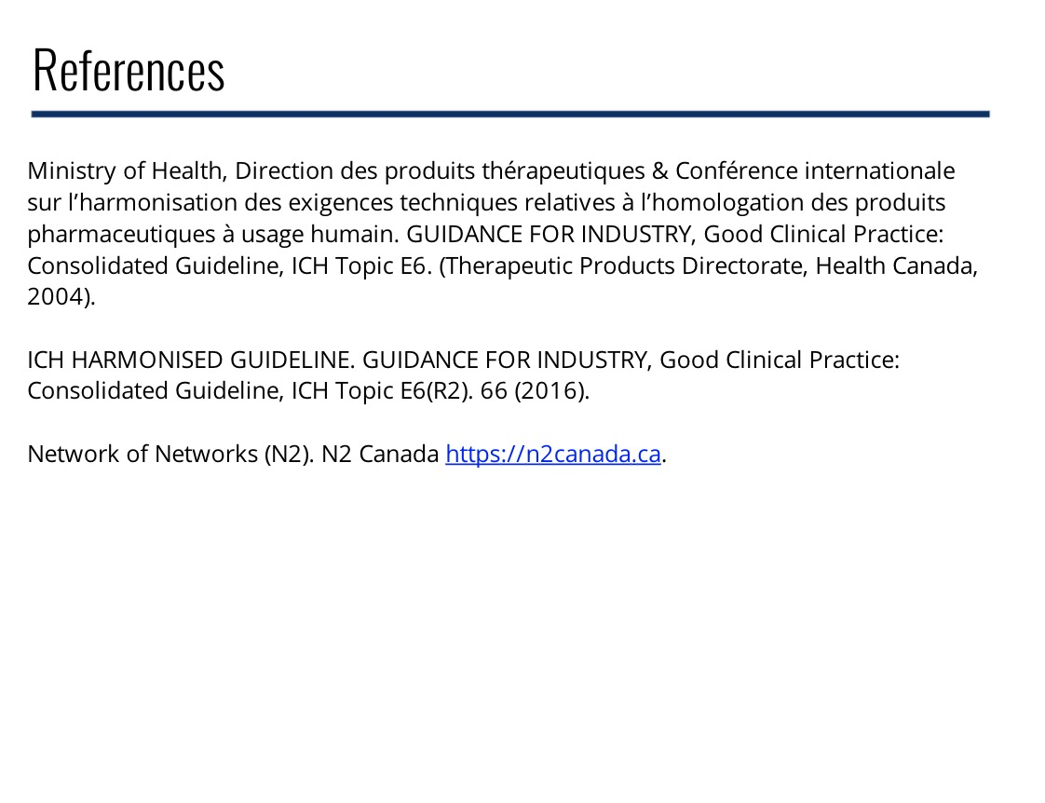
https://n2canada.ca.
Notes:
https://n2canada.ca

