Slide 1
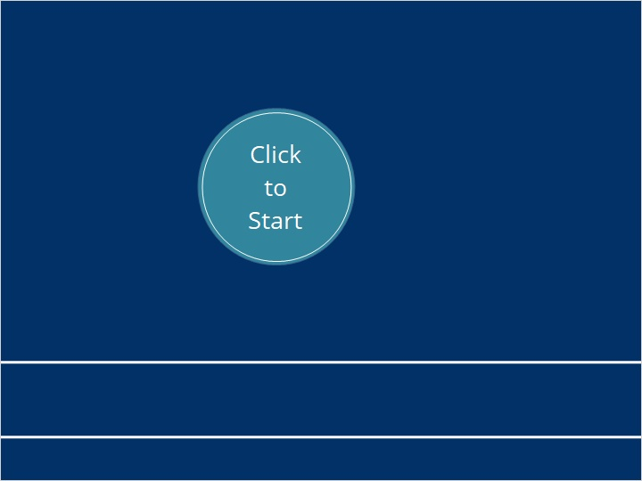
Good
Laboratory
Practice

Slide 2

https://www.youtube.com/watch?v=y0_TjkvkoiI
Notes:
https://www.youtube.com/watch?v=y0_TjkvkoiI

Slide 3
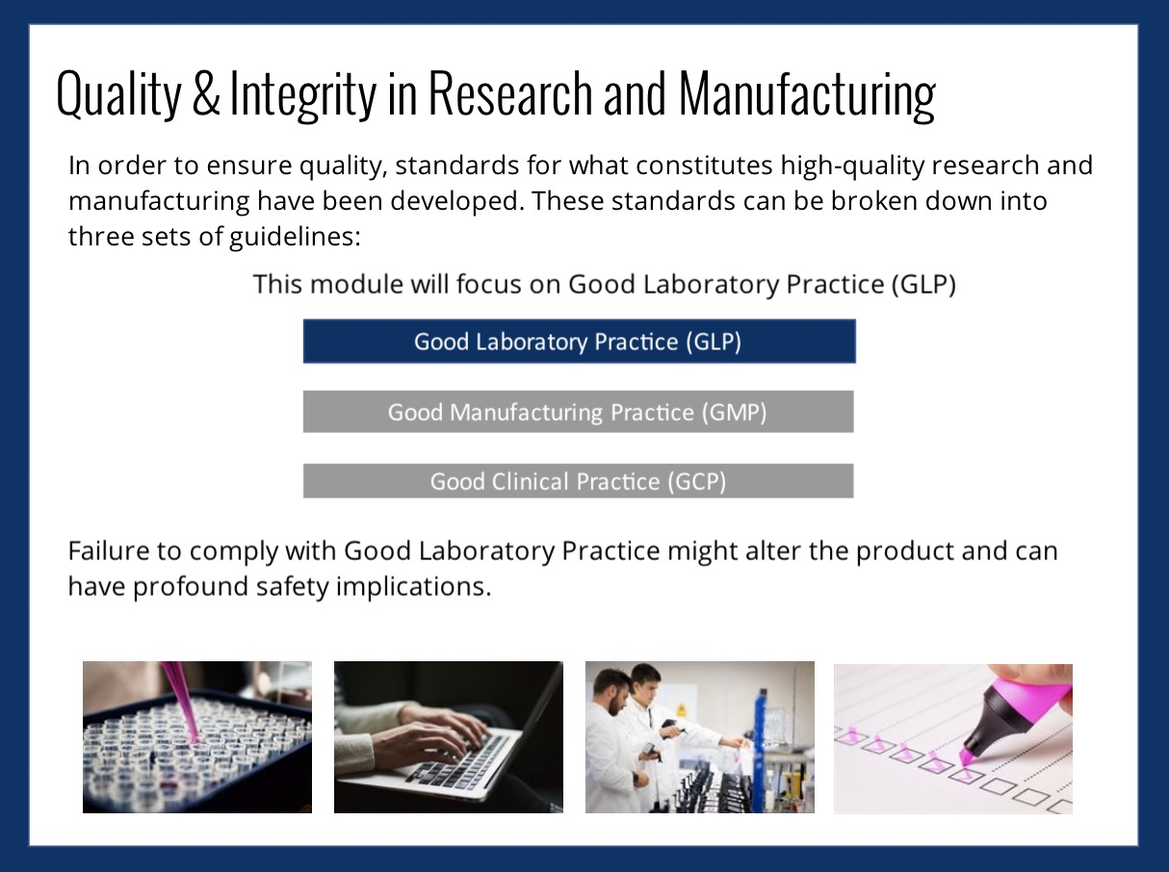

Slide 4
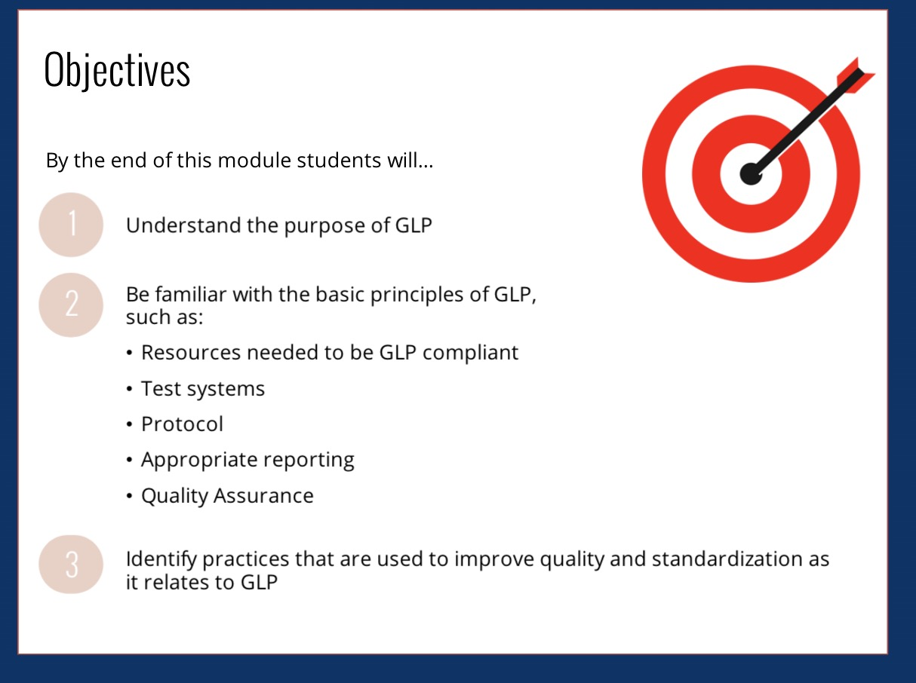

Slide 5
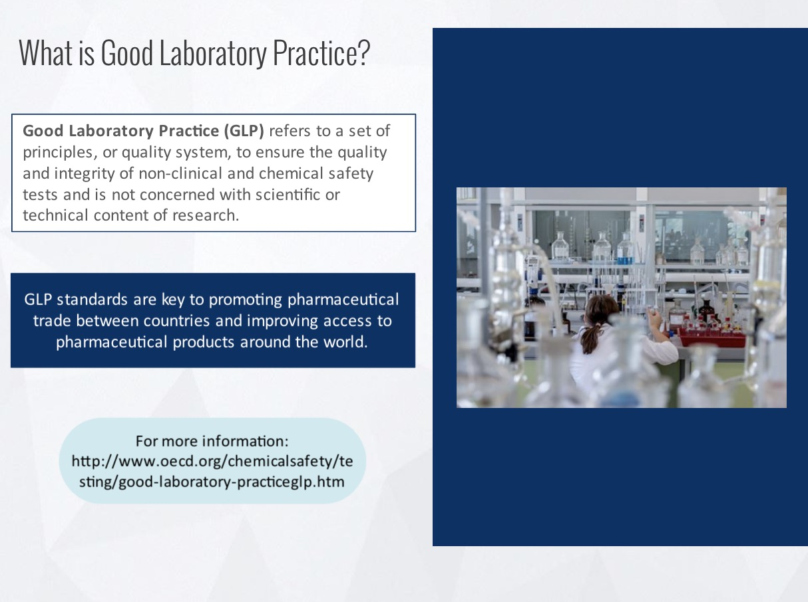
http://www.oecd.org/chemicalsafety/testing/good-laboratory-practiceglp.htm
Notes:
http://www.oecd.org/chemicalsafety/testing/good-laboratory-practiceglp.htm

Slide 6
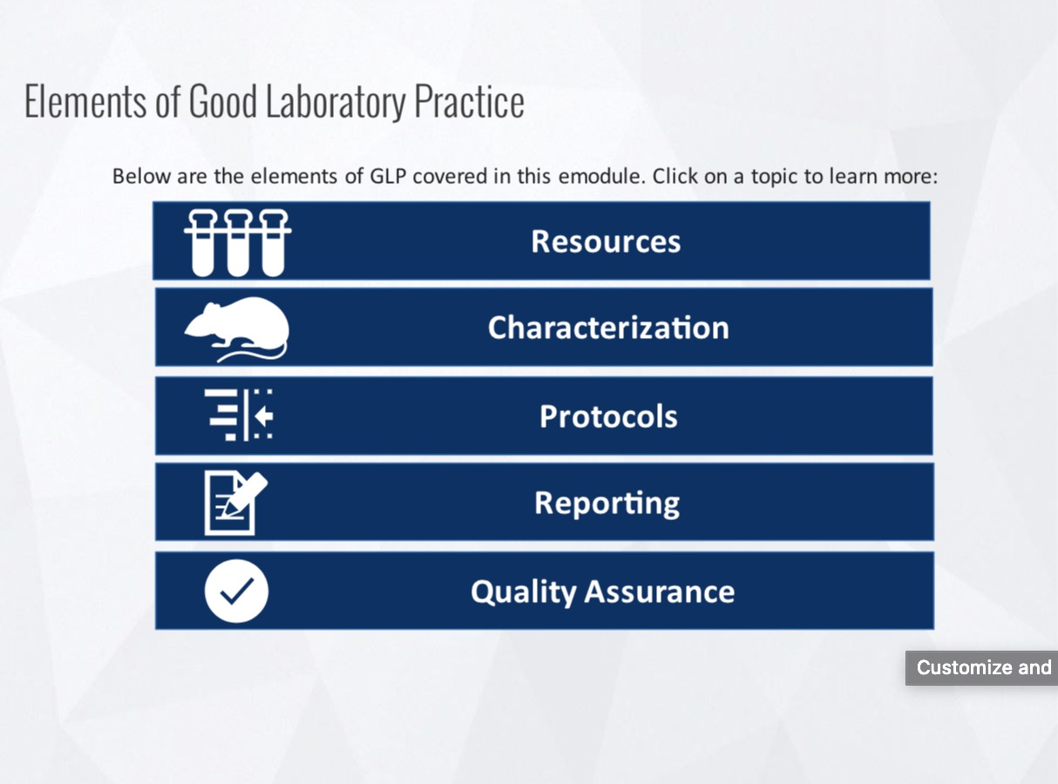
Notes:
http://www.oecd.org/chemicalsafety/testing/good-laboratory-practiceglp.htm

Slide 7
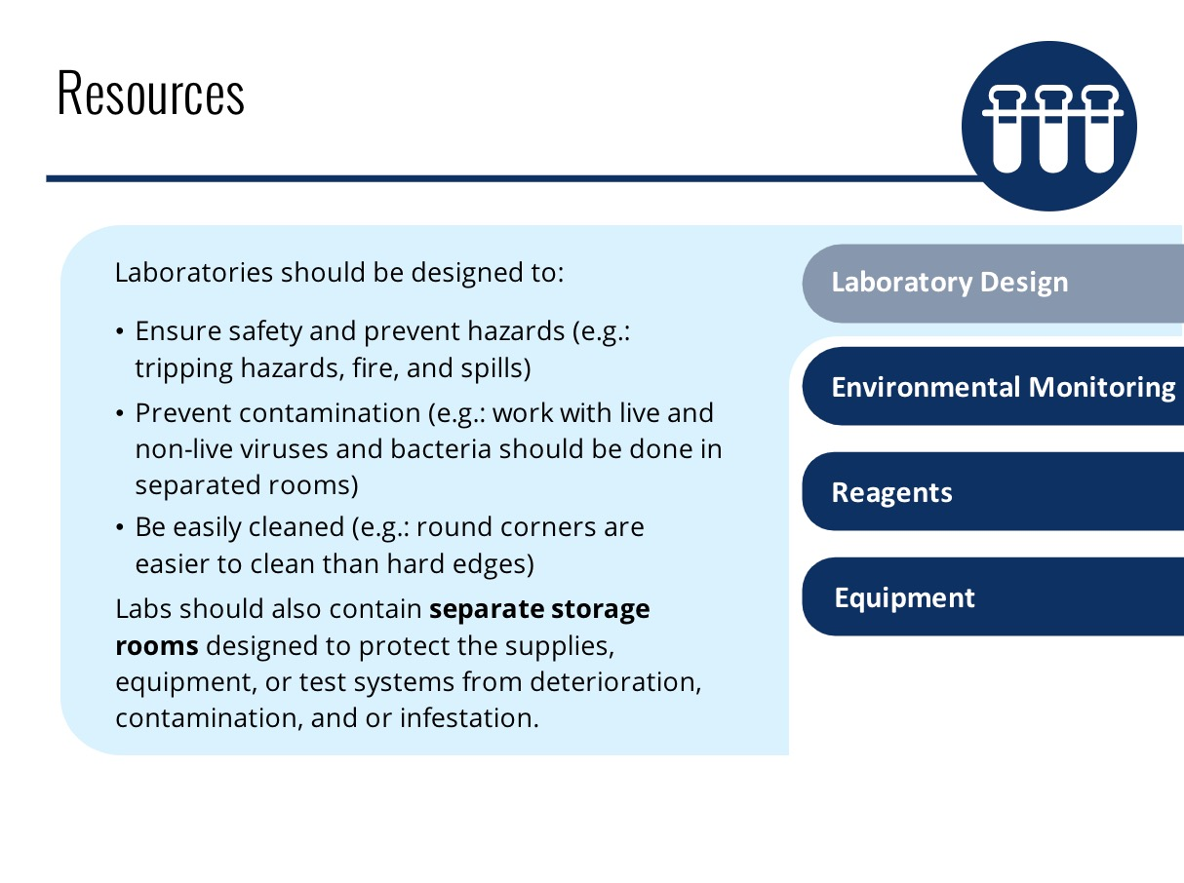

Slide 8
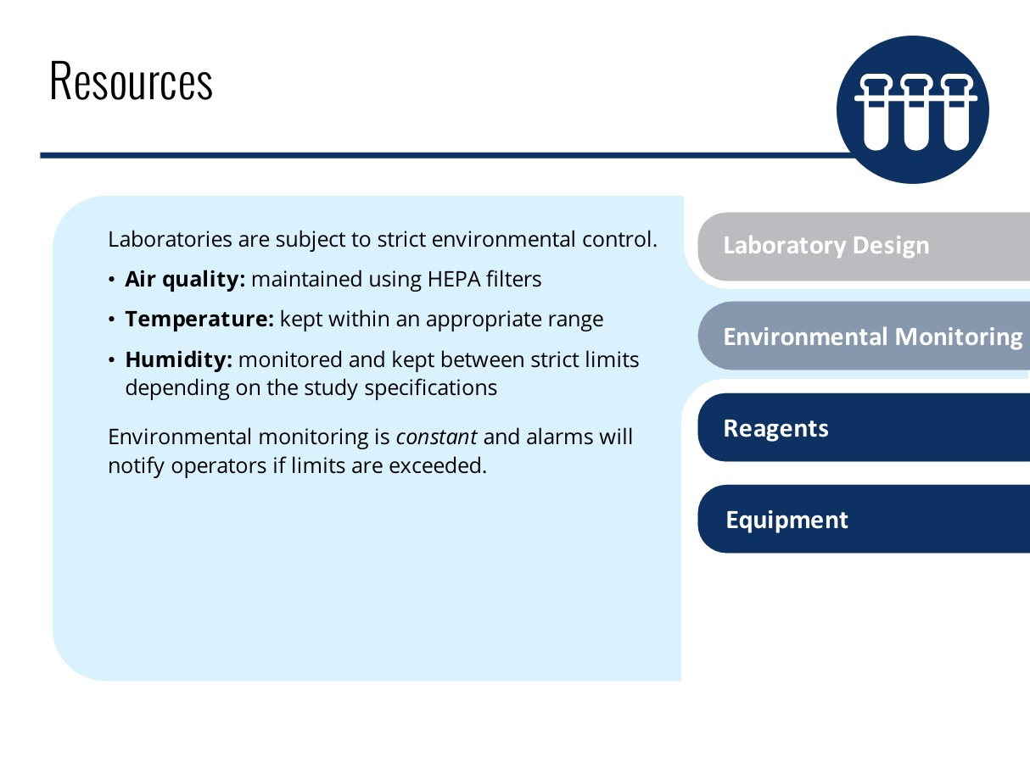
Improper environmental conditions can have serious consequences, including invalidation of all data generated during the period when conditions were abnormal.
Lab Design and Environmental Monitoring are built into your environment. Although you will not change these on a daily basis, you should be aware of their importance.

Slide 9
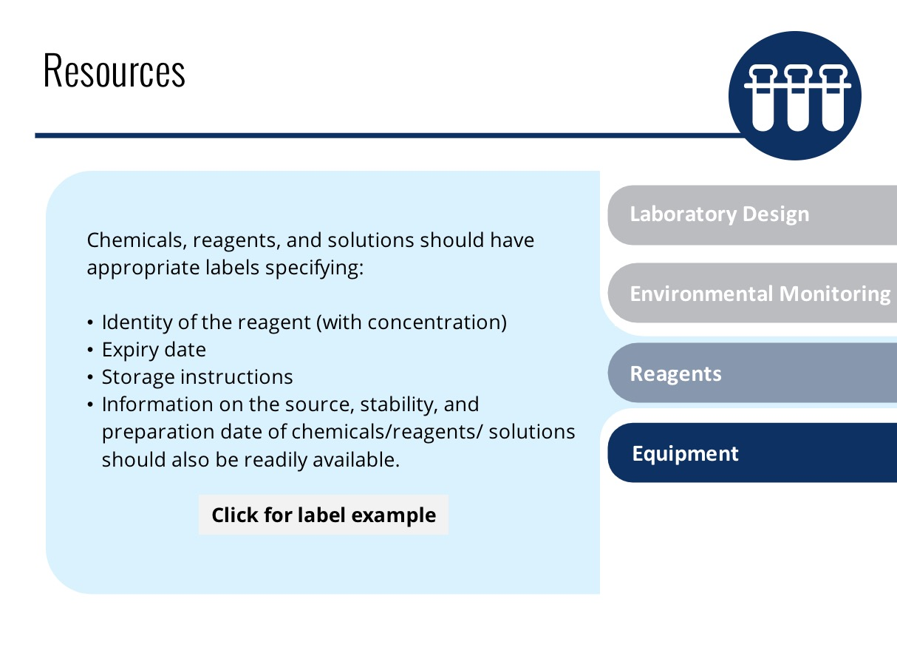

Slide 10
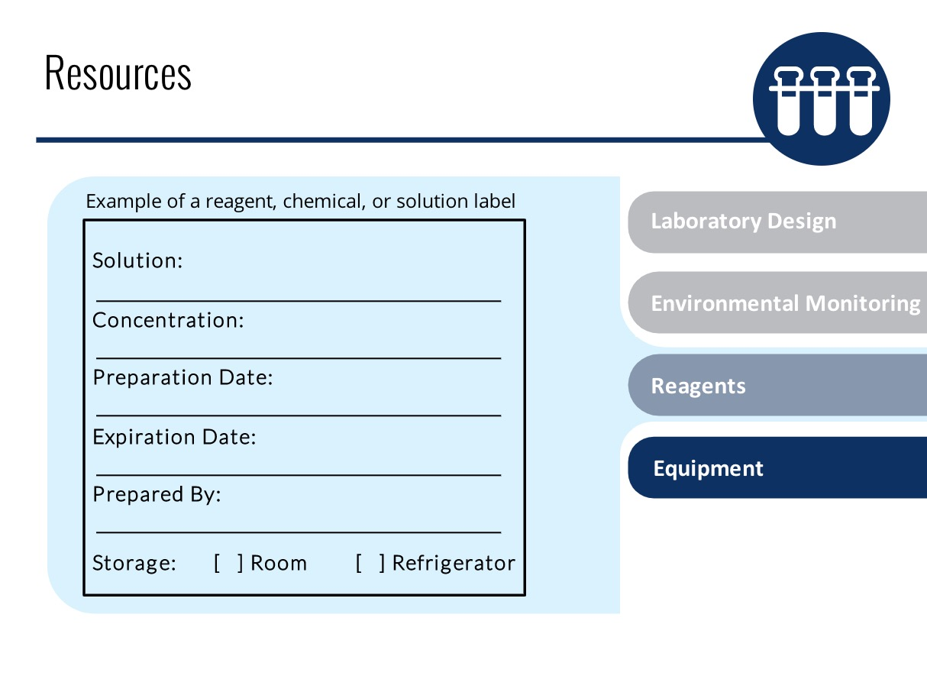

Slide 11
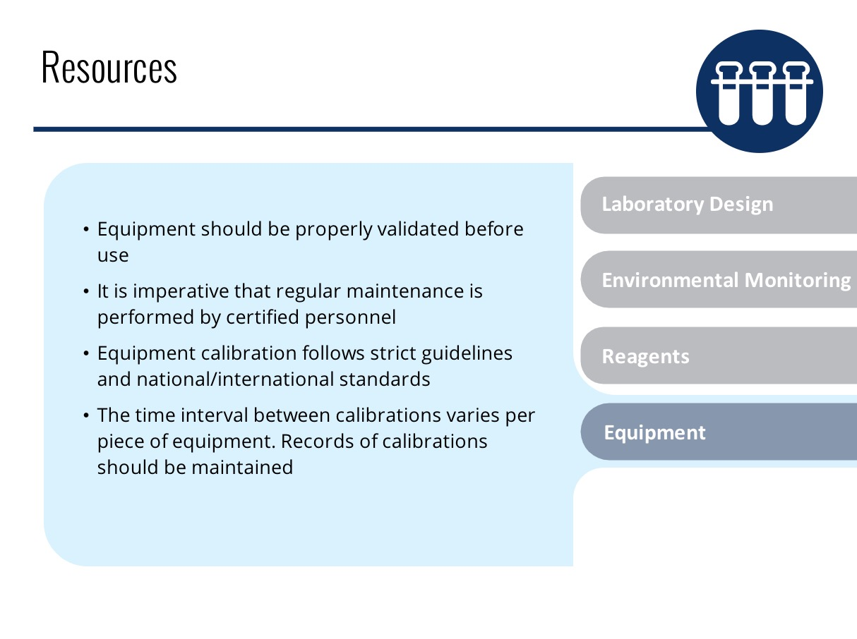
Improper maintenance and calibration or calibration done by uncertified personnel can lead to invalid data and potentially big financial losses for the pharmaceutical company.

Slide 12
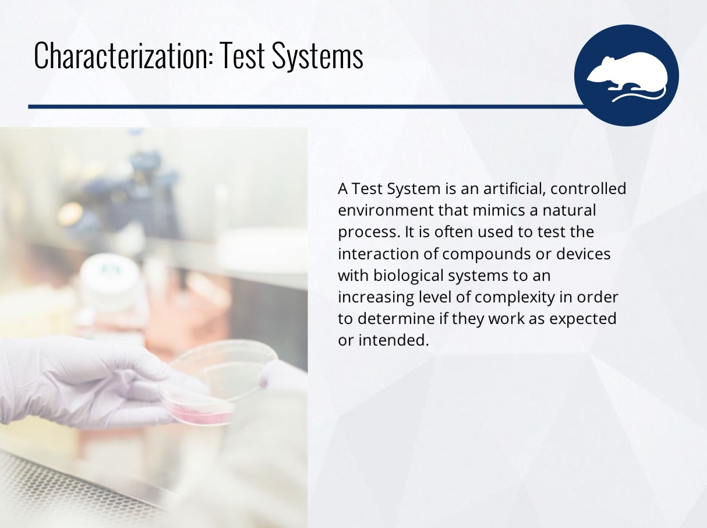

Slide 13
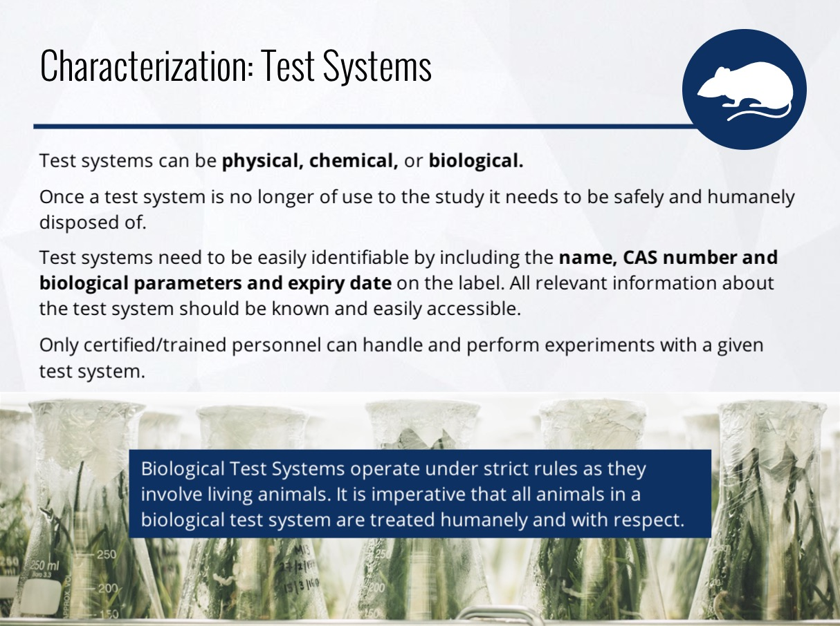

Slide 14
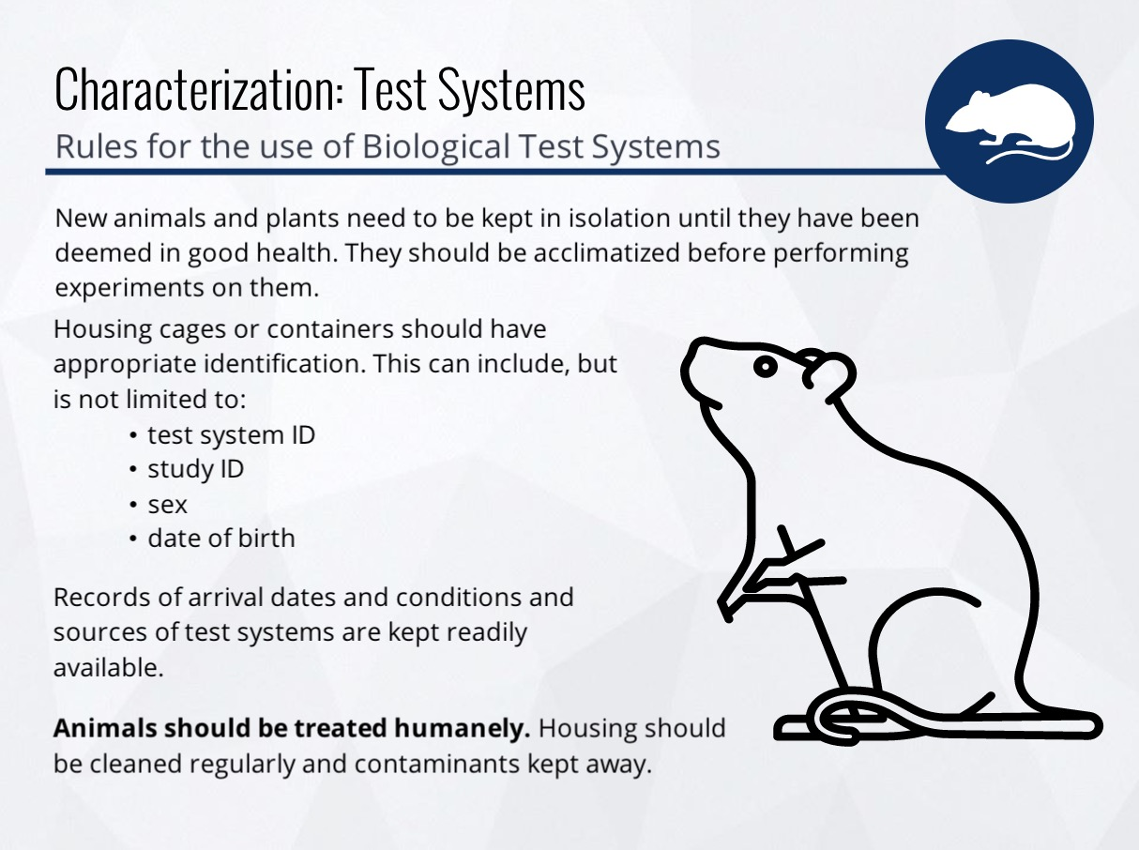

Slide 15
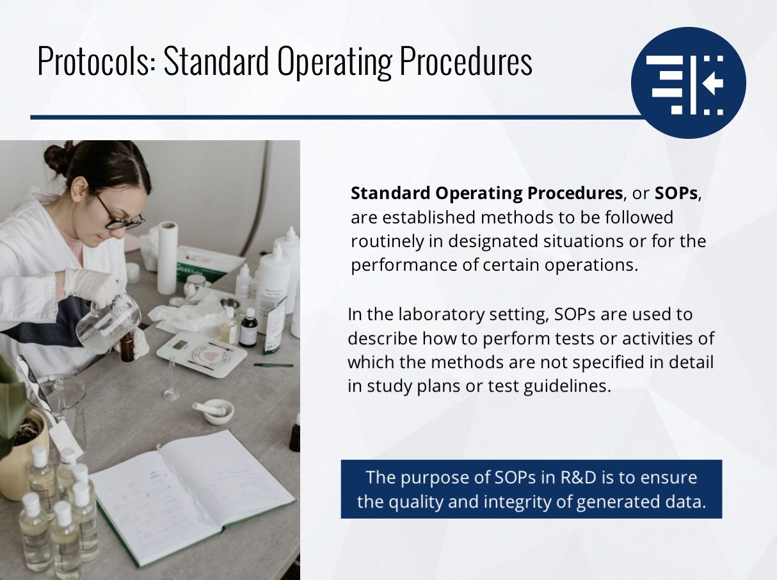

Slide 16
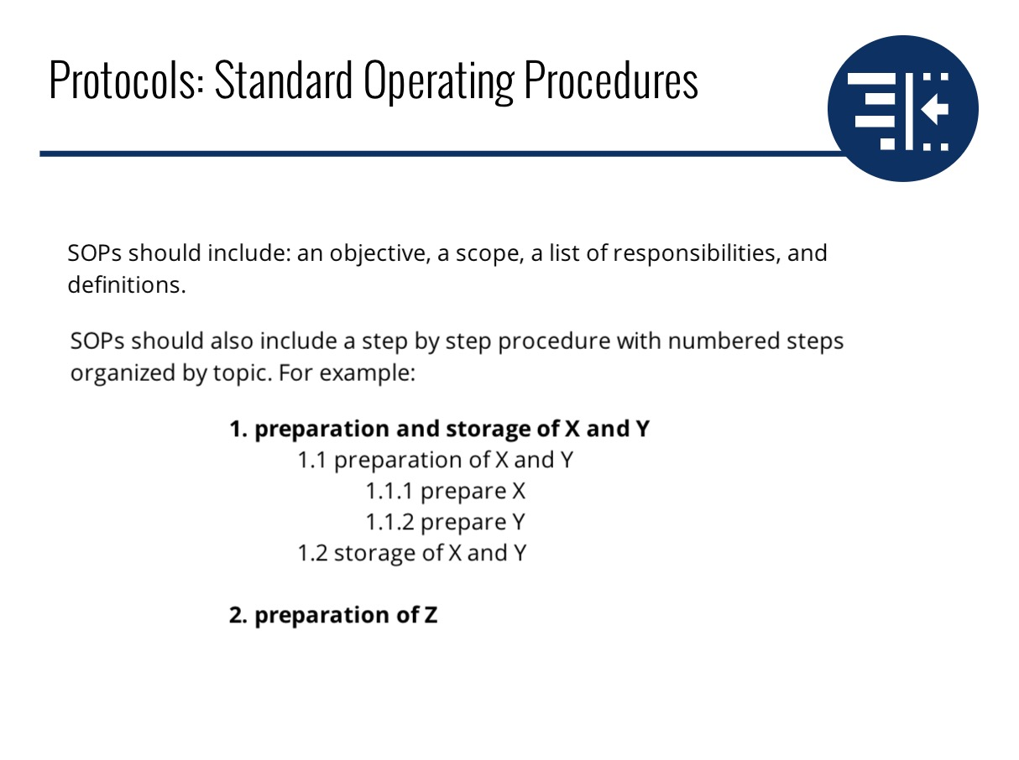

Slide 17
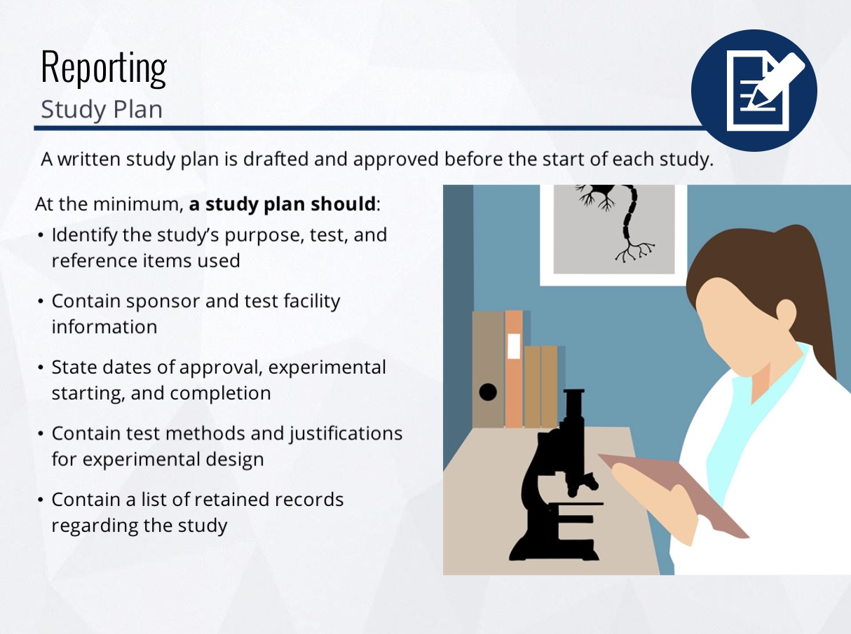

Slide 18
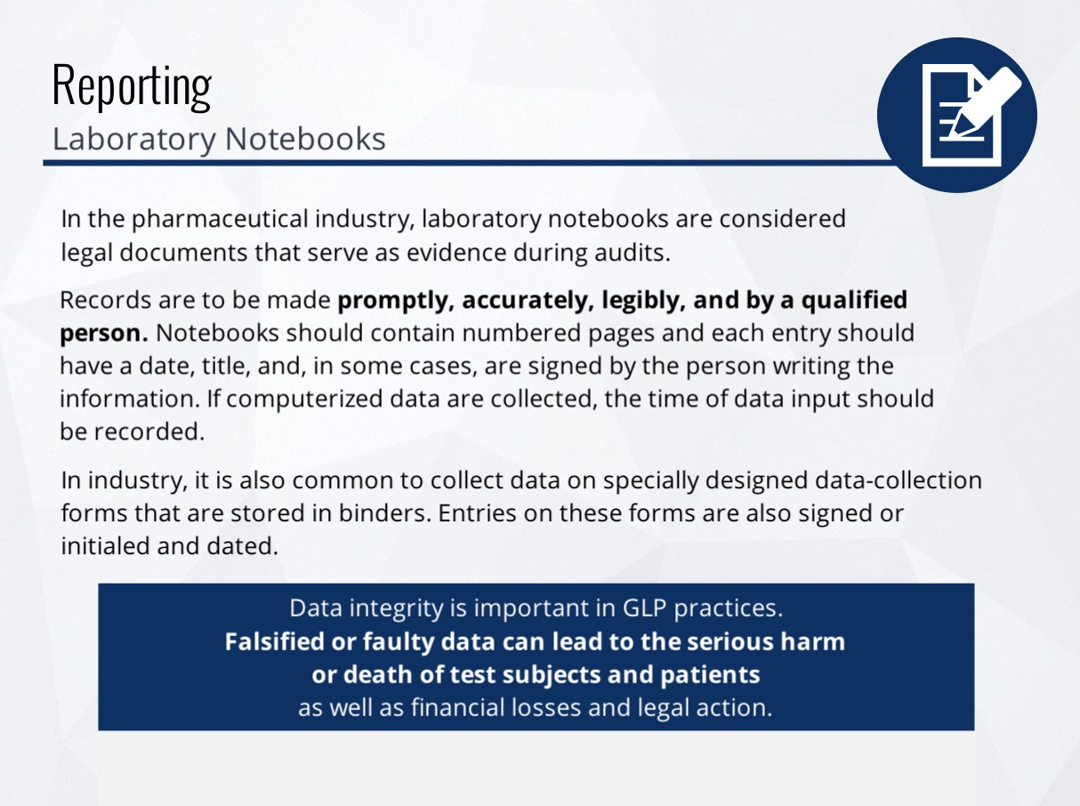

Slide 19
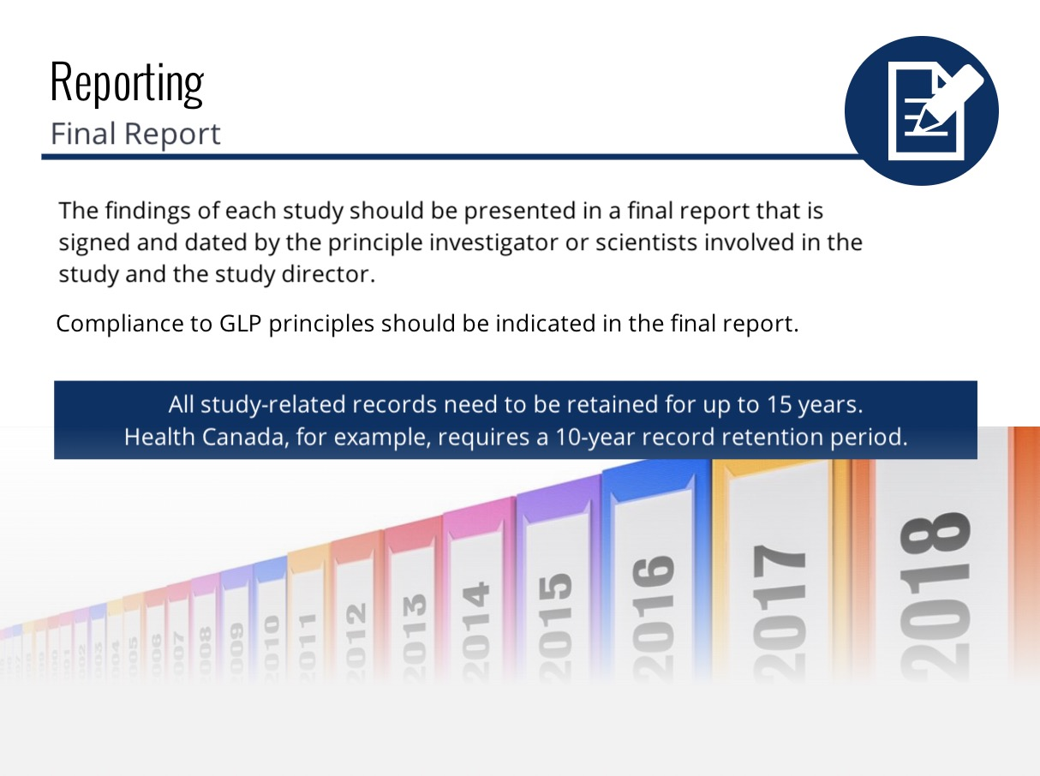
Notes:
Link for the video

Slide 20
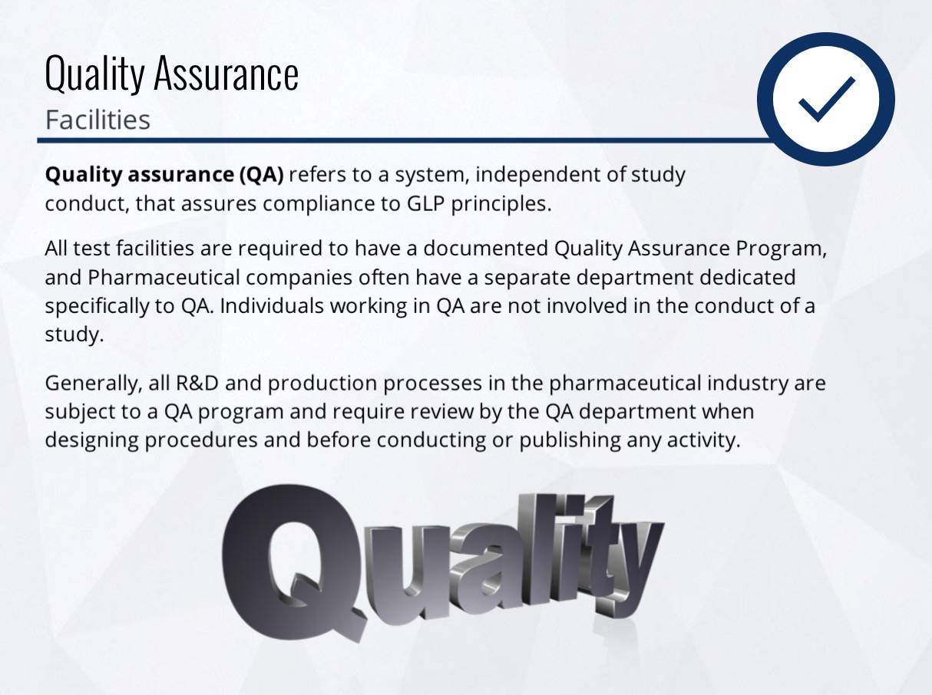

Slide 21
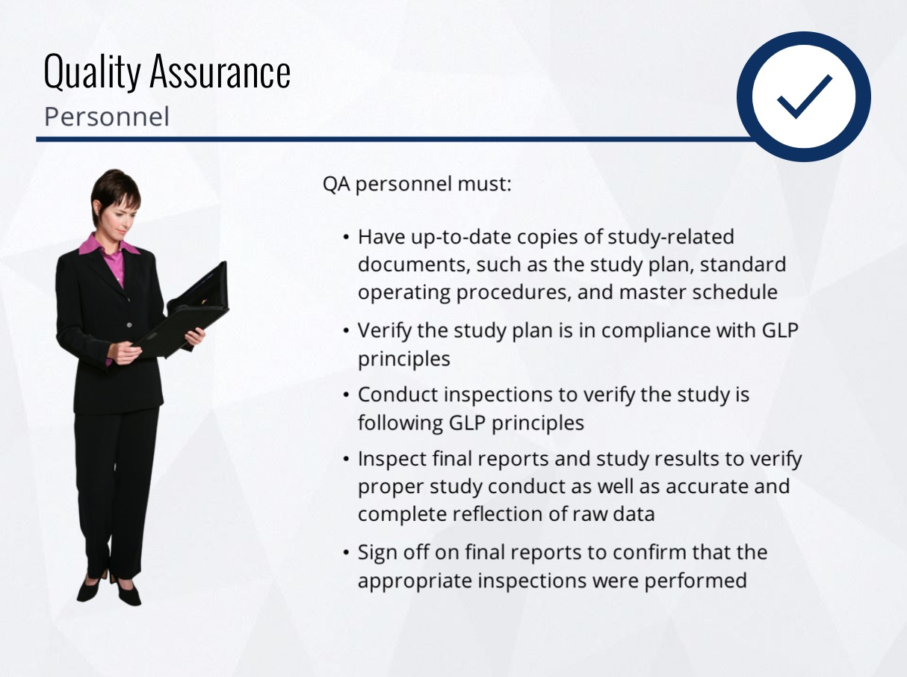

Slide 22
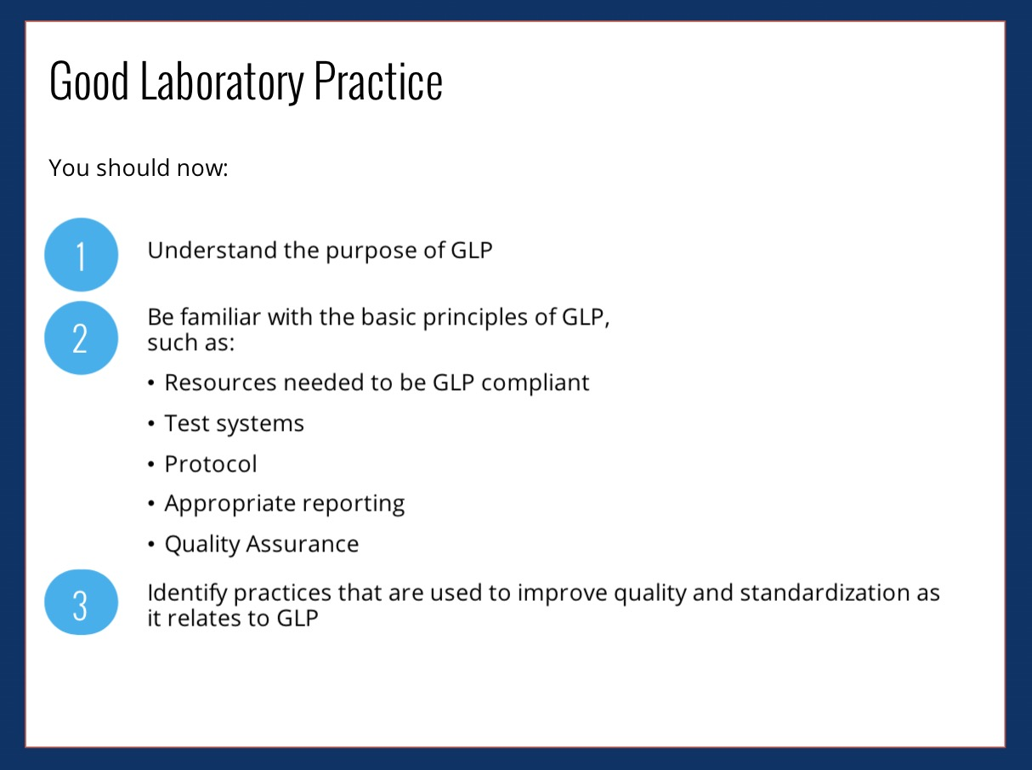

Slide 23


Slide 24
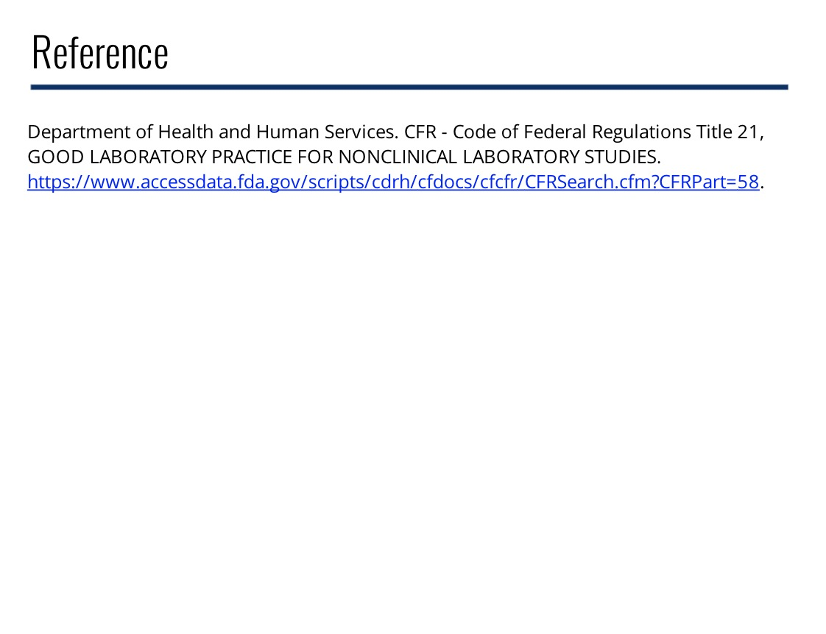
https://www.accessdata.fda.gov/scripts/cdrh/cfdocs/cfcfr/CFRSearch.cfm?CFRPart=58.
Notes:
https://www.accessdata.fda.gov/scripts/cdrh/cfdocs/cfcfr/CFRSearch.cfm?CFRPart=58

