Slide 1
Project Management
for Health Sciences

Slide 7
Notes:
Link for the video

Slide 8
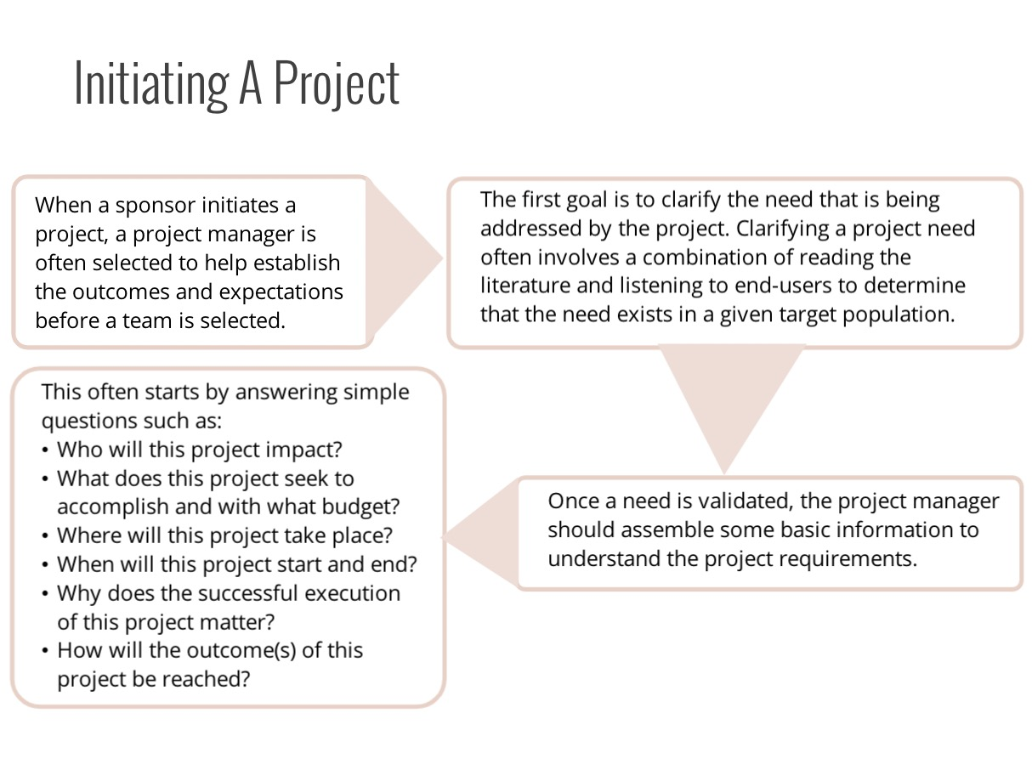

Slide 12
Notes:
* Add video link here

Slide 24
Notes:
Link for the video

Slide 29
Notes:
* Add video link here

Slide 36
https://www.pmi.org
https://pmief.org/library/resources/project-management-skills-for-life (2018).
Notes:
https://www.pmi.org
https://pmief.org/library/resources/project-management-skills-for-life

