Slide 1
Roles and Responsibilities of a Research Team

Slide 8
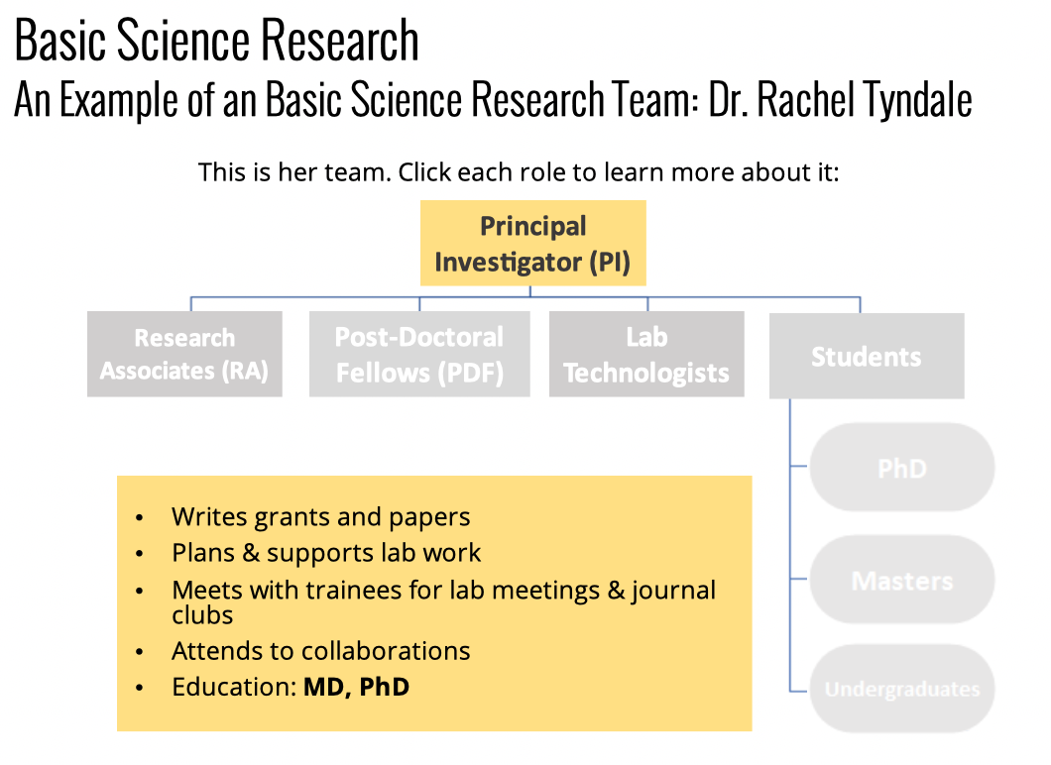

Slide 9
