Slide 1
Developing a Personal Learning Plan for Competency Development
LEARNING THROUGH EXPERIENCE
Notes:
Image: https://c.pxhere.com/photos/b4/dc/student_typing_keyboard_text_woman_startup_business_people-710504.jpg!d

Slide 2
MODULE OBJECTIVES
In this module you will undertake a set of goal-setting steps in order to create a “personal learning plan” for competency development in your experiential learning opportunity.
By the end of this module you will be able to:
Consider your personal or professional development objectives
Select some competencies you want to develop during this experience
Establish SMART goals to allow you to develop those competencies

Slide 3
THE VALUE OF GOAL SETTING
Notes:
https://www.youtube.com/watch?v=pIlzsSfMyVw

Slide 4
What are Competencies?
Notes:
Image: https://www.autodesk.com/products/fusion-360/blog/wp-content/uploads/2019/03/brainstorming.jpg

Slide 5
WHAT ARE COMPETENCIES?
A competency consists of 3 elements:
Knowledge Information that you are aware of, including theories, facts and procedures
Skill The ability to do something well, usually developed through training and practice
Attribute A personal quality that is expressed through what you think, do and feel
The University of Toronto Co-Curricular Record Competency Framework contains a list of common competencies. LEARN MORE.
Adapted from: https://www.uvic.ca/coopandcareer/assets/docs/student-docs/competencies /What_makes_up_a_competency_infosheet.pdf

Slide 6
AN EXAMPLE OF A COMPETENCY
For example, in an experiential learning opportunity you might focus on developing your competency in communication by:
Learning about expected communication styles in a particular field (Knowledge)
Practicing, and getting feedback on, your writing and your oral presentations (Skills)
Developing the ability to be calm under pressure so you can organize your thoughts (Attributes)

Slide 7
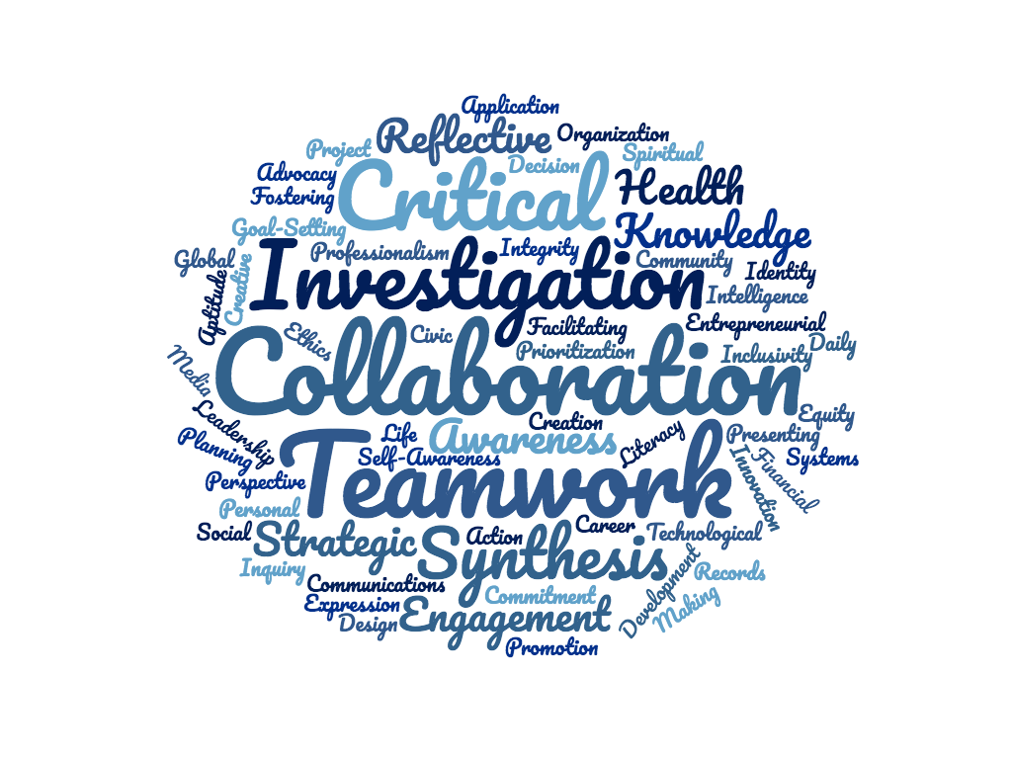
WHY CONSIDER COMPETENCIES IN CAREER DEVELOPMENT?
Your future career will require specific competencies, which you can intentionally develop through your current experiences.
To do this, you may wish to set competency development goals for yourself as well as create a plan for how to reach those goals.

Slide 8
Competencies and Your Professional Development
Notes:
Image: https://c.pxhere.com/photos/75/9f/workplace_team_business_meeting_business_people_business_teamwork_office_people-559565.jpg!d

Slide 9
WHAT IS A PERSONAL LEARNING PLAN?
A “Personal Learning Plan” is a tool you can use in your experiential learning opportunity to set competency development goals and reflect on your progress.
STEP
STEP
STEP
STEP
STEP
1
2
3
4
5
Determine which competencies you want to develop in your experiential learning opportunity
List examples of when you have previously demonstrated those competencies
Identify specific tasks or projects that will allow you to develop those competencies in your experiential learning opportunity
Develop SMART goals for competency development in your experiential learning opportunity
Reflect on your competency development over the course of the experiential learning opportunity
In this module, you will work through Steps 1 through 4 to create your own personal learning plan.
You can reflect on your competency development (Step 5) in the “Reflecting on Your Competency Development” module.

Slide 10
YOUR TURN: YOUR LONG-TERM CAREER GOALS
Take a few minutes to think or write about what your long-term career goals are at present.
What kinds of work are you interested in?
What would you like to accomplish in your career?
What kinds of competencies will this work require?

Slide 11
YOUR TURN: COMPETENCIES FOR DEVELOPMENT
With your long-term goals in mind, select three competencies you would like to develop in your experiential learning role.
Strategies for success:
It may be helpful to refer the Co-Curricular Competencies Framework for ideas.
SEE THE FRAMEWORK

Slide 12
YOUR TURN: PREVIOUS COMPETENCY EXPERIENCE
In the next section, you will be asked to review the three competencies you selected and consider how you have previously demonstrated each of these competencies.
Student Example: Competency: Financial literacy
As the photography club treasurer, I tracked all of the expenses and revenue at our fundraising event.
I had to project our expenses and earnings to allocate money for the club to spend on supplies.
Strategies for success:
Consider all areas of your experience including work, education, and community engagement.

Slide 13
HOW HAVE YOU ALREADY DEMONSTRATED THIS COMPETENCY?
Competency 1:
How have you already demonstrated this competency?

Slide 14
HOW HAVE YOU ALREADY DEMONSTRATED THIS COMPETENCY?
Competency 2:
How have you already demonstrated this competency?

Slide 15
HOW HAVE YOU ALREADY DEMONSTRATED THIS COMPETENCY?
Competency 3:
How have you already demonstrated this competency?

Slide 16
YOUR PERSONAL LEARNING PLAN FOR COMPETENCY DEVELOPMENT
Now that you have a list of competencies you would like to develop and some examples of where you have demonstrated those competencies, it is time to:
Identify how you plan to develop those competencies
Develop SMART goals for competency development
STEP
STEP
STEP
STEP
STEP
1
2
3
4
5
Determine which competencies you want to develop in your experiential learning opportunity
List examples of when you have previously demonstrated those competencies
Identify specific tasks or projects that will allow you to develop those competencies in your experiential learning opportunity
Develop SMART goals for competency development in your experiential learning opportunity
Reflect on how you have developed your competencies over the course of the experiential learning opportunity

Slide 17
Setting Goals for Competency Development
Notes:
Image https://encrypted-tbn0.gstatic.com/images?q=tbn:ANd9GcRbg4NgP2KaGb-S3j7mJp6jVsgkcia_XJmECRlPEMzxKlbUrjy6Cw

Slide 18
ESTABLISHING SMART GOALS
When creating goals for competency development, make sure they are ‘SMART’
S
Specific
What exactly will you accomplish?
M
Measurable
How will you know when you have reached this goal?
A
Achievable
Is this goal realistic, given the level of effort required?
R
Results-focused
Can you describe the results you are aiming for?
T
Time-bound
When will this goal be achieved?

Slide 19
YOUR TURN: WHICH OF THESE GOALS IS A SMART GOAL?
I want to develop communication skills in this experience to help me with my future academic and career success. I will tell my placement supervisor that I want to develop my communication skills and listen to their recommendations. I am a nervous presenter so I think this is an important goal to work towards.
I want to co-facilitate a workshop for refugees on where they can access nutritious and affordable food. This workshop will help me develop communication and presentation skills which are important for my future academic and career success. I will share my goal with my placement supervisor to see if it will be possible to accomplish during my 4 month placement.

Slide 20
YOUR TURN: PLAN FOR COMPETENCY 1
In this section, you can create a detailed plan for how you will develop each of your selected competencies in your role by (1) Identifying specific tasks you can undertake and (2) Establishing SMART goals for each competency.
Competency 1:
Project/task in your experiential learning role:
SMART Goal:

Slide 21
YOUR TURN: PLAN FOR COMPETENCY 2
Competency 2:
Project/task in your experiential learning role:
SMART Goal:

Slide 22
YOUR TURN: PLAN FOR COMPETENCY 3
Competency 3:
Project/task in your experiential learning role:
SMART Goal:

Slide 23
YOUR PERSONAL LEARNING PLAN IS COMPLETE
In this module, you have created a personal learning plan by following these steps:
Considering your personal and professional development objectives
Deciding which competencies you wanted to develop in this experience
Establishing SMART goals for developing those competencies

Slide 24
NEXT STEPS: USING YOUR PERSONAL LEARNING PLAN
Now that you have created your personal learning plan, there are ways that you can use it to ensure a successful experiential learning opportunity.
Review your personal learning plan with your external supervisor.
Review your goals at the mid-point of your opportunity to evaluate your progress. (You can use this activity to help you)
Complete the “Reflecting on your competency development” module at the end of your experiential learning opportunity.

Slide 25
REFERENCES
“What Makes Up a Competency?” Co-operative Education Program and Career Services, University of Victoria. https://www.uvic.ca/coopandcareer/assets/docs/student-docs/competencies /What_makes_up_a_competency_infosheet.pdf. Accessed May 9, 2019.

