Slide 1
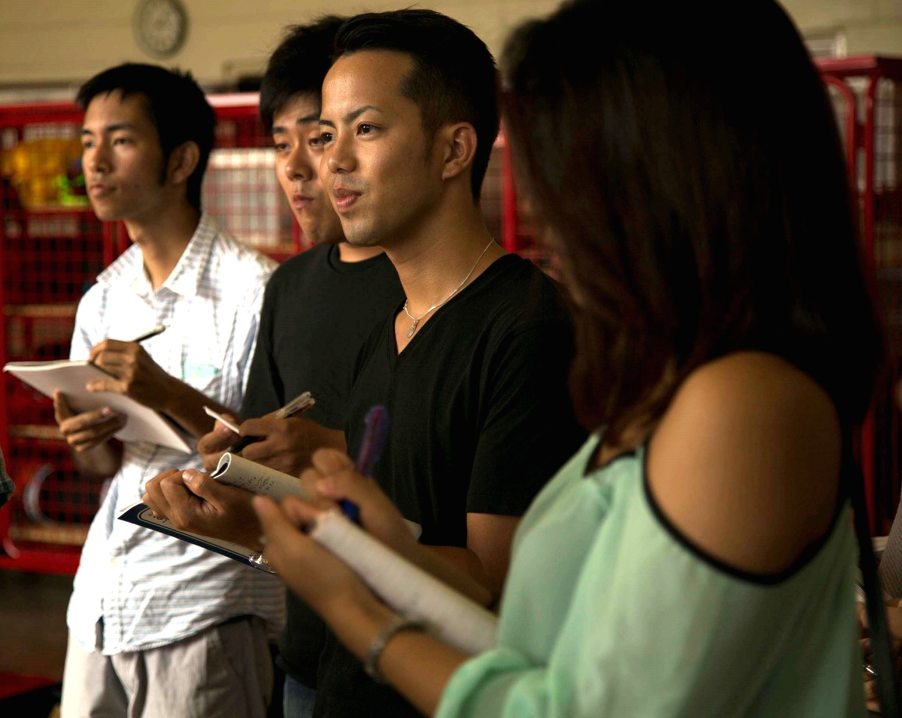
An Introduction to Community-Engaged Learning
LEARNING THROUGH EXPERIENCE
Notes:
Image: https://commons.wikimedia.org/wiki/File:Okinawa_International_University_students_learn_disaster_preparation_at_Camp_Foster_Fire_Station_140929-M-DM081-002.jpg

Slide 2

MODULE OBJECTIVES
This module will introduce
ideas, theories and activities
related to community-engaged learning (CEL).
By the end of this module you
will be able to:
Describe the key features of CEL
Reflect on your goals for your CEL experience
Consider how to align your goals with your community partner’s priorities

Slide 3
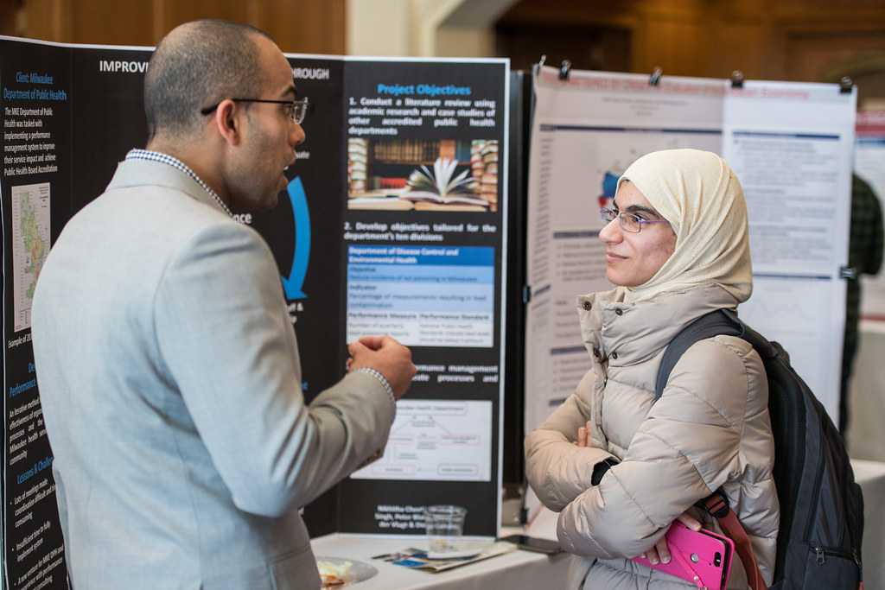
What is
Community-Engaged Learning?
Notes:
Image: https://live.staticflickr.com/810/41056331052_ee5f6050ef_b.jpg

Slide 4

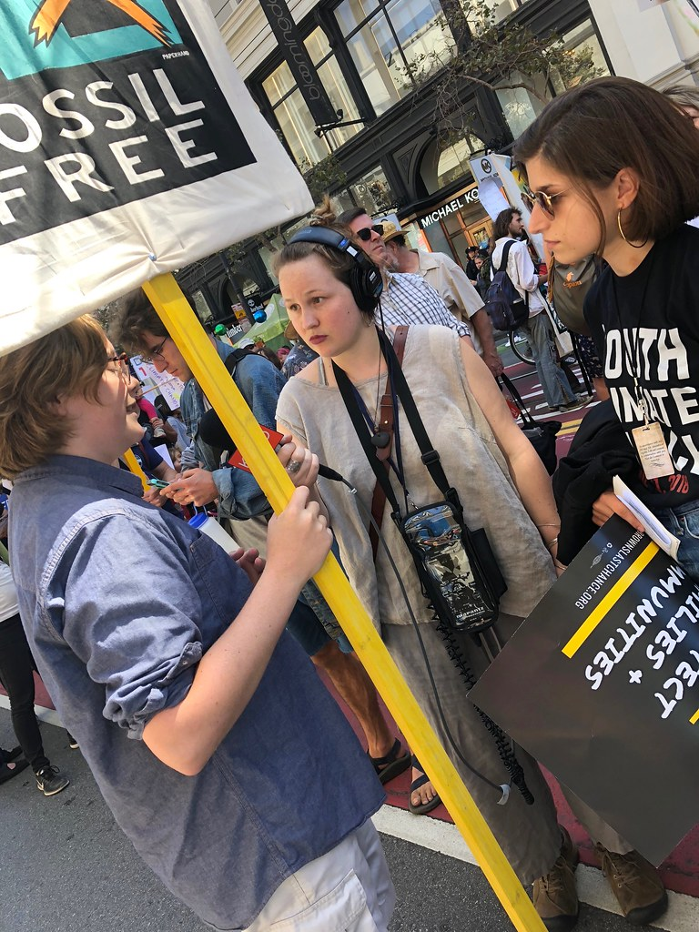
WHAT IS COMMUNITY-ENGAGED LEARNING (CEL)?
    “a form of experiential education in which students engage in activities that address human and community needs, together with structured opportunities for reflection designed to achieve desired learning outcomes”
    Community-engaged
    learning is sometimes referred to as “Service-Learning”
Jacoby, B. (2015) Service-learning Essentials: Questions, Answers, and Lessons Learned. San Francisco: JosseyBass.
Notes:
Image: https://live.staticflickr.com/1845/43753741615_7f1d20be6a_b.jpg

Slide 5

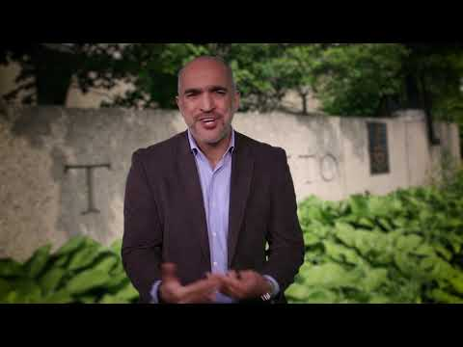
WHY CEL? THE BENEFITS FOR STUDENTS AND COMMUNITIES
Notes:
https://www.youtube.com/watch?v=Lf3-ibLl21Y&feature=youtu.be

Slide 6

KEY FEATURES OF CEL
Experiential
Addresses
community needs
Incorporates
reflection
Tied to
learning outcomes
Jacoby, B. (2015) Service-Learning Essentials: Questions, Answers, and Lessons Learned. San Francisco: JosseyBass.

Slide 7
KEY FEATURES OF CEL: EXPERIENTIAL
Experiential learning means “learning from experience, or learning by doing.”
In a CEL course, you will take
part in experiential activities
beyond what might be typical in your other courses.
For instance, you might be:
Placed on-site at a community organization
Undertaking research for a community organization
Engaged in an activity with other members of a community towards a common goal
Lewis, L. H. and Williams, C. J. (1994). Experiential Learning: Past and Present. New Directions for Adult and Continuing Education, 5-16.

Slide 8
CEL EXPERIENCES CAN TAKE MANY FORMS
With partner
on-site
Project-based
Local
Curricular
Research
Working
off-site
Placement-based
Global
Direct
service
support
Co-curricular

Slide 9
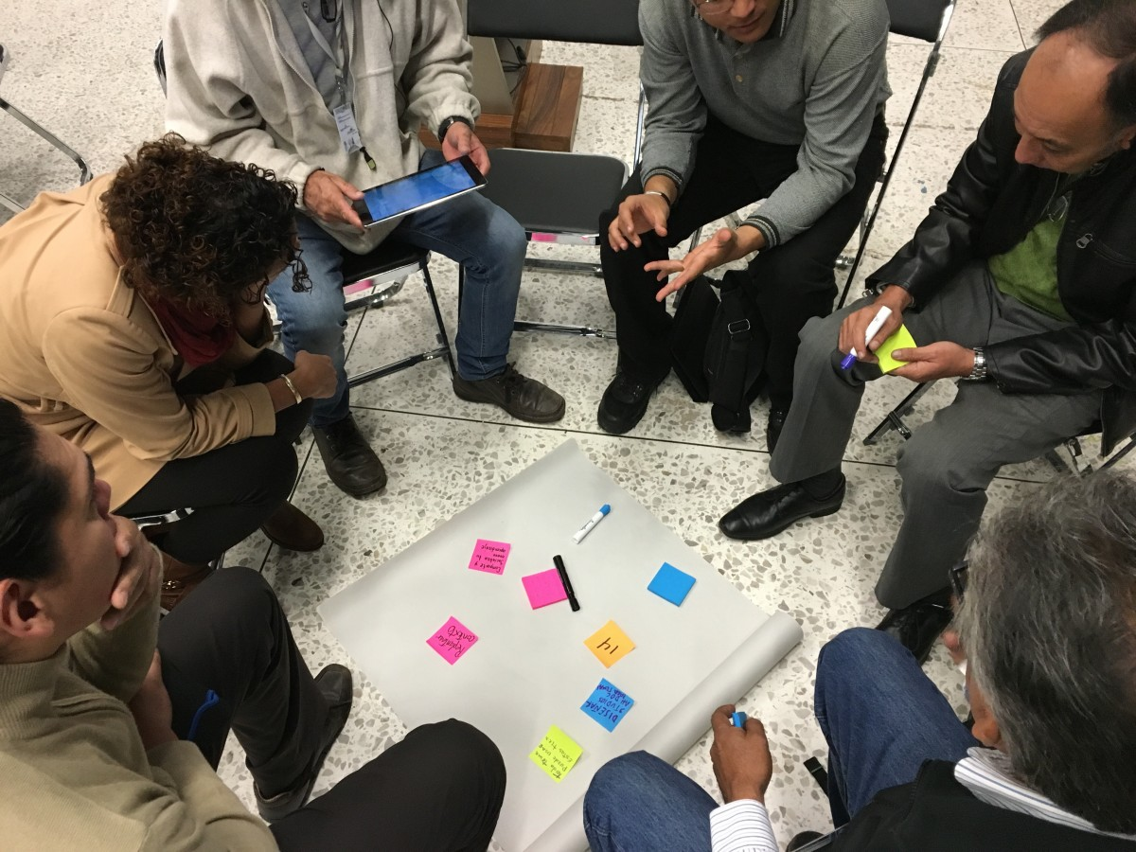
KEY FEATURES OF CEL: ADDRESSES COMMUNITY NEEDS
CEL differs from other forms of
experiential learning in its exclusive
focus on “activities that address human and community needs.”
For instance, CEL is typically accomplished in partnership with a community, a non-profit organization or a public organization. The quality of that partnership should be paramount and both you and your community partners should benefit from your CEL efforts.
In CEL you contribute to, and learn from, the activities of community organizations to support community priorities.
Notes:
Image: https://c.pxhere.com/photos/52/25/photo-198744.jpg!d

Slide 10
WHAT IS RECIPROCITY?
The concept of reciprocity is central to CEL:
“[reciprocity] is about establishing and sustaining partnerships that …emphasize respect, trust, genuine commitment, balancing power, sharing resources, and clear communication”
Respect
Trust
Commitment
Balancing
power
Sharing
resources
Clear communication
Jacoby, B. (2015) Service-Learning Essentials: Questions, Answers, and Lessons Learned. San Francisco: JosseyBass.

Slide 11
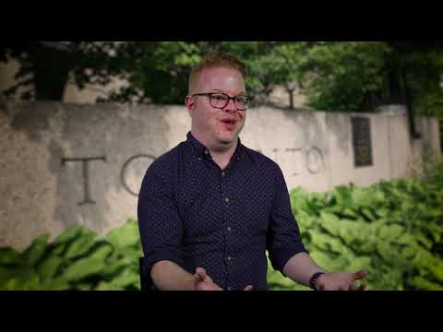
WHAT IS "RECIPROCITY" IN COMMUNITY-ENGAGED LEARNING
Notes:
Https://www.youtube.com/watch?v=VzPCXVUj4Bw&feature=youtu.be

Slide 12

YOUR TURN: THE VALUE OF RECIPROCITY
Why do you think reciprocity is such a central concept to CEL?
Can you think of at least two ways that you will be able to enact the values of reciprocity in your CEL opportunity?
    Strategies for success:
    The concept of reciprocity incorporates respect, trust, commitment, balancing power, sharing resources and clear communication.

Slide 13
KEY FEATURES OF CEL: INCORPORATES REFLECTION
Reflection is any activity or assignment that allows you to:
Critically explore your CEL experience
Intentionally integrate
what you have learned
from your experience
with your previous
knowledge and experience
Previous knowledge and experience
Experiential
learning experience
Reflection

Slide 14

LEARNING FROM EXPERIENCE
“...Learning does not necessarily happen as a result of experience itself, but rather as a result of reflection designed to achieve specific learning outcomes.”
Jacoby, B. (2015) Service-learning Essentials: Questions, Answers, and Lessons Learned. San Francisco: JosseyBass.
Notes:
Image: https://www.google.ca/url?sa=i&source=imgres&cd=&cad=rja&uact=8&ved=2ahUKEwj8g7i-k8jiAhUNnOAKHV9CD7wQjRx6BAgBEAU&url=https%3A%2F%2Fwww.flickr.com%2Fphotos%2Fwocintechchat%2F25900702512&psig=AOvVaw0nfKX9zNPBbS5Rfbl8d0R7&ust=1559473997001917

Slide 15
HOW WE LEARN THROUGH REFLECTION
Reflection Generates Learning | You will often understand things in new ways when you ask yourself key questions about your experience.
Reflection Deepens Learning | Taking the time to consider your experience, and sharing those thoughts with your instructor/supervisor/peers, can help you refine and reconsider your initial assumptions.
Reflection Documents Learning | Completing reflective exercises and assignments allows you to demonstrate and track what you have learned for both yourself and others.
Ash, S. L., & Clayton, P. H. (2009). Generating, Deepening, and Documenting learning: The Power of Critical Reflection in Applied Learning. Journal of Applied Learning in Higher Education, 1(1), 25-48.

Slide 16
REFLECTION IS BOTH A PROCESS AND A PRODUCT
Reflection is a process that can take any form:
Writing
Essays
Research papers
Speaking
Discussions
Arts and Media
Photo or video essays
Journals
Portfolios
Presentations
Interviewing
Storytelling
Creative writing
Visual Art
Podcast
Activities
Role playing
Tableaux
Movement-based exercises
Jacoby, B. (2015) Service-learning essentials: Questions, Answers, and Lessons Learned. San Francisco: JosseyBass.

Slide 17
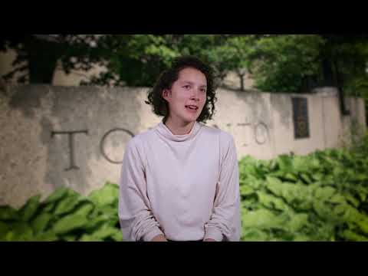
THE VALUE OF REFLECTION
Notes:
https://www.youtube.com/watch?v=H5x__GRxm7Q&feature=youtu.be

Slide 18
KEY FEATURES OF CEL: TIED TO LEARNING OUTCOMES
Community-engaged learning experiences should have structured learning outcomes.
These outcomes may be determined by the course instructor or program coordinator as well as by individual students.
These outcomes may be related to various domains including:
Disciplinary
Knowledge
Skill and
Competency
Development
Personal and civic
Development
Career
Development

Slide 19
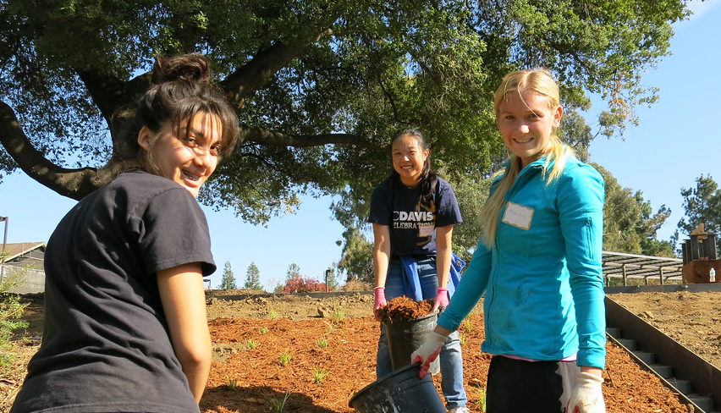
Reflecting on
Your Learning Goals
Notes:
Image: https://live.staticflickr.com/7401/10842785256_cee6704abc_n.jpg

Slide 20
YOUR GOALS FOR YOUR CEL EXPERIENCE
Your course instructor or program coordinator will establish general learning outcomes for your CEL experience. However, taking the time to intentionally consider what your personal goals are for this experience can contribute to your success.
In this section of the module you will be asked to consider what you hope to learn and achieve in a variety of areas.
Disciplinary
Knowledge
Skill and
Competency
Development
Personal and civic
Development
Career
Development

Slide 21

STUDENT EXAMPLE: ESTABLISHING GOALS
In the community-engaged learning
course Valeria is taking in
Human Biology she will be:
Placed with a community organization
Working with that organization for
20 hours over the course of the term
Supporting staff to develop an exercise program for a depression support group
While her instructor has outlined course
goals for all students, Valeria is expected
to determine her individual goals for
the experiential learning component
of the course.
Notes:
Image: https://c.pxhere.com/photos/ef/5a/women_teamwork_team_business_people_office_working_woman_woman_business-595817.jpg!d

Slide 22
YOUR TURN: CONSIDERING YOUR GOALS
Valeria might set goals for her community-engaged
learning opportunity in the following four areas:
Valeria wants to develop
her collaboration skills
(by working with others to
develop an exercise program)
and her critical thinking skills
(by evaluating evidence
and applying it to this
exercise program).
Valeria wants to learn
more about the relationship
between the biochemistry
of depression and specific
forms of exercise.
Disciplinary
Knowledge
Skill and
Competency
Development
Because members
of Valeria's family have
experienced depression,
she wants to learn how to be
a stronger ally and support.
Personal
and civic
Development
Career
Development
Valeria is interested
in a career in the field of
mental health; she wants
to learn about career opportunities in this area.

Slide 23
YOUR TURN: DISCIPLINARY KNOWLEDGE
Ideally your community-engaged learning opportunity will allow you to develop, extend and apply knowledge related to the disciplines that you study (i.e. the subject areas of your course or academic program).
What goals do you have in the area of disciplinary knowledge for this experience?
    Strategies for success:
    You may want to consider the learning outcomes for your course or program as you determine your goals related to disciplinary knowledge.

Slide 24
YOUR TURN: SKILL AND COMPETENCY DEVELOPMENT
A skill is the ability to do something well and is usually developed through training and practice.
A competency is a broader concept; a competency is a combination of knowledge, skills and attributes.
What kinds of skills and competencies would you like to develop while undertaking this experience?
    Strategies for success:
    Click here to access a list of competencies that are recognized on the Co-curricular Record to see the breadth of what counts as a competency.
Notes:
https://www.utm.utoronto.ca/utm-engage/sites/files/utm-engage/public/shared/pdfs/Competency%20Charts.pdf

Slide 25
YOUR TURN: CAREER DEVELOPMENT
The experiences you have in a community-engaged learning opportunity may allow for career exploration and developing specific career-related skills and competencies.
What career development goals do you have for this experience?
    Strategies for success:
    Consider your professional goals and aspirations and how this experiential learning opportunity might support you in understanding more about those aspirations or reaching those goals.

Slide 26
YOUR TURN: PERSONAL AND CIVIC DEVELOPMENT
Personal and civic development is a broad area for goal-setting that provides space for you to include any additional goals you might have for your own development as a person or, more broadly, as a community member.
What goals related to personal and civic development do you have for this experience?
    Strategies for success:
    Consider your personal motivations for participating in this opportunity. For instance, you might:
    Have a goal related to your climate change activism that you can work towards in this experience
    Wish to find and develop new areas for learning that are not related to your degree
    Have specific traits, like empathy, that you wish to develop

Slide 27

Aligning your Goals with your Community Partner’s Priorities
Notes:
Image: https://www.oregoned.org/images/uploads/blog/Member_Benefits_Page_Image.jpg

Slide 28
CREATING YOUR OWN LEARNING EXPERIENCE
As a student in an experiential learning opportunity, one of your key responsibilities is to create a meaningful learning experience for yourself while meeting the expectations of your external partner.
Look for ways to:
Align your own goals with the broader goals of the organization with which
you are working
Learn new things from the work your external partner needs accomplished
even when it doesn’t directly align
with your goals
Your
Learning Goals
The Organization’s Goals

Slide 29
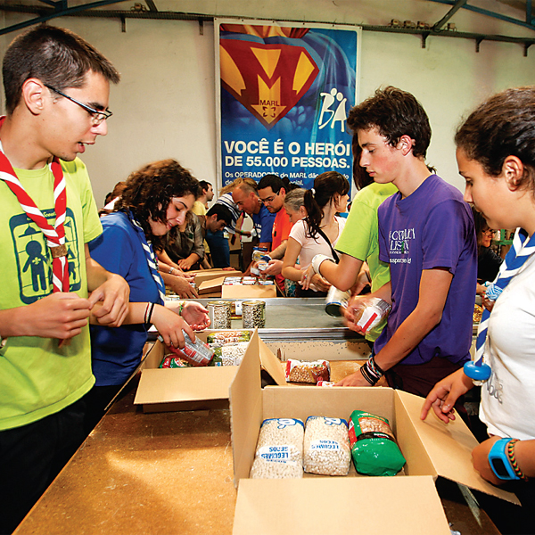
STUDENT EXAMPLE: PLACEMENT AT A FOOD BANK
As part of his course on food security, Rahim is placed at a local food bank.
His work involves:
Researching and writing a
brochure on nutrition
Sorting donated food
Rahim knows he is gaining strong research and work experience through the brochure project, but feels less certain that sorting food is a productive use of his time and skills.
Notes:
Public domain picture
http://www.publicdomainfiles.com/show_file.php?id=13985748015487

Slide 30
STUDENT EXAMPLE: CREATING LEARNING OPPORTUNITIES
There are many ways to understand the educational value in all of the work that Rahim is doing at the Food Bank.
How might sorting donated food be a valuable learning opportunity?
What steps could Rahim take to align his own learning goals with his external partner’s priorities?

Slide 31
STUDENT EXAMPLE: LEARNING THROUGH REFLECTION
To explore how sorting food can be
a learning opportunity, Rahim could consider some reflective questions about himself, his work, or the subject of the course.
Rahim could ask himself:
How does this experience connect
with what I am learning in my course?
What can I learn from the people, practices and environment of the organization?
What can I learn about my own skills and interests based on my reaction
to this work?
How can I best contribute to this organization’s priorities?

Slide 32
ALIGNING GOALS: LEARNING ABOUT YOUR ORGANIZATION
Each organization you work with
will have different priorities, activities and ways of operating. To prepare for your experience, it can help to learn more about the organization and its working environment.
For instance, you can:
Review any materials you were given about your organization and placement.
Research your organization online to learn about its priorities and activities.
Ask your supervisor at the organization about how you can best contribute to those priorities in a way that also allows you to meet your own goals for the experience.
    Strategies for success:
    When reviewing your organization’s
    website, look for their
    Mission and vision statements
    Strategic plans
    Annual reports
    All of these documents will reveal what
    your organization values and how it frames
    the work that it undertakes.

Slide 33
YOUR TURN: ALIGNING YOUR LEARNING GOALS
Based on the goals you set earlier for this experience, and what you
already know of your organization and placement (and anything you can
find in a web search), answer the questions below.
What are your learning goals ​for this experience?
What do you think are some of your organization’s goals?
How might these ​goals overlap?

Slide 34



ALIGNING GOALS: SOME FINAL TIPS
Aligning your goals with the organization’s goals can be challenging.
Here are three tips to help you navigate that balance:
1
2
3
Create
a plan
Consult with your supervisor about the organization’s priorities and develop a plan together to achieve
both sets of goals.
Establish open lines
of communication
Request regular meetings
with your supervisor
to discuss your work.
Find the assistance
you need
When you encounter
challenges, contact your supervisor, instructor or program
coordinator for advice.

Slide 35
SUMMARY: AN INTRODUCTION TO CEL
In this module you have engaged with ideas, theories and activities related to CEL.
You should now be able to:
Describe the key features of CEL
Experiential
Addresses community needs
Incorporates reflection
Tied to learning outcomes
Reflect on your goals for your CEL experience
in a range of domains
Disciplinary knowledge
Skill and competency development
Personal and civic development
Career development
Align your goals with
your community partner’s priorities
Ask yourself what you can learn from all of your CEL experiences
Learn about your organization’s priorities
Communicate with your external partner

Slide 36
REFERENCES
Ash, S. L., & Clayton, P. H. (2009). Generating, Deepening,
and Documenting Learning: The Power of Critical Reflection in Applied Learning. Journal of Applied Learning in Higher Education, 1(1), 25-48.
Jacoby, B. (2015). Service-learning Essentials: Questions, Answers,
and Lessons Learned. San Francisco: JosseyBass.
Lewis, L. H. and Williams, C. J. (1994). Experiential Learning:
Past and Present. New Directions for Adult and Continuing Education, 5-16.

Slide 37



