Slide 1
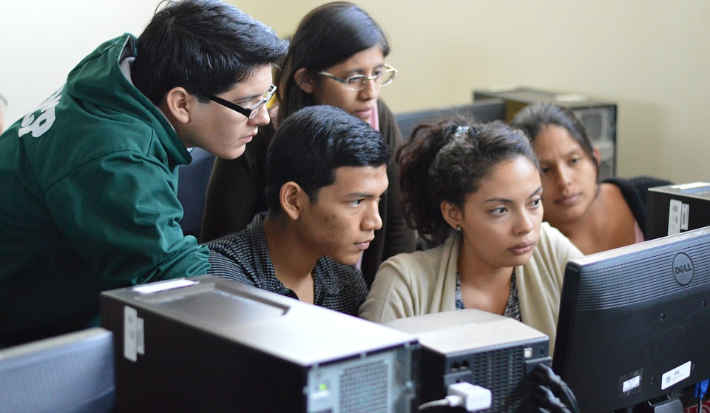
Preparing for your Community-Engaged Learning Experience
LEARNING THROUGH EXPERIENCE
Notes:
Image: https://www.evidencebasedmentoring.org/wp-content/uploads/2018/05/student-2816892_1280_banner.jpg

Slide 2

MODULE OBJECTIVES
This module will present ideas, theories and activities related
to community-engaged learning (CEL).
By the end of this module
you will be able to:
Recognize how a community-engaged learning course might differ from your other courses
Develop strategies to maximize your learning in your community-engaged learning course

Slide 3

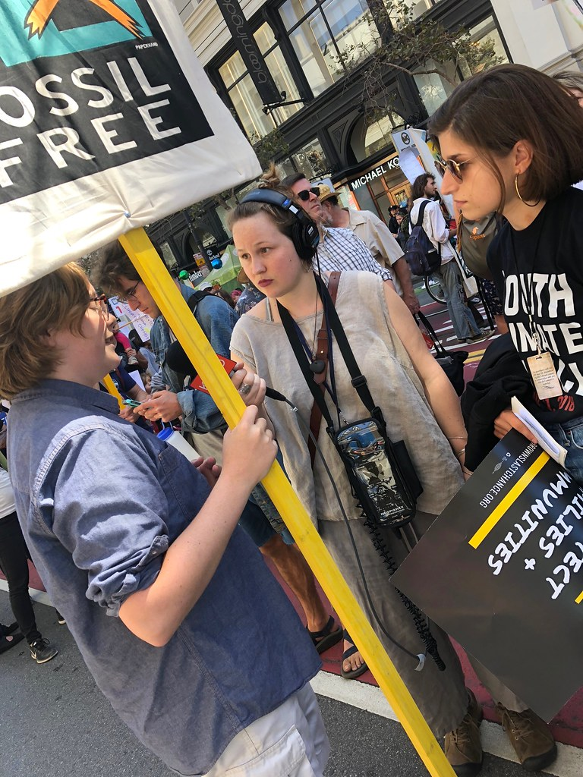
WHAT IS COMMUNITY-ENGAGED LEARNING (CEL)?
    “a form of experiential education in which students engage in activities that address human and community needs, together with structured opportunities for reflection designed to achieve desired learning outcomes”
    Community-engaged
    learning (CEL) is sometimes referred to as “Service-Learning”
Jacoby, B. (2015) Service-learning Essentials: Questions, Answers, and Lessons Learned. San Francisco: JosseyBass.
Notes:
Image: https://live.staticflickr.com/1845/43753741615_7f1d20be6a_b.jpg

Slide 4

What to Expect in a Community-Engaged Learning Course
Notes:
Image: https://pbs.twimg.com/media/D6ui0A9VUAAI4qN.jpg

Slide 5

YOUR TURN: EXPECTATIONS FOR YOUR CEL COURSE
How do you think this
CEL course will
differ from other university
courses you have taken?

Slide 6


HOW A CEL COURSE MAY DIFFER FROM OTHER COURSES
Notes:
https://www.youtube.com/watch?v=2vFdmNVapPo&feature=youtu.be

Slide 7
UNIQUE CHARACTERISTICS OF CEL
“The ‘real world’ messiness
and unpredictability,
complexities of social change processes, personal
and intellectual risks inherent
in reflection, and shared control
and responsibility implicit
in partnerships are among
the many unique characteristics
of service-learning [or CEL].”
Clayton, P.H. and Ash, S.L (2004). Shifts in Perspective: Capitalizing on the Counter-Normative Nature of Service-Learning. Michigan Journal of Community Service-Learning.
Notes:
.

Slide 8
CEL AS “COUNTER-NORMATIVE”
Jeff Howard argues that CEL courses are “counter-normative” because of how they may differ from the norms of traditional, classroom-based university learning.
Areas of Difference | Traditional Classroom-based University Learning | Community-Engaged Learning
Goals | Individual achievement | Commitment to broader good
What counts as valuable learning | Academic knowledge | Academic and community knowledge and experience
Control | Instructor provides structure and direction | Students direct more of their own learning
Ways of knowing | Objectivity often valued | Subjectivity and multiple ways of knowing valued
Howard, J.P. (1998). Academic Service-Learning: A Counternormative Pedagogy. New Directions for Teaching and Learning, 1998. 21-29.

Slide 9
LEARNING FROM THE CHALLENGES OF CEL
These unique features of a CEL course can also lead to unique challenges as you encounter new situations, additional expectations and unpredictable outcomes.
“Uncertainty, confusion, insecurity, and frustration [are]... normal, acceptable, and even beneficial dimensions
of learning—[and they are]... signs, in fact, that learning
and growth are taking place”
Clayton, P.H. and Ash, S.L (2004). Shifts in Perspective: Capitalizing on the Counter-Normative Nature of Service-Learning.
Michigan Journal of Community Service-Learning.

Slide 10

ENSURING A SUCCESSFUL CEL EXPERIENCE
Because of these additional, and often unpredictable, elements, CEL courses may make new demands on you as a student and may require you to develop new strategies for success.
Also, in addition to meeting your own learning objectives, you’ll want to ensure that your community partner also feels that the course partnership has been a success.
Your
Learning Goals
The Organization’s Goals

Slide 11

Preparing for a Successful Community-Engaged Learning Experience
Notes:
Image: https://cdn.pixabay.com/photo/2017/07/31/11/21/people-2557396_960_720.jpg

Slide 12
PILLARS OF A SUCCESSFUL CEL EXPERIENCE
CEL courses may differ from the courses that you have taken previously
in a number of ways. While you will still have classroom time, an instructor, readings
and assignments, you may also have these key additional elements:
Focus
on the application
of knowledge
Partnership
with a community organization
Expectation
of independent
learning
Emphasis
on reflection

Slide 13
PILLAR 1: INDEPENDENT LEARNING
Because much of your course experience will happen in partnership with your community organization rather than in the classroom, CEL courses increase the possibilities for independent learning.
In your reflections you will be explicitly naming and engaging with what you are learning from your experience.
You will also be bringing that learning back into the classroom with you and sharing it with your classmates.
Ash and Clayton describe this as moving from being a “passive recipient of knowledge” to an “active co-generator of knowledge”.
Expectation
of independent
learning
Passive
recipient
of knowledge
Active
co-generator
of knowledge
Clayton, P.H. and Ash, S.L (2004). Shifts in Perspective: Capitalizing on the Counter-Normative Nature of Service-Learning.
Michigan Journal of Community Service-Learning.

Slide 14
YOUR TURN: INDEPENDENT LEARNING
Consider an experience in your past (whether academic or not) where you were required to learn independently in an unpredictable situation.
What was that experience like for you?
What did you learn from that experience that you can apply to your CEL experience?

Slide 15
FEATURES OF INDEPENDENT LEARNING IN A CEL COURSE
Recognizing many sources of knowledge
Your course instructor may take on a more facilitative role rather than instructive role and encourage you to learn from your class and community colleagues.
Taking responsibility
for your own learning
Learning may occur in unexpected circumstances, when things are challenging, or when you are engaged in tasks that seem unrelated to your academic pursuits.
Focusing on the
process of CEL
Try to de-emphasize the products of a course (assignments, grades, etc.) in favor of focusing on how learning is taking place.

Slide 16
PILLAR 2: THE APPLICATION OF KNOWLEDGE
Focus
on the application
of knowledge
A key expectation for you as a CEL
student is that you will continually aim to connect your academic, course-based learning and your experience in the community (essentially, connecting
theory and practice).
Ideally, this will be a parallel experience:
Your theoretical knowledge
will inform your practice
What you learn through practice
will inform your theory
Community-engaged experience
Academic course-based learning

Slide 17
YOUR TURN: INDEPENDENT LEARNING
Consider an experience in your past (whether academic or not) where you were required to apply your academic knowledge outside of the classroom.
What was that experience like
for you?
What did you learn from that experience that you can apply to your CEL experience?

Slide 18
FEATURES OF THE APPLICATION OF KNOWLEDGE IN CEL
Tolerating
uncertainty
Applied learning can often be messy and unpredictable.
Sharing your learning
in the classroom
Ideally you can share what you have learned with your classmates through class discussions, group reflections or presentations.
Developing
new skills
Applying your knowledge may require developing skills you may not already have (e.g. writing a brochure for the general public instead of an academic essay).

Slide 19
PILLAR 3: AN EMPHASIS ON REFLECTION
Reflection is the process of “turning experience into learning. That is, of exploring experience in order to learn new things from it.” (Boud, 2001, 10).
Keep in mind:
Reflection can take many forms, including essays, journals, presentations and discussions
Reflection can help you integrate your course-based and experience-based learning
Reflection is a skill that you can cultivate through practice
Emphasis
on reflection
Reflection
takes
many
forms
Reflection
can integrate course-based
and experience-based learning
Reflection
Is a skill
you can
cultivate
Boud, D. (2001). Using Journal Writing to Enhance Reflective Practice. In English, L.M. and Gillen, M.A. (Eds.)
Promoting Journal Writing In Adult Education. New Directions in Adult and Continuing Education No.90. San Francisco: Jossey Bass

Slide 20
YOUR TURN: AN EMPHASIS ON REFLECTION
Have you written “reflections” for academic courses before?
IF SO,
what did you find useful about the process?
What did you learn about successful reflective writing?
IF NOT,
where have you used your reflective skills in other
areas of your life?
What can you apply from those experiences to CEL?

Slide 21
FEATURES OF SUCCESSFUL REFLECTION IN CEL
Understanding that reflection is continuous
You may be asked to reflect multiple times and each reflection can provide you with new insights and additional practice; reflection is a process
not a product.
Accepting that it is
not about finding the “right answer”
Instead of trying to find
the right answers,
try to articulate your own thinking and learning processes.
Moving beyond description
towards analysis
Try to connect to the key themes of your course,
see situations from multiple perspectives, and ask yourself “why?” and “how”?

Slide 22
PILLAR 4: COMMUNITY PARTNERSHIP
As co-educators, mentors and hosts, community partners are the backbone of any CEL course.
Because “reciprocity,” or ensuring that both you and your community partner benefit through the partnership, is central to CEL,
it is important that you approach your partnership thoughtfully and professionally.
Your
Learning Goals
The Organization’s Goals
Partnership
with a community organization

Slide 23
YOUR TURN: COMMUNITY PARTNERSHIP
Consider a time in the past when you were engaged with community work, whether alongside a community organization or other community members.
What skills and competencies
did you contribute to this work?

Slide 24
FEATURES OF RESPECTFUL COMMUNITY PARTNERSHIPS
Considering your partner’s context
In most cases, they are operating with limitations on both their funding and time and their work timelines will not align with your course timelines.
Exhibiting
professional behavior
Ensure that you complete your work reliably, satisfy your time commitment, and request clarification and feedback when you need it.
Taking
initiative
Aim to proactively respond to your communitypartner’s priorities and needs.

Slide 25
CONSIDERING YOUR APPROACH TO COMMUNITY PARTNERSHIP
Anti-oppressive and
asset-based approaches
Community engagement is fraught with problematic power structures and challenging ethical questions, especially if you are working with marginalized communities.
Consider how you want to approach this work in order to avoid replicating unjust power dynamics.
LEARN MORE
Building Effective
Community Partnerships
Considering your
own positionality
Are you working with your own community
or with a community that you don’t belong to?
How will your own intersectional identity
affect how you work with the community
you are engaging with?
What power and privilege should
you be mindful of?
LEARN MORE
Deconstructing power
and privilege in communities

Slide 26
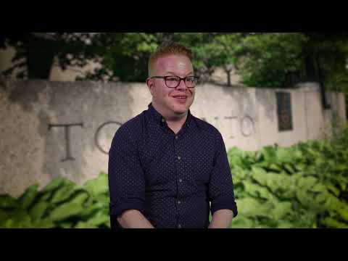
STUDENTS SHOULD KNOW BEFORE THE CEL EXPERIENCE?
Notes:
https://www.youtube.com/watch?v=5Bm8du28S_w&feature=youtu.be

Slide 27
REFERENCES
Boud, D. (2001). Using Journal Writing to Enhance Reflective Practice. In English, L.M. and Gillen, M.A. (Eds.) Promoting Journal Writing In Adult Education. New Directions in Adult and Continuing Education No.90. San Francisco: Jossey Bass.
Clayton, P.H. and Ash, S.L (2004). Shifts in Perspective: Capitalizing on the Counter-Normative Nature of Service-Learning. Michigan Journal of Community Service-Learning.
Howard, J.P. (1998). Academic Service-Learning: A Counternormative Pedagogy. New Directions for Teaching and Learning, 1998. 21-29.

Slide 28



