Slide 1
Reflecting on Your Competency Development
LEARNING THROUGH EXPERIENCE
Notes:
Image: https://c.pxhere.com/photos/0a/c9/student_typing_keyboard_text_woman_startup_business_people-710502.jpg!d

Slide 2
MODULE OBJECTIVES
By the end of this module you will be able to:
Identify which competencies you developed in your experiential learning opportunity.
Communicate your competencies on your resume and in interviews.

Slide 3
IDENTIFYING YOUR COMPETENCIES FOR CAREER SUCCESS
A survey of 815 employers found that while “students were equipped with needed workplace competencies,” they were unable to describe their experience and the skills they gained which negatively impacted their job searching and interviewing.
Simply having an experience isn’t enough for career success.
You need to be able to:
Identify the competencies developed through your experience.
Clearly communicate how you demonstrated those competencies with examples.
Gardner, P. n.d. Collegiate Employment Research Institute at Michigan State University as referenced in A Roadmap for Transforming the College-To-Career Experience A Crowdsourced Paper (2013) Page 5. Edited by Andy Chan and Tommy Derry, Wake Forest University

Slide 4
What is a Competency?
Notes:
Image: https://c.pxhere.com/photos/95/d8/startup_business_people_students_office_strategy_work_technology-710510.jpg!d

Slide 5
WHAT ARE COMPETENCIES?
A competency consists of 3 elements:
Knowledge Information that you are aware of, including theories, facts and procedures
Skill The ability to do something well, usually developed through training and practice
Attribute A personal quality that is expressed through what you think, do and feel
The University of Toronto Co-Curricular Record Competency Framework contains a list of common competencies. LEARN MORE.
Adapted from: https://www.uvic.ca/coopandcareer/assets/docs/student-docs/competencies /What_makes_up_a_competency_infosheet.pdf

Slide 6
AN EXAMPLE OF A COMPETENCY
For example, in an experiential learning opportunity you might focus on developing your competency in communication by:
Learning about expected communication styles in a particular field (Knowledge)
Practicing, and getting feedback on, your writing and your oral presentations (Skills)
Developing the ability to be calm under pressure so you can organize your thoughts (Attributes)

Slide 7
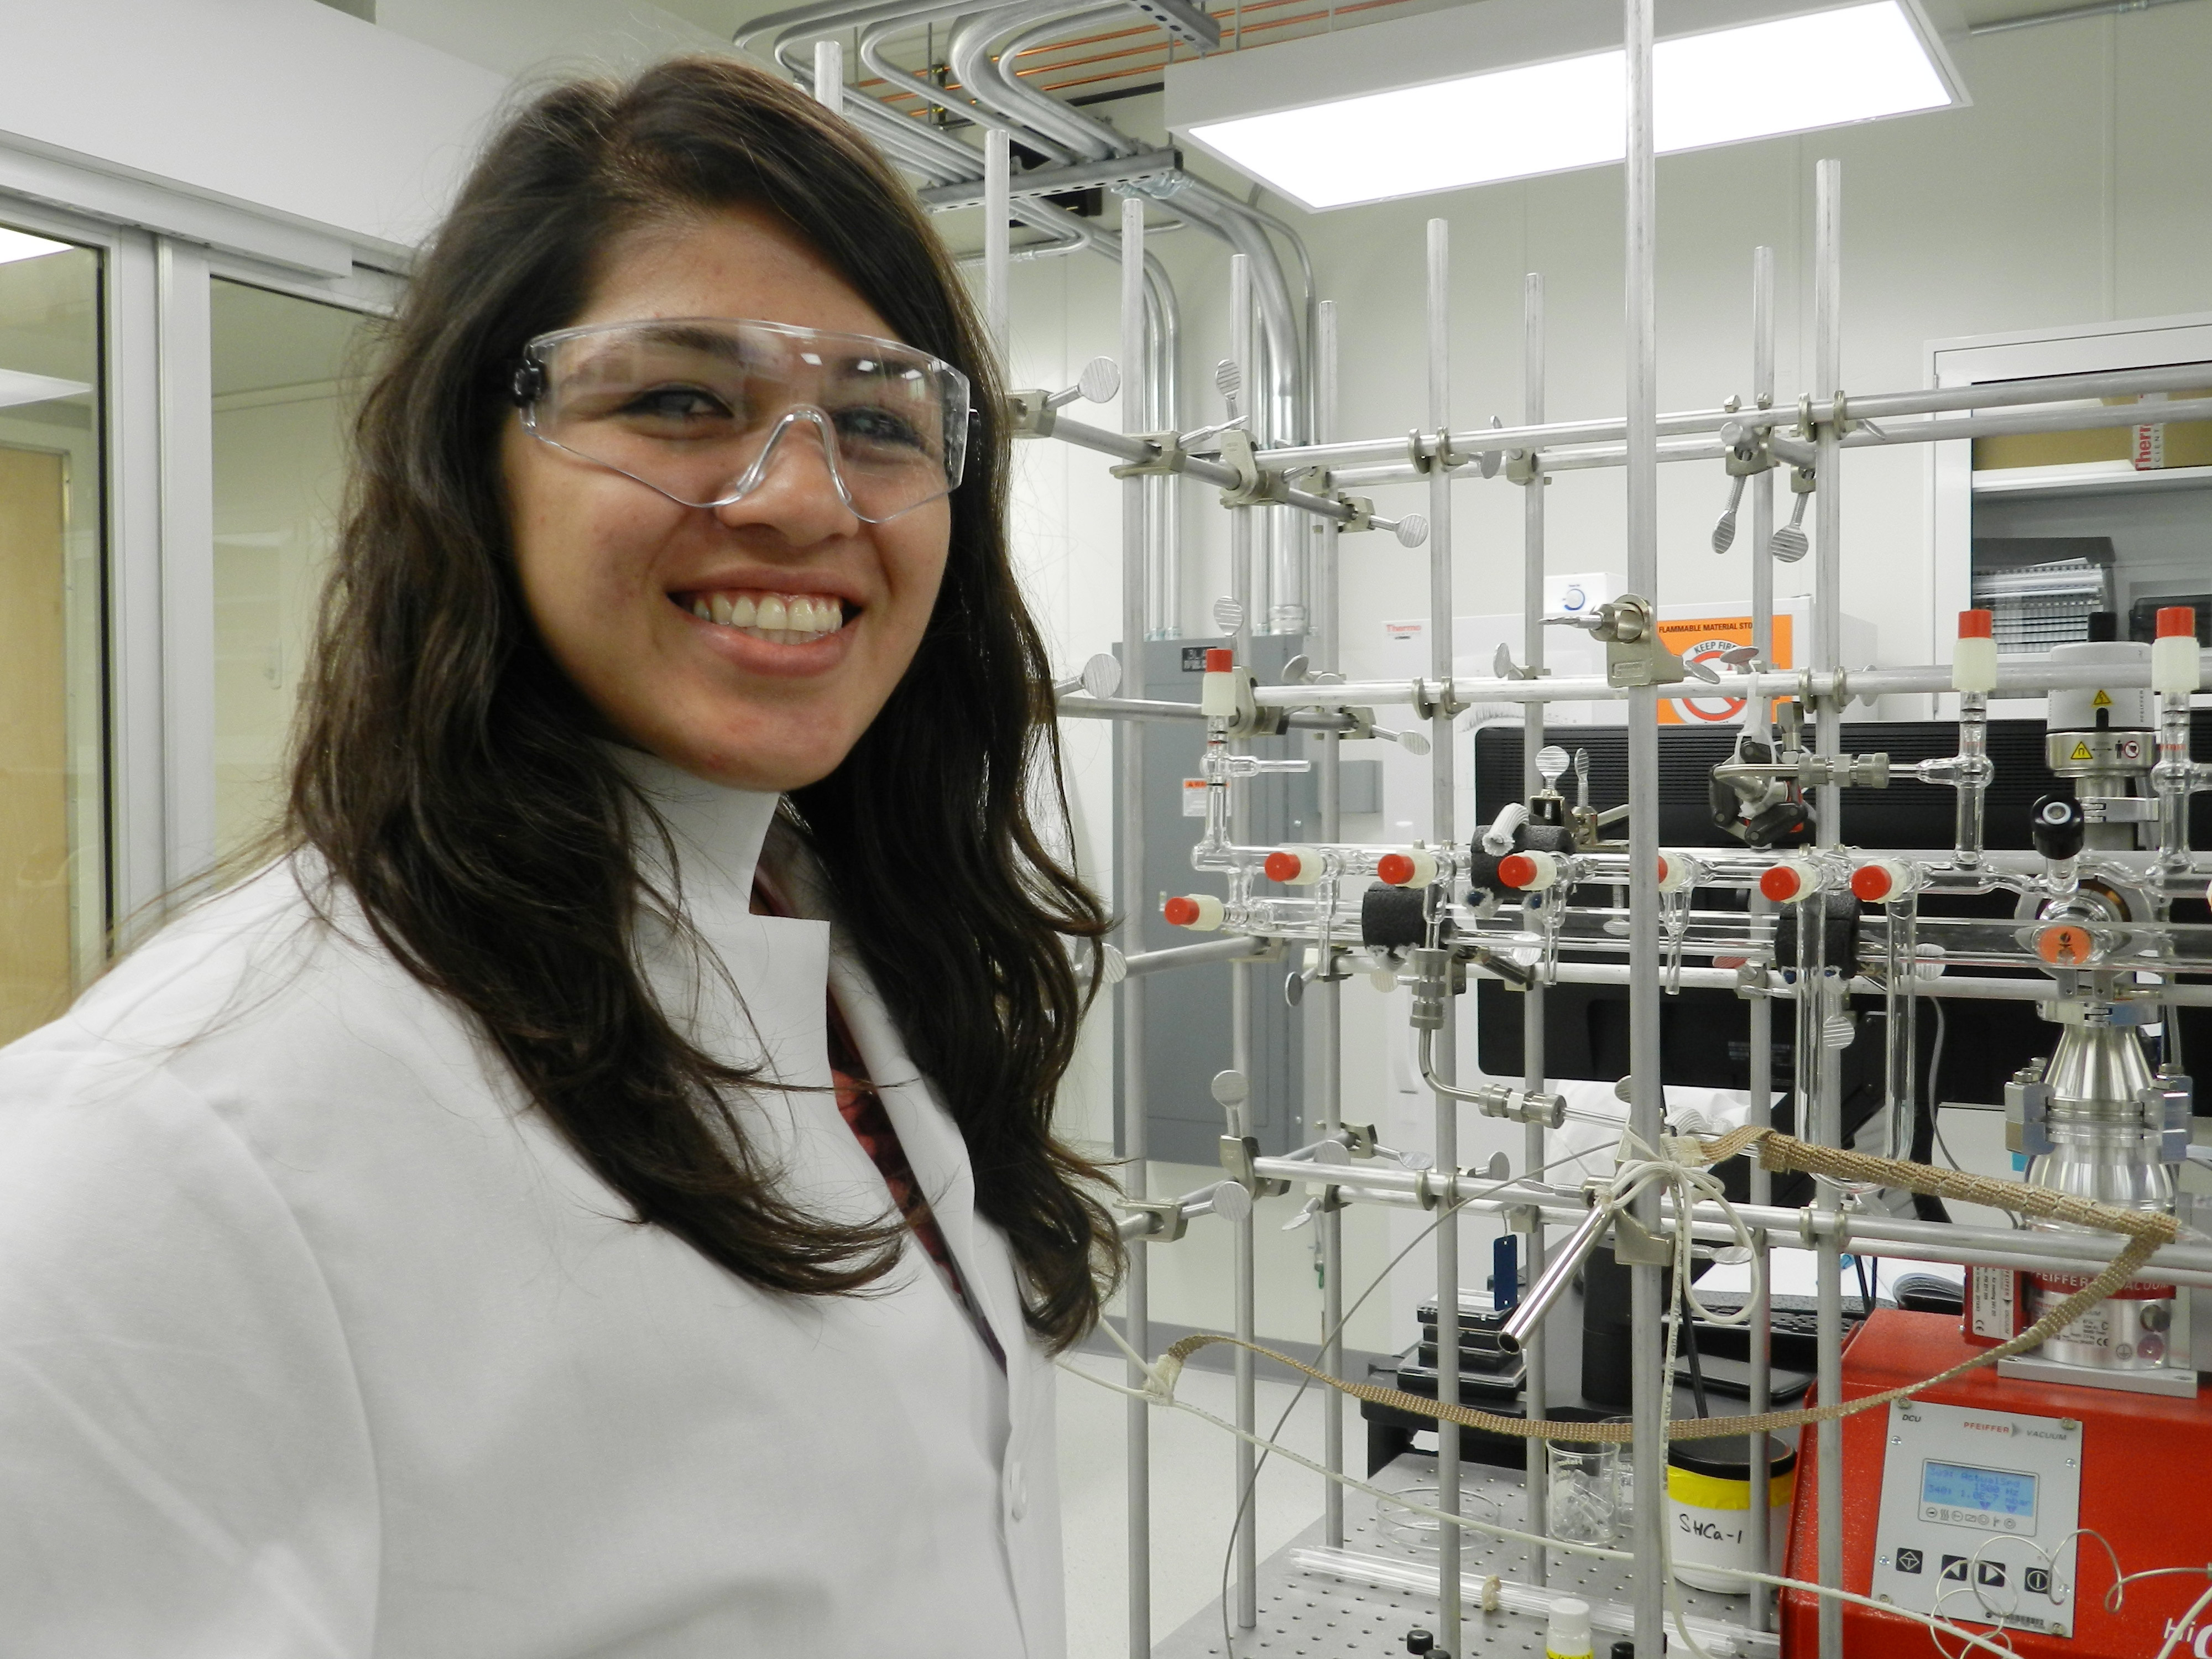
Identifying the Competencies You Developed
Notes:
Image: https://imagecache.jpl.nasa.gov/images/edu/education/images/full/intern_frausto-640x350.jpg

Slide 8
IDENTIFYING YOUR COMPETENCIES
In this section, you will identify which competencies you developed during your experiential learning role.
If you completed the “Developing a Personal Learning Plan for Competency Development” module prior to your placement, refer to your responses in the following exercise.
If you did not complete the “Developing a Personal Learning Plan for Competency Development’” module prior to your placement, take some time now to identify three competencies you believe you developed over the course of this experiential learning opportunity.
Refer the Co-Curricular Competencies Framework for ideas.

Slide 9
STUDENT EXAMPLE: COMPETENCY DEVELOPMENT RESULTS
Experiential learning role: Internship at a nonprofit settlement organization
Competency: Communication
Results: When did you demonstrate this competency in your role?
Listened to the needs of community members and aligned those needs with the organization’s services.
Wrote a pamphlet with a list of local services and suggestions for how to access them.
What resulted from your use of this competency?
Met with over 100 community members over 8 months and was able to refer them to relevant resources in almost all of my appointments.
Community members consistently commented on how helpful I was at the end of our appointments.
Hundreds of community members have been provided with the pamphlet about local services.
How is this competency related to your field of study?
Communication is a major part of the Engineering profession including during consultation, project management and evaluation phases.
Engineers need to be able to make outcomes clear to all stakeholders, not just engineers.

Slide 10
STUDENT EXAMPLE: WHICH COMPETENCIES DID YOU DEVELOP?
Once you have identified 3 competencies, complete the exercise below to reflect on how you developed these competencies and their significance to both your experiential learning role and your field of study.
Competency 1 | Financial Literacy
When did you demonstrate this competency in your role? | I worked with a team of commerce students to run a tax-return session for students, I demonstrated my financial literacy by speaking with 20 students about their financial data and their tax returns.
What resulted from your use of this competency? | Over 20 students had their questions answered and were better prepared to submit their tax returns.
How is this competency related to your field of study? | My ability to respond to questions from non-experts about finance and interpret financial data is directly related to my commerce degree.

Slide 11
YOUR TURN: WHICH COMPETENCIES DID YOU DEVELOP?
Competency 1
When did you demonstrate this competency in your role?
What resulted from your use of this competency?
How is this competency related to your field of study?
Competency 2
When did you demonstrate this competency in your role?
What resulted from your use of this competency?
How is this competency related to your field of study?
Competency 3
When did you demonstrate this competency in your role?
What resulted from your use of this competency?
How is this competency related to your field of study?

Slide 12
Articulating Your Competencies in Resumes and Interviews
Notes:
Image: https://images.pexels.com/photos/1249158/pexels-photo-1249158.jpeg?auto=compress&cs=tinysrgb&dpr=2&h=650&w=940

Slide 13
ARTICULATING YOUR COMPETENCIES IN RESUMES
In creating job application materials, including resumes and cover letters, you will want to describe not only what you did but which competencies you demonstrated and the results or impact of your actions.
Accomplishment statements allow you to do this. They follow a simple formula:
action verb + task/project + result
TIPS:
It is important that you use action verbs to describe both what you did and the result (or impact) of that experience for your external partner
It may be helpful to refer to a list of action verbs to build your accomplishment statements

Slide 14
ACCOMPLISHMENT STATEMENTS AND RESUMES
Resumes often contain lists of tasks rather than lists of accomplishments.
But accomplishment statements capture both your competencies and the impact those competencies have on the work you are doing.
Example: Accomplishment Statements
Create compelling marketing materials and publicity plans through promotion of bi-monthly panels via social media, email and poster campaigns, resulting in a 75% increase in attendance.
Example: Lists of Tasks
Responsible for organizing and marketing events and panels.

Slide 15
COMMUNICATING YOUR ACCOMPLISHMENTS
The description of your result in an accomplishment statement can be qualitative or quantitative
Qualitative results
Designed [action verb] a web-based interactive manual [what you did] that is currently in use by residence dons across the University of Toronto [result/impact].
Quantitative result
Sold [action verb] tickets for raffle draws at Varsity football games [what you did], earning $2000 over the season to support the purchase of 30 team jerseys [result/impact].

Slide 16
YOUR TURN : COMPETENCIES AS ACCOMPLISHMENT STATEMENTS
Describe each of your three competencies as an accomplishment statement: action verb + what you did + result.
Competency 1
Action verb | What you did | Results/Impact
Competency 2
Action verb | What you did | Results/Impact
Competency 3
Action verb | What you did | Results/Impact

Slide 17
ARTICULATING YOUR COMPETENCIES IN INTERVIEWS
During interviews, you will be often asked to describe a time when you demonstrated a particular competency.
These interview questions usually start with “tell me about a time when…” or “describe your experience with…”
The STAR method provides a way for you to organize your responses to these kinds of interview questions that includes all the relevant details and stays focused on “action” and “results.”
S
T
A
R
Situation
Task
Action
Results

Slide 18
STUDENT EXAMPLE: STAR METHOD INTERVIEWING
Interview question: Tell us about a time when you were working on a team and encountered a challenge. How did you respond? What were the results?
Situation: I was working as a Research Assistant in the Political Science department at the University of Toronto as part of a three-person team.
Task: We were analyzing election results in electoral districts of Canada deriving from demographic variants as well as other contemporary political topics. We were having difficulty coming to a consensus on how to analyze the data.
Action: I recommended that we individually consider the various methods and meet again in a few days. We met again and respectfully discussed the various methods including their strengths and weaknesses. Over two meetings we brainstormed how to blend the valuable parts of each method and negotiated a new analysis strategy, which was an amalgamation of the methods proposed.
Results: This approach prevented delays in the project’s completion, maintained a collegial working environment with team members, and allowed us to arrive at a method of analysis that was superior to the individual approaches we initially proposed.
S
T
A
R

Slide 19
YOUR TURN: THE STAR METHOD FOR INTERVIEWS
For each of your three competencies, use the STAR method to craft an example that you can use in future interviews.
Competency 1
Situation | Task | Action | Result
Competency 2
Situation | Task | Action | Result
Competency 3
Situation | Task | Action | Result

Slide 20
THE STAR METHOD IN INTERVIEWS
The STAR method can help you:
Focus on the results of the work you perform
Better communicate those results to others
In interviews, respondents often focus on the tasks they performed rather than the actions and results emerging from those tasks.
Use the STAR method to better capture both your competencies and the impact those competencies have on the work you are doing.

Slide 21
FOCUSING ON COMPETENCIES AND RESULTS
Reflecting on the competencies you developed during your experiential learning opportunity can help you understand the impact of your work.
Your results, or impact, are what employers want to learn about when reviewing your resume and speaking with you at an interview.
Use accomplishment statements when building your resume:
Action verb + Task/project + Result
Use the STAR method when interviewing:
Situation. Task. Action. Results.

Slide 22
RESUME AND INTERVIEW RESOURCES
In this module you have identified and articulated your competencies and the results of the work that you undertook in your experiential learning opportunity.
You have also learned how to communicate the competencies you are developing as concise accomplishment statements on your resume, and as brief STAR stories for your interviews.
For further support:
Attend a Resume or Interview workshop. Register on CLNx.utoronto.ca.
Visit your campus career services for more:
UTSG: studentlife.utoronto.ca/cc
UTM: https://www.utm.utoronto.ca/careers
UTSC: https://utsc.utoronto.ca/aacc/career-employment

