Slide 1
Setting Goals
LEARNING THROUGH EXPERIENCE
Notes:
Image: wocintech chat https://www.flickr.com/photos/wocintechchat/25677176162/in/photostream/

Slide 2
MODULE OBJECTIVES
This module will introduce activities and strategies for getting the most from your experiential learning opportunity.
By the end of this module you will have:
Identified the characteristics of experiential learning
Considered a variety of types of goals for experiential learning
Explored your goals as well as how they might align with your external partners’ goals

Slide 3
THE VALUE OF GOAL SETTING FOR EXPERIENTIAL LEARNING
Notes:
https://www.youtube.com/watch?v=pIlzsSfMyVw&feature=youtu.be

Slide 4
WHAT IS EXPERIENTIAL LEARNING?
“Learning from experience or learning by doing”
“Experiential education first immerses learners in an experience and then encourages reflection about the experience to develop new skills, new attitudes, or new ways of thinking (5).”
Lewis, L. H. and Williams, C. J. (1994), Experiential Learning: Past and present. New Directions for Adult and Continuing Education. 5-16.

Slide 5
Establishing Your Goals
Notes:
Image: US Army https://www.army.mil/e2/c/images/2015/02/19/382520/size0.jpg

Slide 6
YOUR TURN: THE BENEFITS OF EXPERIENTIAL LEARNING
How do you think you will benefit from your upcoming experience?
How do you think you will benefit your external partner through your upcoming experience?

Slide 7
APPROACHES TO GOAL SETTING
In the following section, you will encounter a semi-structured approach to goal setting that organizes your goals into four sections:
Strategies for success:
Keep in mind that there are many approaches to setting goals for an experiential learning experience and you may want to choose one that feels like the best fit for your own interests and objectives.
You may prefer:
A less structured approach, such as writing freely on a blank sheet of paper for 5 minutes about what you want to accomplish in this experience or discussing your goals with someone.
A more structured approach, such as developing a detailed personal learning plan using learning goals inventory.
Disciplinary Knowledge
Skill and Competency Development
Personal Development
Career Development

Slide 8
STUDENT EXAMPLE: ESTABLISHING GOALS
In the community-engaged learning course Valeria is taking in Human Biology she will be:
Placed with a community organization
Working with that organization for 20 hours over the course of the term
Supporting staff to develop an exercise program for a depression support group
While her instructor has outlined course goals for all students, Valeria is expected to determine her individual goals for the experiential learning component of the course.
Notes:
Image: https://c.pxhere.com/photos/ef/5a/women_teamwork_team_business_people_office_working_woman_woman_business-595817.jpg!d

Slide 9
YOUR TURN: CONSIDERING YOUR GOALS
Valeria might set goals for her experiential learning opportunity in the following four areas:
Valeria wants to develop her collaboration skills (by working with others to develop an exercise program) and her critical thinking skills (by evaluating evidence and applying it to this exercise program).
Valeria wants to learn more about the relationship between the biochemistry of depression and specific forms of exercise.
Disciplinary Knowledge
Skill and Competency Development
Because members of Valeria's family have experienced depression, she wants to learn how to be a stronger ally and support.
Personal Development
Career Development
Valeria is interested in a career in the field of mental health; she wants to learn about career opportunities in this area.

Slide 10
YOUR TURN: CONSIDERING YOUR GOALS
In the section that follows, you will have an opportunity to consider your goals for this experiential learning opportunity in the four areas identified below:
Disciplinary Knowledge
Skill and Competency Development
Personal Development
Career Development

Slide 11
YOUR TURN: DISCIPLINARY KNOWLEDGE
Ideally your experiential learning opportunity will allow you to develop, extend and apply knowledge related to the disciplines that you study (i.e. the subject areas of your course or academic program).
What goals do you have in the area of disciplinary knowledge for this experience?
Strategies for success:
You may want to consider the learning outcomes for your Experiential Learning course as you determine your goals related to disciplinary knowledge.

Slide 12
YOUR TURN: SKILL AND COMPETENCY DEVELOPMENT
A skill is the ability to do something well and is usually developed through training and practice.
A competency is a broader concept; a competency is a combination of knowledge, skills and attributes.
What kinds of skills and competencies would you like to develop while undertaking this experience?
Strategies for success:
Click here to access a list of competencies that are recognized on the Co-curricular Record to see the breadth of what counts as a skill or competency.

Slide 13
YOUR TURN: CAREER DEVELOPMENT
The experiences you have in an experiential learning opportunity allow for career exploration and developing specific career-related skills and competencies.
What career development goals do you have for this experience?
Strategies for success:
Consider your professional goals and aspirations and how this experiential learning opportunity might support you in understanding more about those aspirations or reaching those goals.

Slide 14
YOUR TURN: PERSONAL DEVELOPMENT
Personal development is a broad area for goal-setting that provides space for you to include any goals you might have for yourself that aren't included in disciplinary, competency or career development.
What goals related to personal development do you have for this experience?
Strategies for success:
Consider your personal motivations for participating in this opportunity, for instance you might:
Have a goal related to your climate change activism that you can work towards in this experience
Wish to find and develop new areas for learning that are not related to your degree
Have specific traits, like empathy, that you wish to develop

Slide 15
Aligning Your Goals with Your Experiential Learning Opportunity
Notes:
Image: http://www.tradeready.ca/wp-content/uploads/2019/01/FITT-OWIT-collaboration-article-2019.jpg

Slide 16
CREATING YOUR OWN LEARNING EXPERIENCE
As a student in an experiential learning opportunity, one of your key responsibilities is to create a meaningful learning experience for yourself while meeting the expectations of your external partner.
Look for ways to:
Align your own goals with the broader goals of the organization with which you are working
Learn new things from the work your external partner needs accomplished even when it doesn’t directly align with your goals
Your Learning Goals
The Organization’s Goals

Slide 17
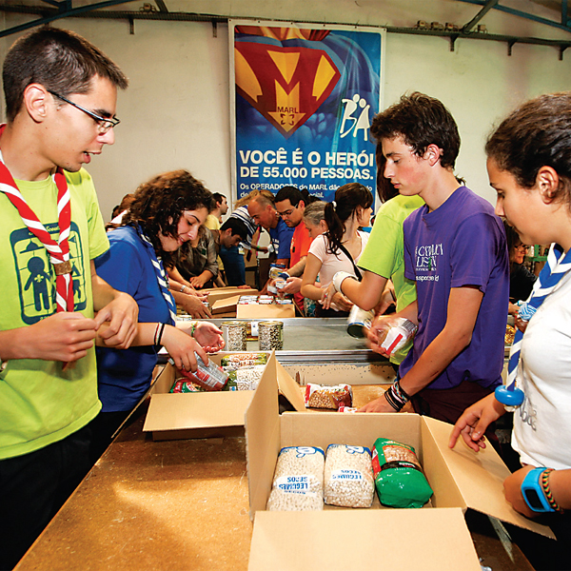
STUDENT EXAMPLE: PLACEMENT AT A FOOD BANK
As part of his course on food security, Rahim is placed at a local food bank.
His work involves:
Researching and writing a brochure on nutrition
Sorting donated food
Rahim knows he is gaining strong research and work experience through the brochure project, but feels less certain that sorting food is a productive use of his time and skills.
Notes:
Image: http://www.publicdomainfiles.com/show_file.php?id=13985748015487

Slide 18
STUDENT EXAMPLE: CREATING LEARNING OPPORTUNITIES
There are many ways to understand the educational value in all of the work that Rahim is doing at the Food Bank.
How might sorting donated food be a valuable learning opportunity?
What steps could Rahim take to align his own learning goals with his external partner’s priorities?

Slide 19
STUDENT EXAMPLE: LEARNING THROUGH REFLECTION
To explore how sorting food can be a learning opportunity, Rahim could consider some reflective questions about himself, his work or the subject of the course.
Rahim could ask himself:
How does this experience connect with what I am learning in my course?
What can I learn from the people, practices and environment of the organization?
What can I learn about my own skills and interests based on my reaction to this work?
How can I best contribute to this organization’s priorities?

Slide 20
ALIGNING GOALS: LEARNING ABOUT YOUR ORGANIZATION
Each organization you work with will have different priorities, activities and ways of operating. To prepare for your experience, it can help to learn more about the organization and its working environment.
For instance, you can:
Review any materials you were given about your organization and placement.
Research your organization online to learn about its priorities and activities.
Ask your supervisor at the organization about how you can best contribute to those priorities in a way that also allows you to meet your own goals for the experience.
Strategies for success:
When reviewing your organization’s website, look for their
Mission and vision statements,
Strategic plans and
Annual reports.
All of these documents will reveal what your organization values and how it frames the work that it undertakes.

Slide 21
YOUR TURN: ALIGNING YOUR LEARNING GOALS
Based on the goals you set earlier for this experience, and what you already know of your organization and placement, (and anything you can find in a web search), answer the questions below.
What are your learning goals ​for this experience?
What do you think are some of your organization’s goals?
How might these ​goals overlap?

Slide 22
ALIGNING GOALS: SOME FINAL TIPS
Aligning your goals with the organization’s goals can be challenging.
Here are three tips to help you navigate that balance:
1
2
3
Create a plan
Consult with your supervisor about the organization’s priorities and develop a plan together to achieve both sets of goals.
Establish open lines of communication
Request regular meetings with your supervisor to discuss your work.
Find the assistance you need
When you encounter challenges, contact your supervisor, instructor or program coordinator for advice.

Slide 23
REFERENCES
Lewis, L. H. and Williams, C. J. (1994), Experiential Learning: Past and Present. New Directions for Adult and Continuing Education, 1994: 5-16.

