Slide 1
Understanding Your Strengths, Values and Interests
LEARNING THROUGH EXPERIENCE
Notes:
Image: https://www.pexels.com/photo/two-women-sitting-on-chair-while-typing-and-writing-near-man-standing-behind-1234099/

Slide 2
MODULE OBJECTIVES
By the end of this module you will be able to:
Recognize the benefits of identifying your strengths, values and interests
Articulate how your strengths, values and interests relate to an experience

Slide 3
WHY CONSIDER YOUR STRENGTHS, VALUES AND INTERESTS?
While you may develop new strengths, values and interests through an experiential learning opportunity, you are undertaking this work with a lot to contribute already.
Understanding your strengths, values and interests can support you as you evaluate your own academic, professional and personal goals and future opportunities.
As you work through this module, you can reflect on questions including:
What personal qualities have you drawn on to meet challenges?
When do you apply more or less of your effort and energy?
How can you critically evaluate your development in order to foster continued growth?
Adapted from Carol Dweck’s Growth Mindset theory: https://www.brainpickings.org/2014/01/29/carol-dweck-mindset/

Slide 4
WHAT ARE STRENGTHS, VALUES AND INTERESTS?
Strengths
Good or beneficial personal qualities or attributes
Values
Judgements about what is important in life
Interests
Activities that are enjoyable to do or subjects that are enjoyable to study
Definitions adapted from the Oxford dictionary: https://en.oxforddictionaries.com

Slide 5
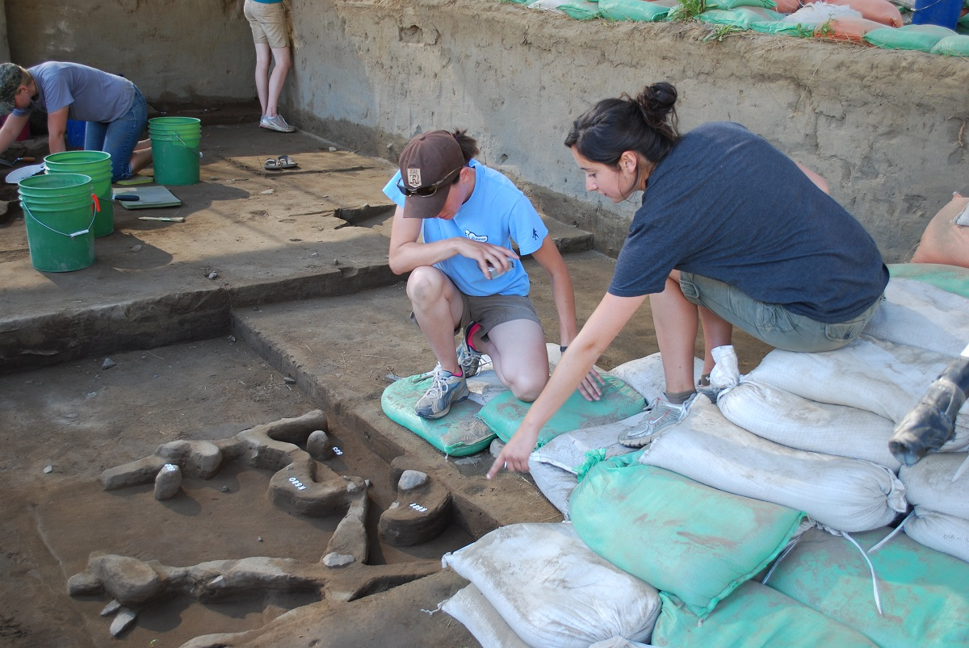
Identifying Strengths, Values and Interests from Experience
Notes:
Image: https://www.blm.gov/sites/blm.gov/files/program_archaeology_ID_partners_photo1.jpg

Slide 6
YOUR STRENGTHS, VALUES AND INTERESTS
Your strengths, values and interests emerge from, and are reflected in, all areas of your life.
Relationships with friends and family
Employment
Strengths, Values, Interests
Education
Volunteering
Community involvement
Hobbies and interests

Slide 7
ACTIVITY: QIN’S STORY
Qin has always been an athlete. Growing up playing soccer, she loved playing team sports and the rush of competition. In university, she played for the Varsity team, and in her fourth year, she became team captain.
Along with practicing and playing six times per week, she also coached a kids' soccer team.
What strengths, values or interests do you think Qin developed through her love of sports? How is Qin demonstrating each of these qualities in this experience?
Teamwork
Healthy lifestyle
Time Management
Leadership
Facilitation
Social Intelligence
Patience
Communication

Slide 8
QIN’S STRENGTH’S, VALUES AND INTERESTS
Teamwork
Qin learned about her teammates’ strengths and weaknesses, and enjoyed working with her team towards a common goal.
Social intelligence
Qin developed positive relationships with others, treated them with respect, and managed interpersonal conflicts.
Time management
Qin had to develop strong time management skills to accommodate all her athletic, educational and personal commitments in her life.
Communication
As a team captain and coach, Qin had to be clear about expectations and goals, and had to communicate with people of different ages.
QIN
Healthy lifestyle
Qin knows the value of exercise to her physical and mental heath and enjoys helping others lead a healthy lifestyle.
Leadership
Through motivating both her teammates and the children she coaches, Qin demonstrated leadership.
Facilitation
Qin plans and facilitates practice drills. She also ensures everyone feels included, and addresses concerns as they arise.
Patience
Qin loves the challenge of working with a large group of children who all have very different personalities and need a lot of support and direction to achieve the team goals.

Slide 9
Articulating your Strengths, Values and Interests
Notes:
Image: https://farm5.static.flickr.com/4581/38127481015_7f13c60212_b.jpg

Slide 10
YOUR TURN: PREVIOUS SUCCESSFUL EXPERIENCE
Think about a time in your life when you experienced success.
This experience can be career-related but does not have to be; consider all areas of your life including your education, personal life, student clubs or volunteering.
Describe your experience (When? Where? What?):
What difficulties did you experience?
How did you overcome them?
What activities and tasks did you most enjoy? Why?
Adapted from Franklin M et al. (2015). Narrative Method of Practice increases curiosity and exploration, psychological capital and personal growth leading to career clarity: A retrospective outcome-study. Canadian Journal of Career Development 14 (2).

Slide 11
YOUR TURN: WHAT STRENGTHS ARE REVEALED BY YOUR STORY?
Refer to your success story to identify any strengths that emerge from the narrative.
Remember:
Strengths are good or beneficial personal qualities or attributes.

Slide 12
YOUR TURN: WHAT VALUES ARE REVEALED BY YOUR STORY?
Refer to your success story to identify any values that emerge from the narrative.
Remember:
Values are judgements about what is important in life.

Slide 13
YOUR TURN: WHAT INTERESTS ARE REVEALED BY YOUR STORY?
Refer to your success story to identify any interests that emerge from the narrative.
Remember:
Interests are activities that are enjoyable to do or subjects that are enjoyable to study.

Slide 14
YOUR STRENGTHS, VALUES AND INTERESTS IN ACTION
Now that you have identified your strengths, values and interests, you can use that information to enrich your experiential learning opportunity.
Before your Experiential Learning opportunity | During your Experiential Learning opportunity | After your Experiential Learning opportunity
When deciding on a role, consider how your strengths, values and interests might align with potential opportunities Describe your strengths, values and interests when applying and interviewing for a role | Consider how you might want to use and develop your strengths, values and interests as you set goals for your learning Articulate your strengths, values and interests when meeting with your external supervisor | Reflect on any development in your strengths, values and interests over the course of your experiential learning opportunity Consider how you might frame these developments as you pursue future opportunities

Slide 15
REFERENCES
Fixed vs. Growth: The Two Basic Mindsets that Shape our Lives. Brainpickings. https://www.brainpickings.org/2014/01/29/carol-dweck-mindset/. Accessed May 22 2019.
Franklin M et al. (2015). Narrative Method of Practice increases curiosity and exploration, psychological capital and personal growth leading to career clarity: A retrospective outcome-study. Canadian Journal of Career Development 14 (2).
Interest. Oxford Dictionary. https://en.oxforddictionaries.com. Accessed May 22 2019.
Strength. Oxford Dictionary. https://en.oxforddictionaries.com. Accessed May 22 2019.
Value. Oxford Dictionary. https://en.oxforddictionaries.com. Accessed May 22 2019.

